Slide 1
Ai Personas and Auto Remediation

Slide 2
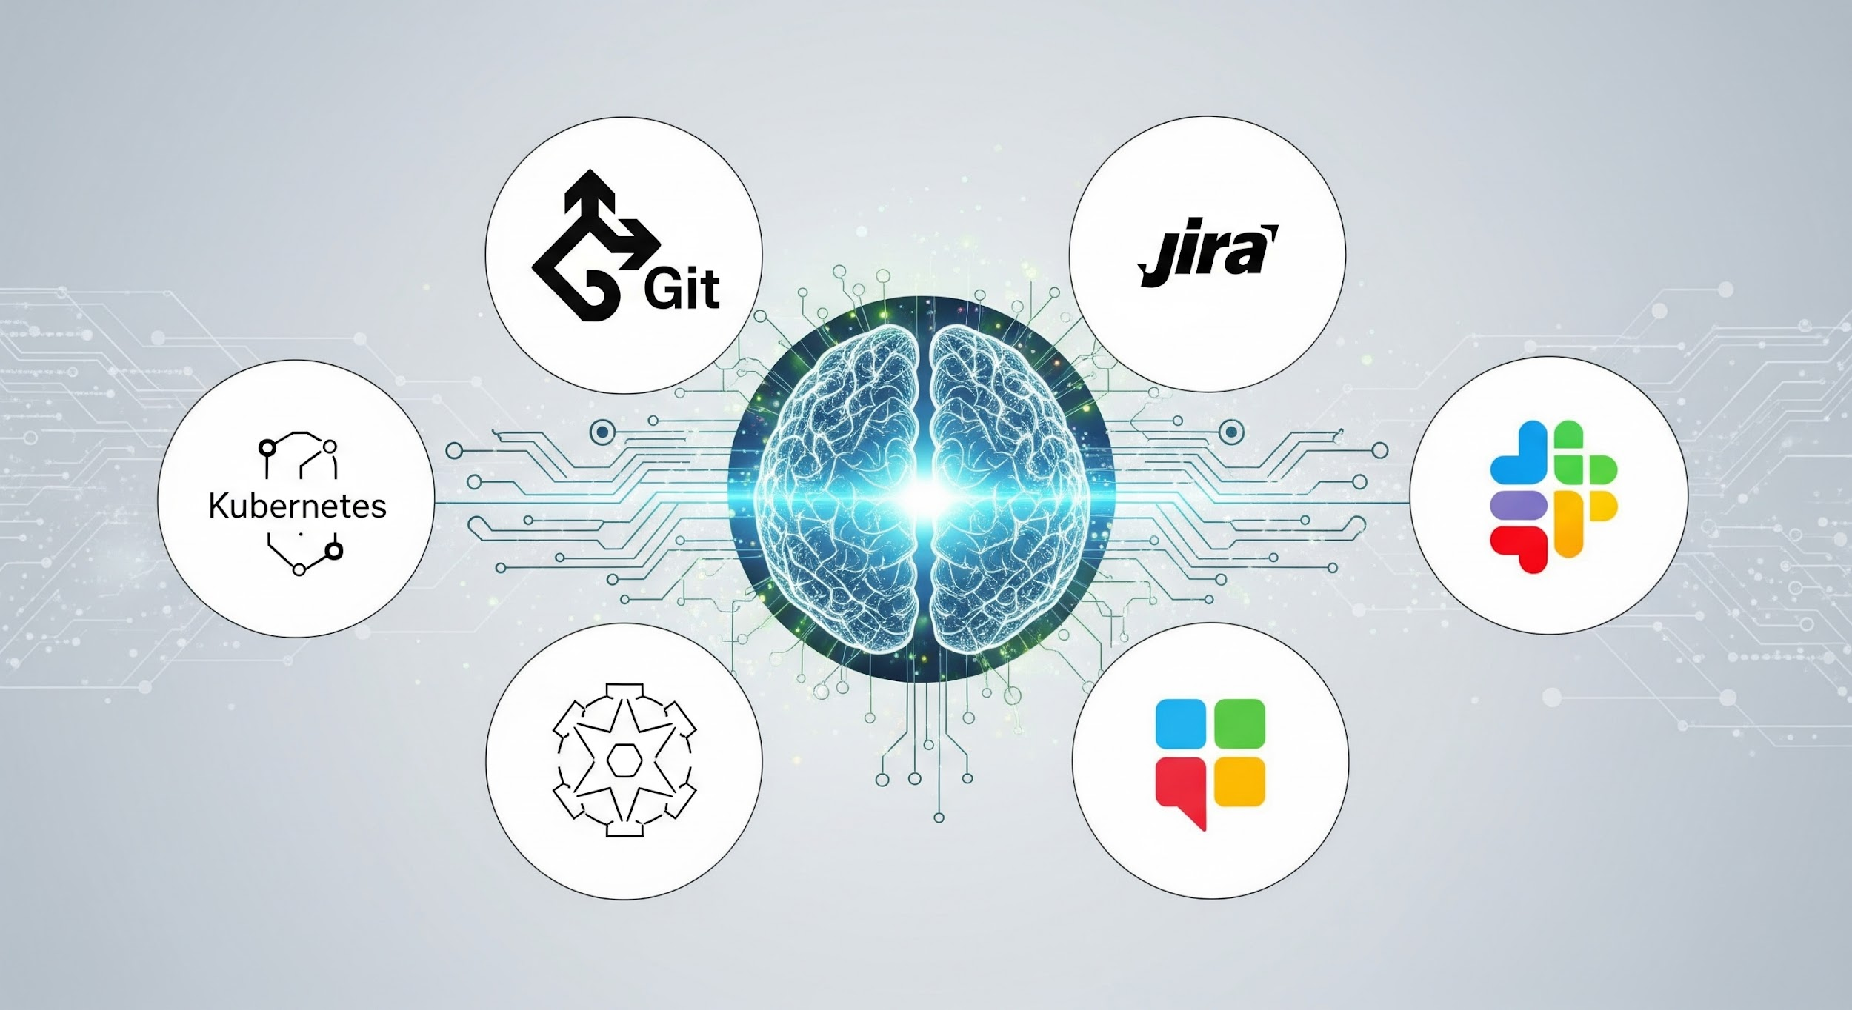
Automating your job?
Transform Claude into your personal DevOps engineer, developer assistant, and incident responder
Notes:
Welcome engineers to the AI Workflow onboarding. This system gives Claude AI the ability to actually DO things - not just answer questions, but execute actions across your entire development stack.

Slide 3
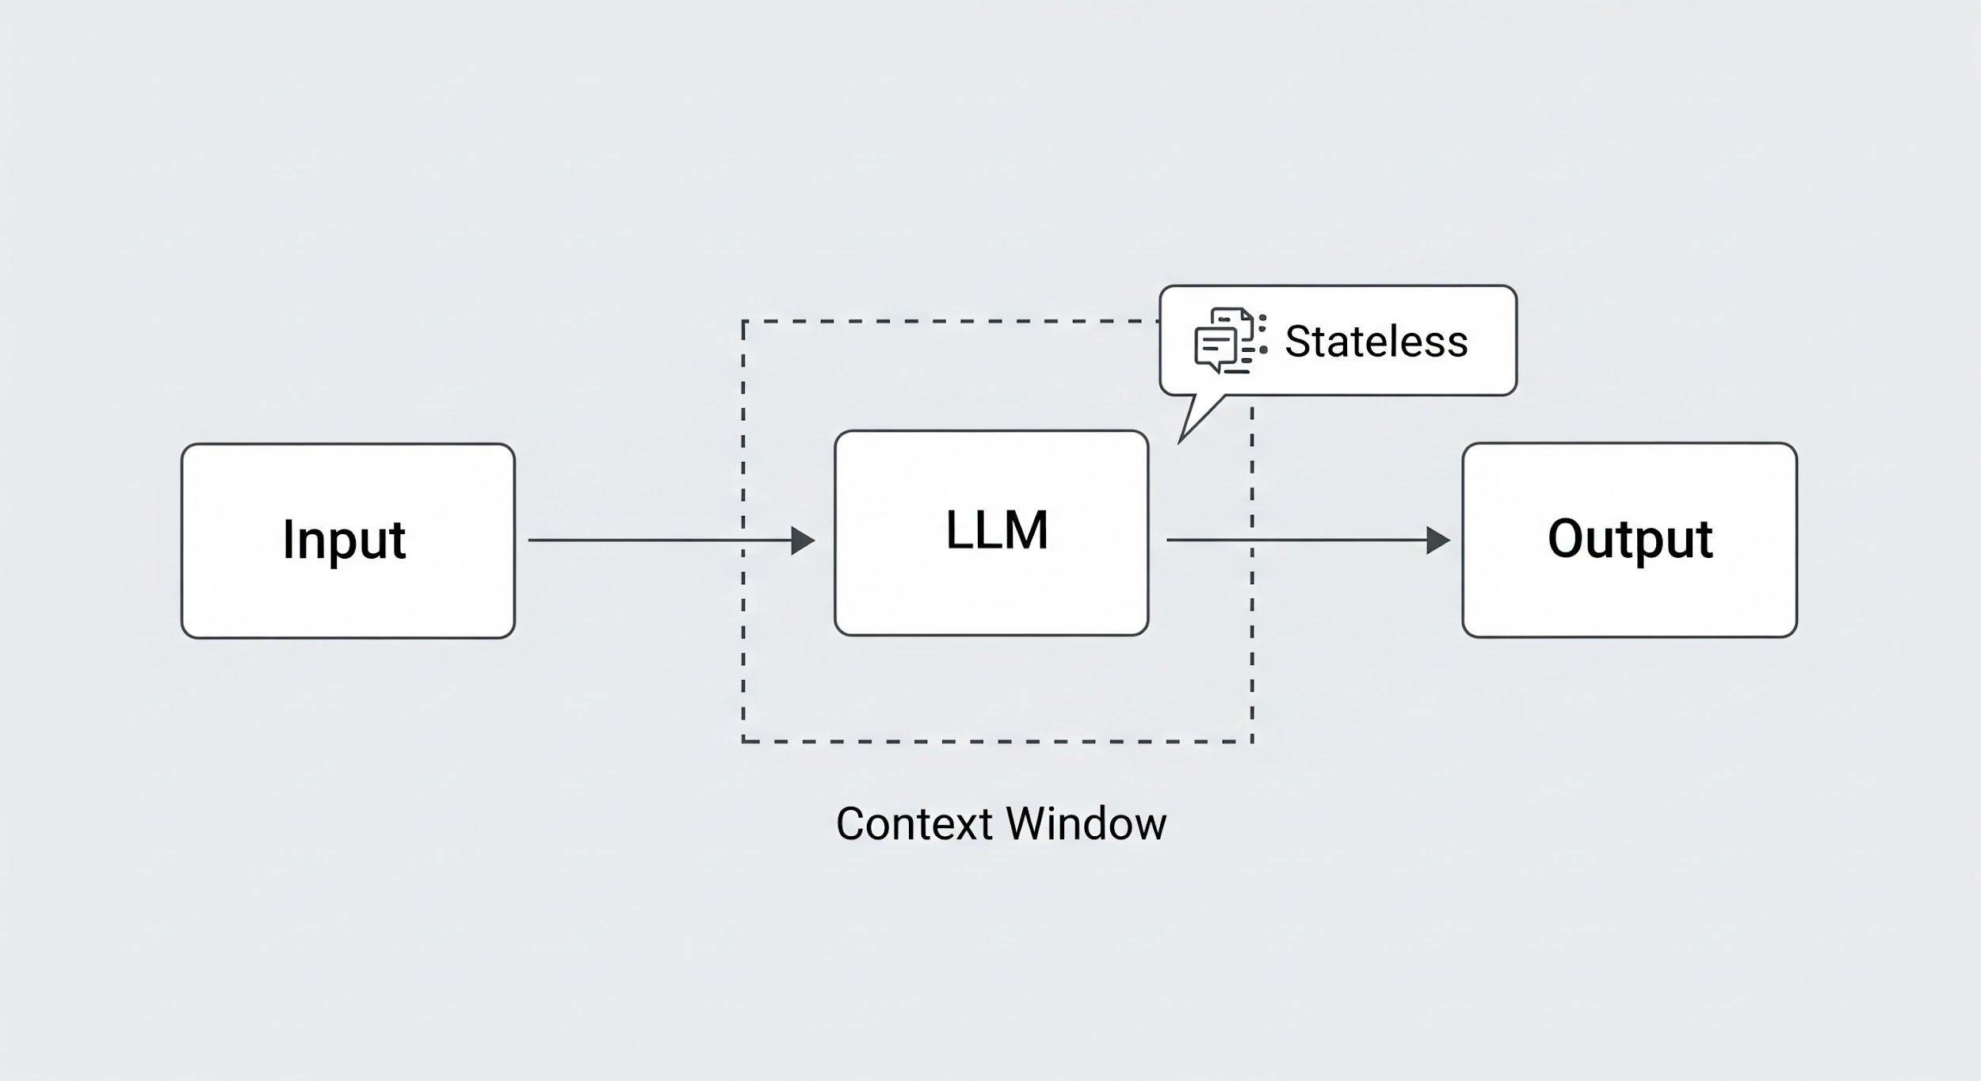
What is an AI Assistant? (LLM is not. lets face it. it can be)
Key Points
• Large Language Models (LLMs) - trained on vast amounts of text
• Context Window - the "working memory" (~200K tokens for Claude)
• Stateless by default - forgets everything between sessions
• Great at understanding, reasoning, and generating text
Visual: Simple diagram showing Input -> LLM -> Output
Notes:
Before we dive into the project, let's establish a baseline. An LLM like Claude is essentially a very sophisticated pattern matching system trained on text. It can understand context, reason about problems, and generate responses. But out of the box, it has limitations - it forgets between sessions and can only talk, not act.

Slide 4
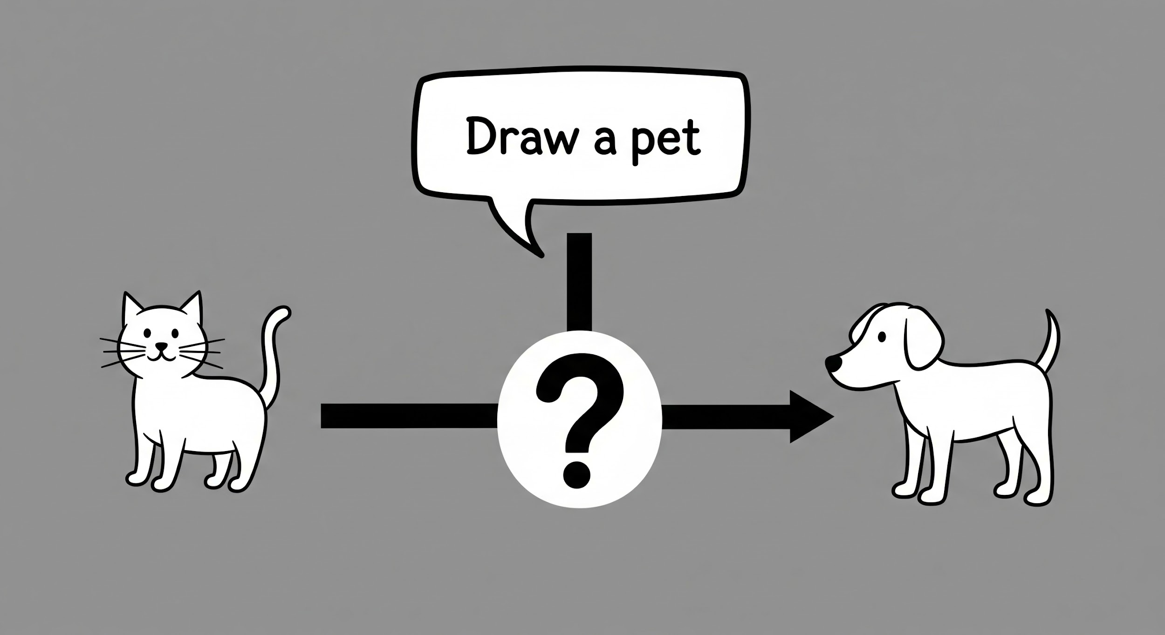
What is an AI Assistant? Basic Prompting?
Examples
Bad Prompt: "Fix the bug" Better Prompt: "The login page shows a 500 error when submitting the form. The error logs show a NullPointerException in AuthService.java line 45. How do I fix this?"
Key Points
• More context = better answers
• Be specific about what you want
• Include relevant error messages, file names, versions
Notes:
Most people start here - asking questions in natural language. The quality of the response directly correlates to the quality of the prompt. Vague prompts get vague answers. This works, but it's inefficient for repeated tasks.

Slide 5
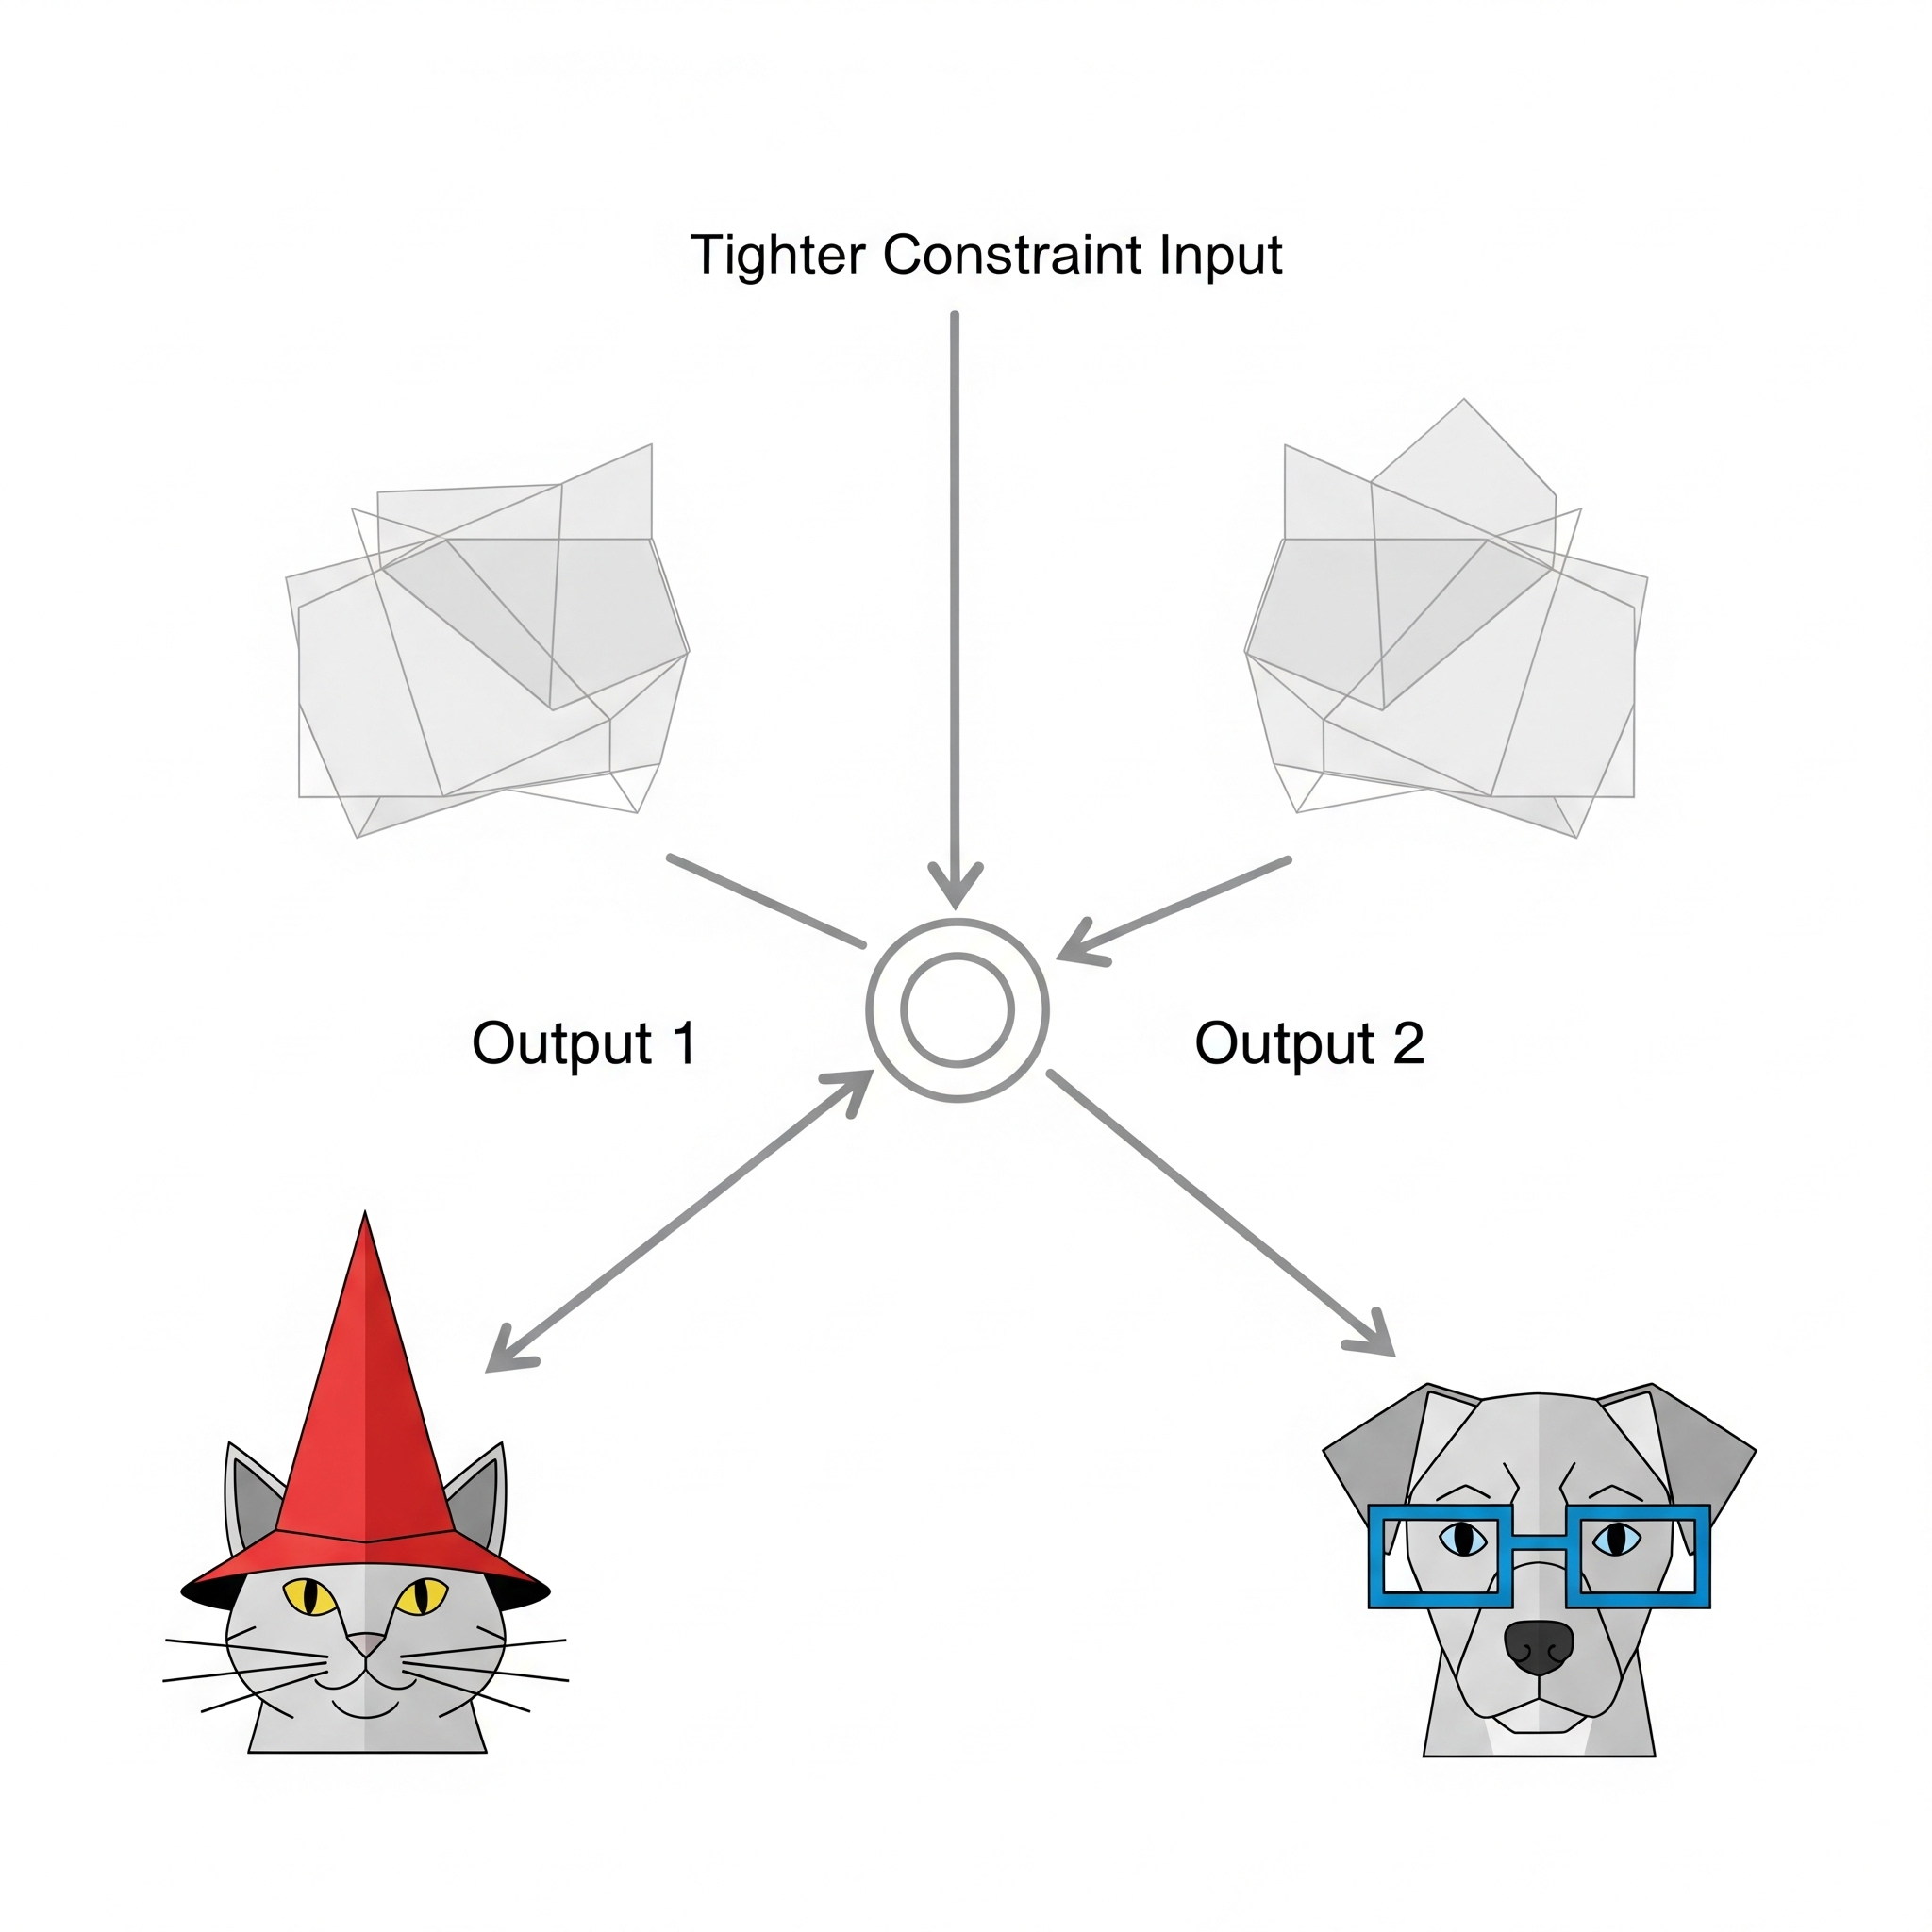
Better Prompting - Structure and Context
Structured Prompt Template
ROLE: You are a senior Python developer CONTEXT: Working on a Django REST API TASK: Review this authentication code CONSTRAINTS: Must be compatible with Python 3.10+ FORMAT: Bullet points with code examples
Key Points
• Role setting focuses the model
• Context provides relevant background
• Constraints narrow the solution space
• Format specifies desired output structure
Notes:
Experienced users learn to structure their prompts. By setting a role, providing context, defining constraints, and specifying output format, you get much more useful responses. But this takes effort every time.

Slide 6

Context Window Problems
The large context window has a practical limit.
Reaching the limit forces the LLM to compact the context.
Context compression results in losing some conversational detail.
This process functions similar to a FIFO queue forgetting older data.
Key instrustructions lost
Frustrated users

Slide 7

Why Memory Matters
The missing component is persistent memory.
Stateless agents can create many disjoint pieces.
One agent with memory creates a masterpiece like the Mona Lisa.
Memory provides continuity for complex tasks.

Slide 8
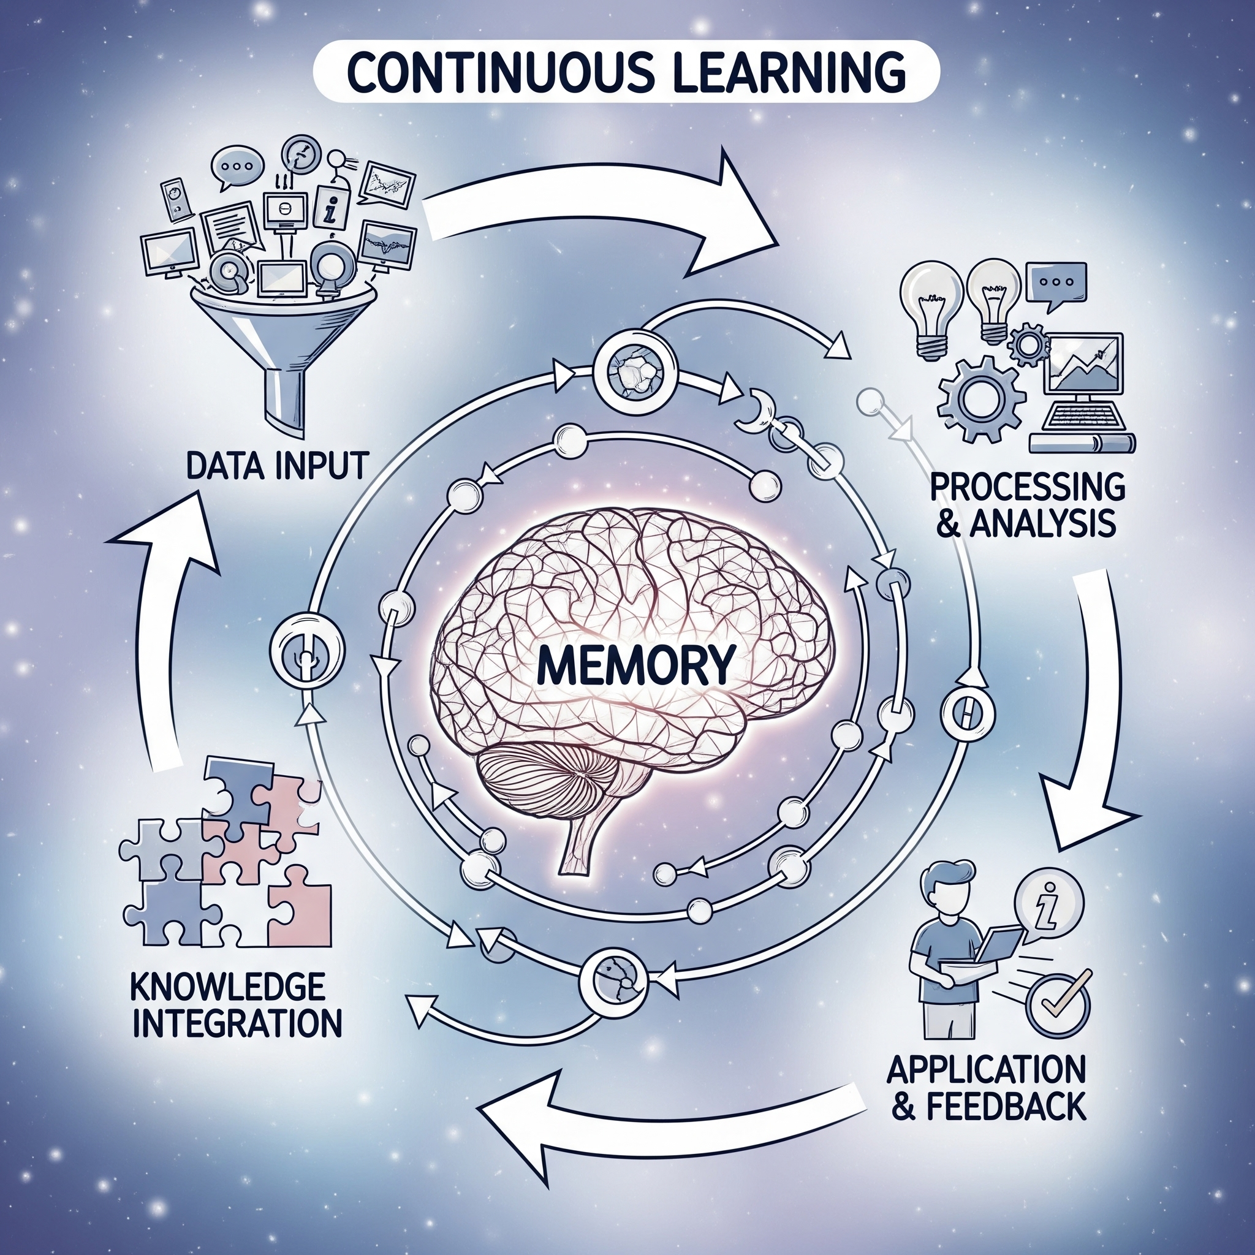
The Learning Loop
Memory is essential for session continuity.
Persistent state prevents repeating work and errors.
Learned knowledge actively prevents known issues before tasks.
Memory tracks current work and learned fixes permanently.

Slide 9
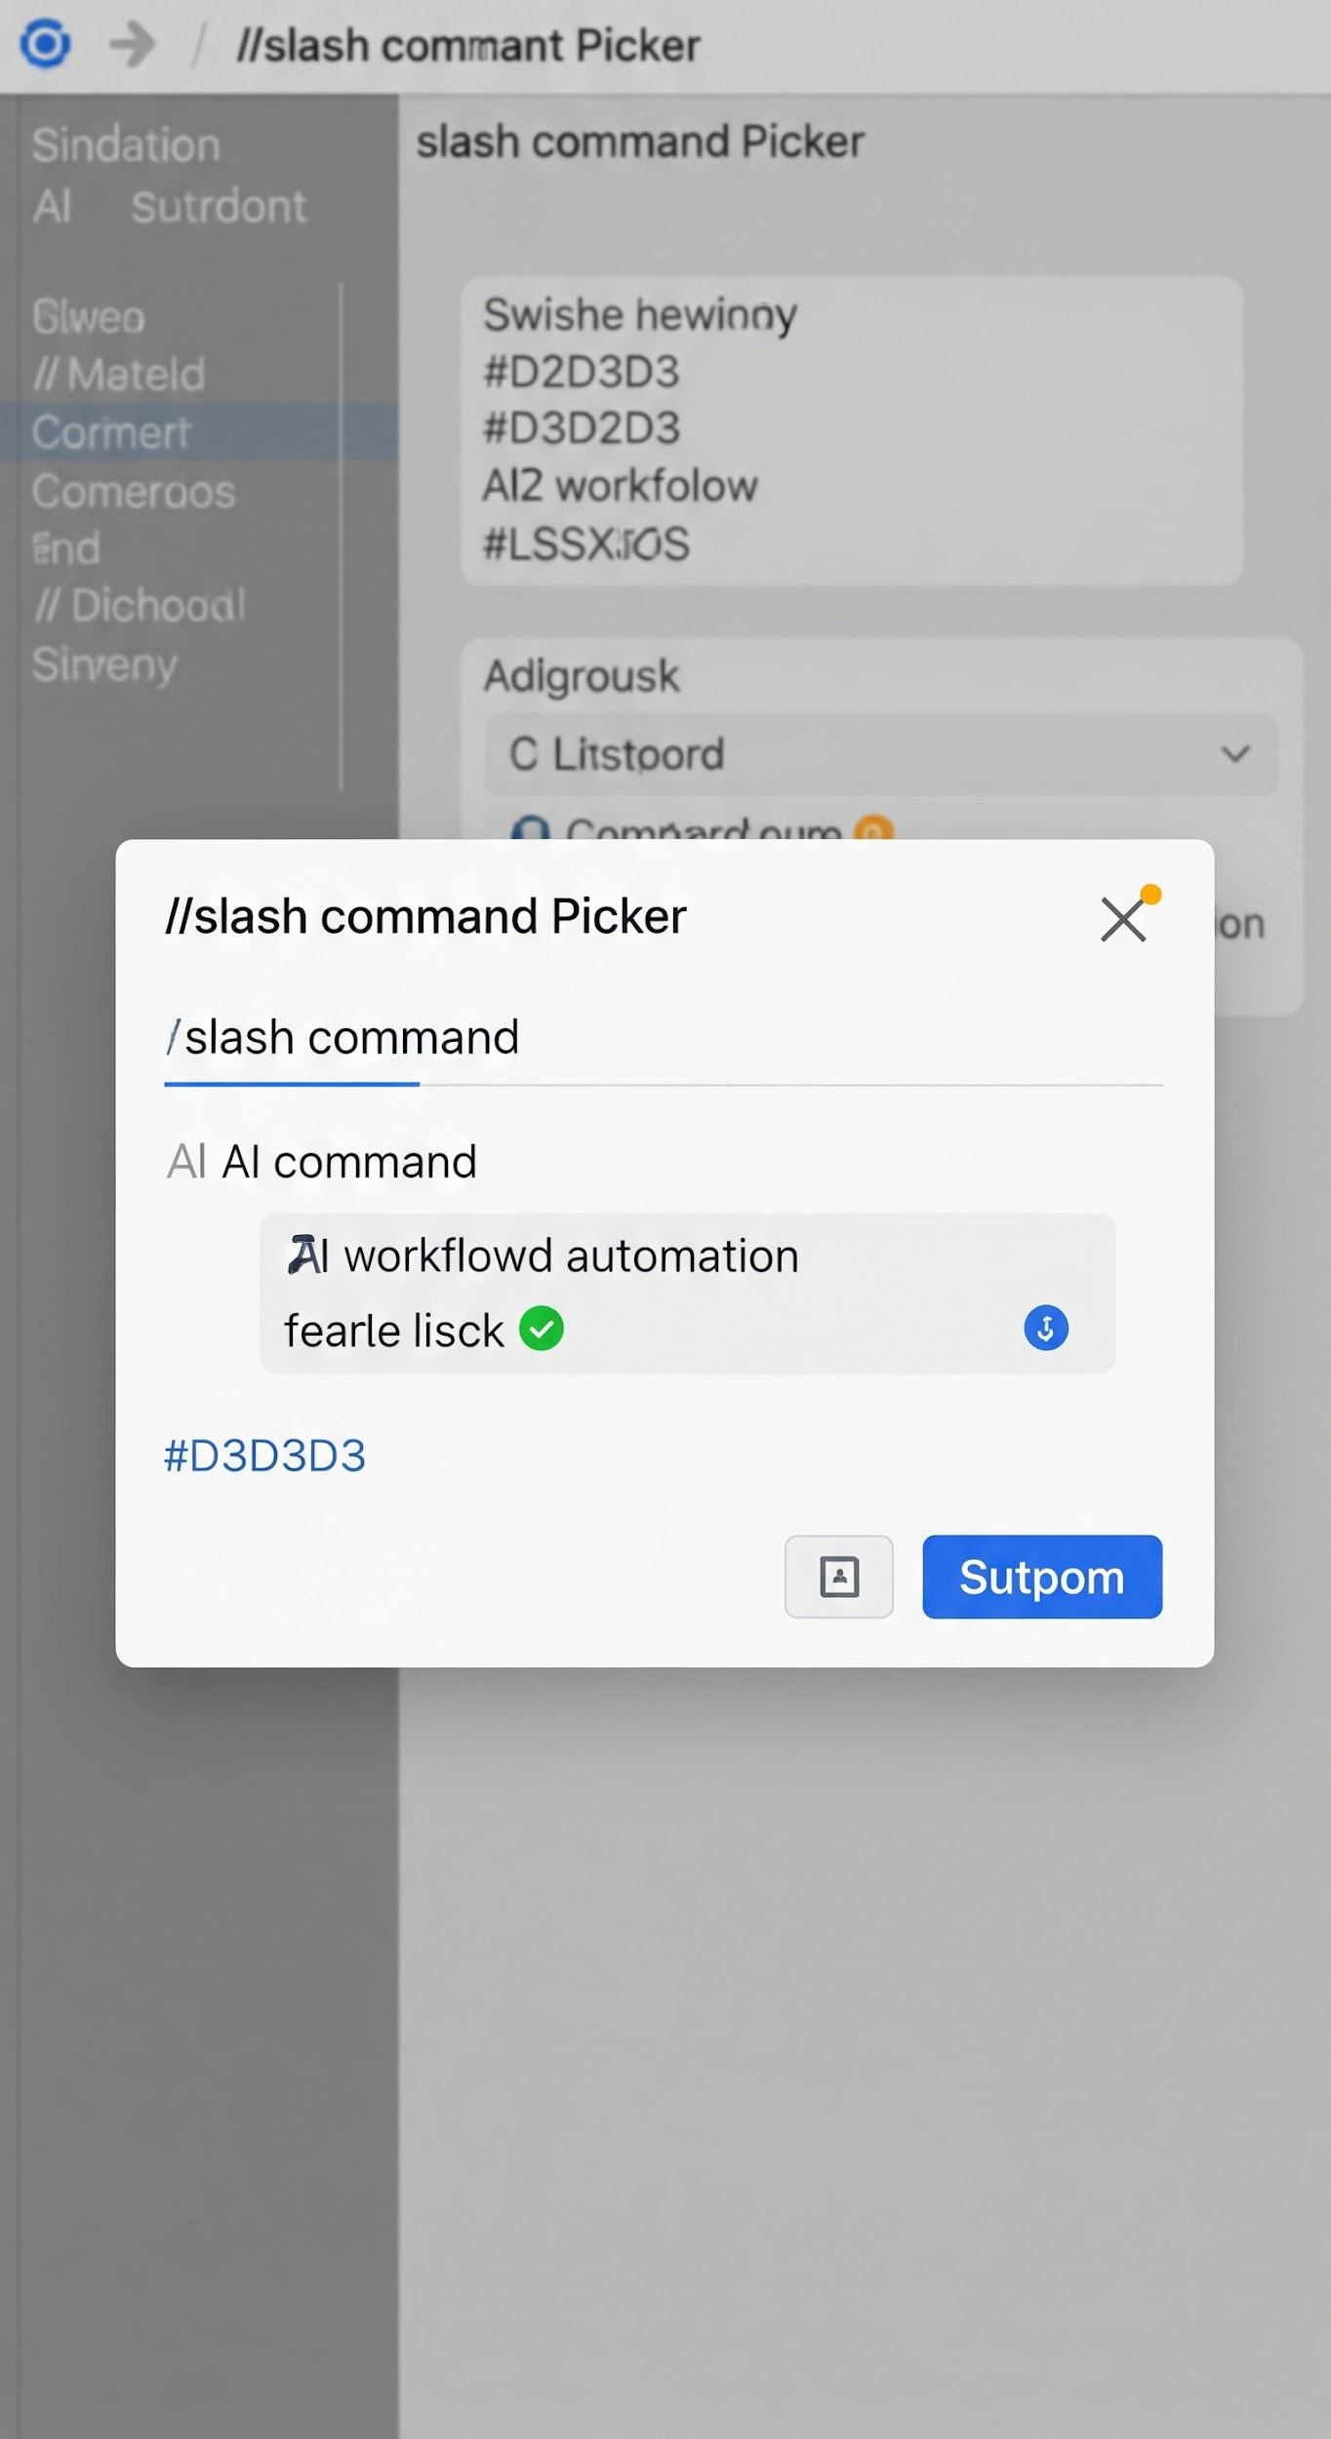
Prompt Databases / Slash Commands
The Problem: Writing good prompts is time-consuming and inconsistent
The Solution: Pre-built, tested prompts as slash commands
Examples from AI Workflow (66 commands)
Command | What It Does
`/coffee` | Morning briefing - email, PRs, Jira, calendar
`/start-work AAP-12345` | Begin work on a Jira issue
`/create-mr` | Create MR with validation
`/deploy-ephemeral` | Deploy to test environment
`/investigate-alert` | Triage production alerts
Visual: Screenshot of slash command picker in Cursor
Notes:
Prompt databases solve the consistency problem. Instead of crafting prompts each time, you use pre-built commands. We have 66 slash commands covering daily workflows, development, review, deployment, and incident response. Same quality every time, no effort required.

Slide 10
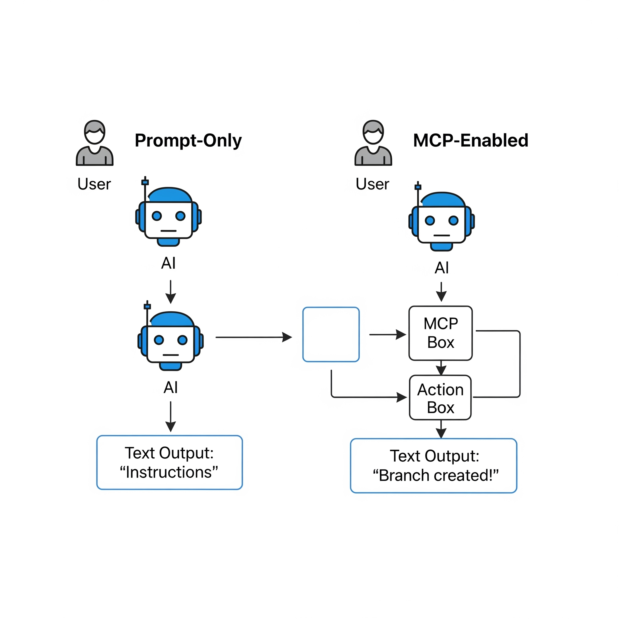
From Prompts to Actions
The Limitation
• AI can explain HOW to create a Git branch
• But it can't actually CREATE the branch (AAP-12345 - fix(xyz): do this)
• AI can describe Kubernetes pod status
• But it can't actually QUERY the cluster (login to console.stage.redhat.com but connect to the vpn?)
The Solution: MCP (Model Context Protocol)
• Standardized way to give AI tools
• AI can call functions, not just generate text
• Turns conversation into action
Notes:
This is the key insight. Traditional AI can only talk - it explains how to do things but can't do them itself. MCP bridges this gap by giving Claude access to tools - functions it can call to take real action. This transforms Claude from an advisor into an executor.

Slide 11
Why Personas Over Multiple Agents

Slide 12
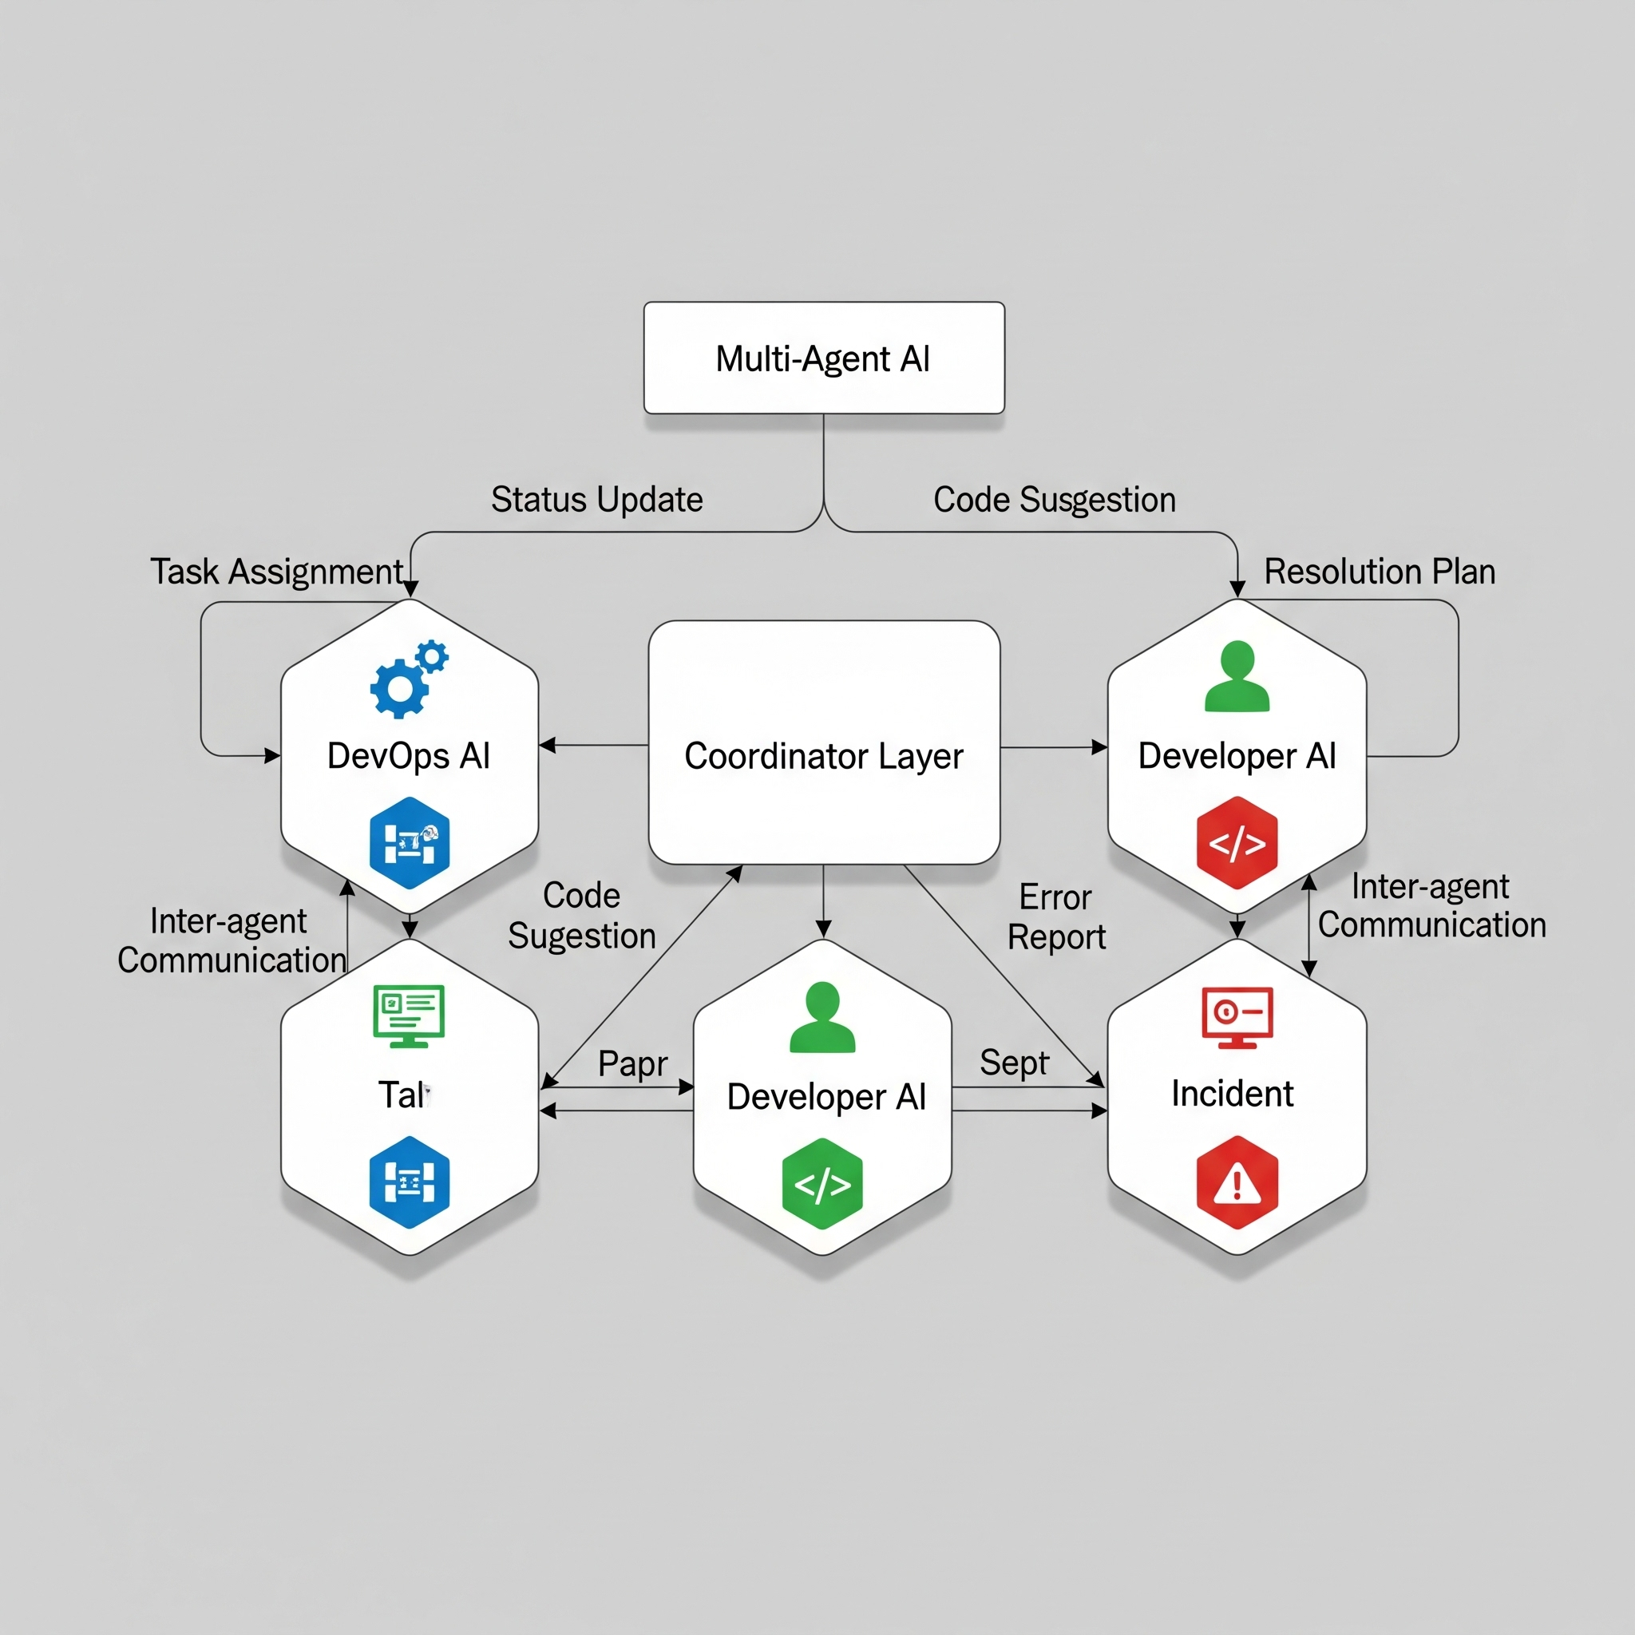
Multi-Agent vs Single-Agent
Multi-Agent Approach
• Separate AI instances for each domain
• DevOps Agent, Developer Agent, Incident Agent
• Coordination layer required
• State synchronization challenges
• Higher costs (multiple API calls)
Notes:
The intuitive approach might be to create separate AI agents for each domain. But this creates significant complexity - you need coordination, state sharing, and handoff logic. It's expensive and error-prone.

Slide 13

Stateless Agents Create Chaos
Stateless multi-agent systems create disjoint work.
Persistent memory is essential for task continuity.
One agent with memory builds a complex masterpiece.
Avoid creating numerous agents without shared state.

Slide 14
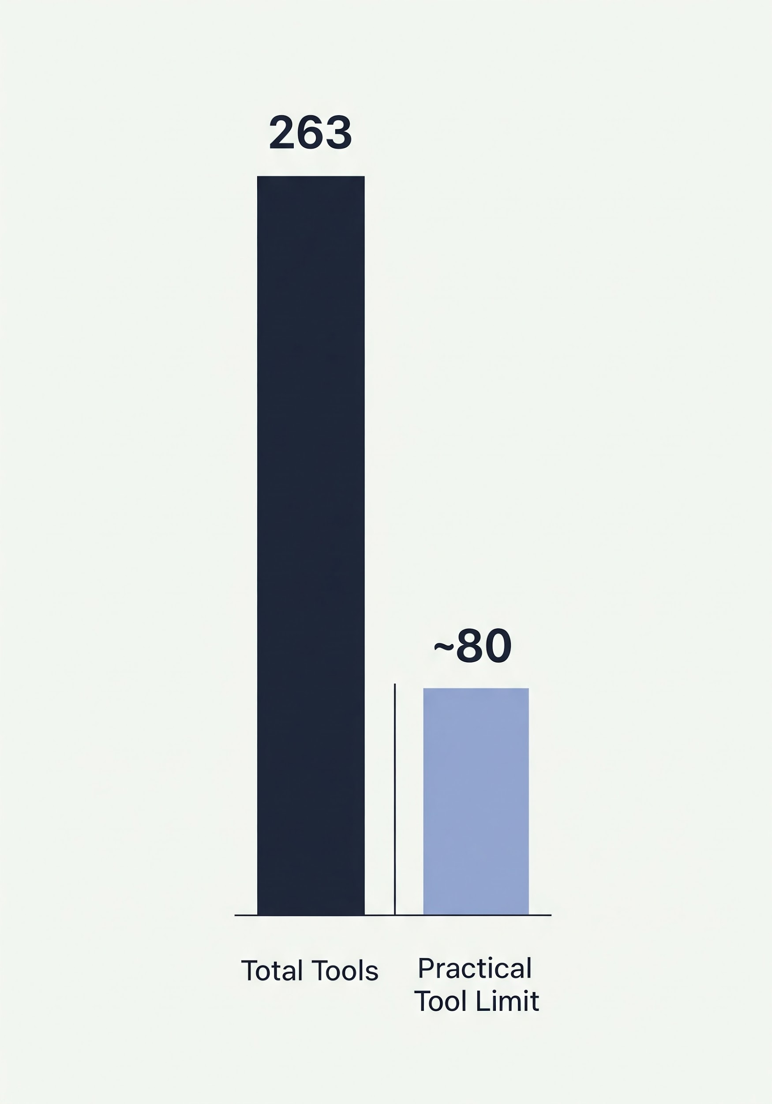
The 80-Tool Limit Problem
The Reality
• Contexts of major LLMS have a ~128 tool limit
• Practical limit is closer to 80 tools
• We have 263 tools across 16 modules!
• Loading all tools would exceed limits and flood context
Why It Matters
• Each tool takes up context window space
• Too many tools = confused model
• Tool descriptions add up quickly
Notes:
Here's a practical constraint - IDEs and Claude itself have limits on how many tools can be loaded. We have 263 tools, but we can only expose about 80 at a time. We need a way to dynamically select which tools are relevant.

Slide 15
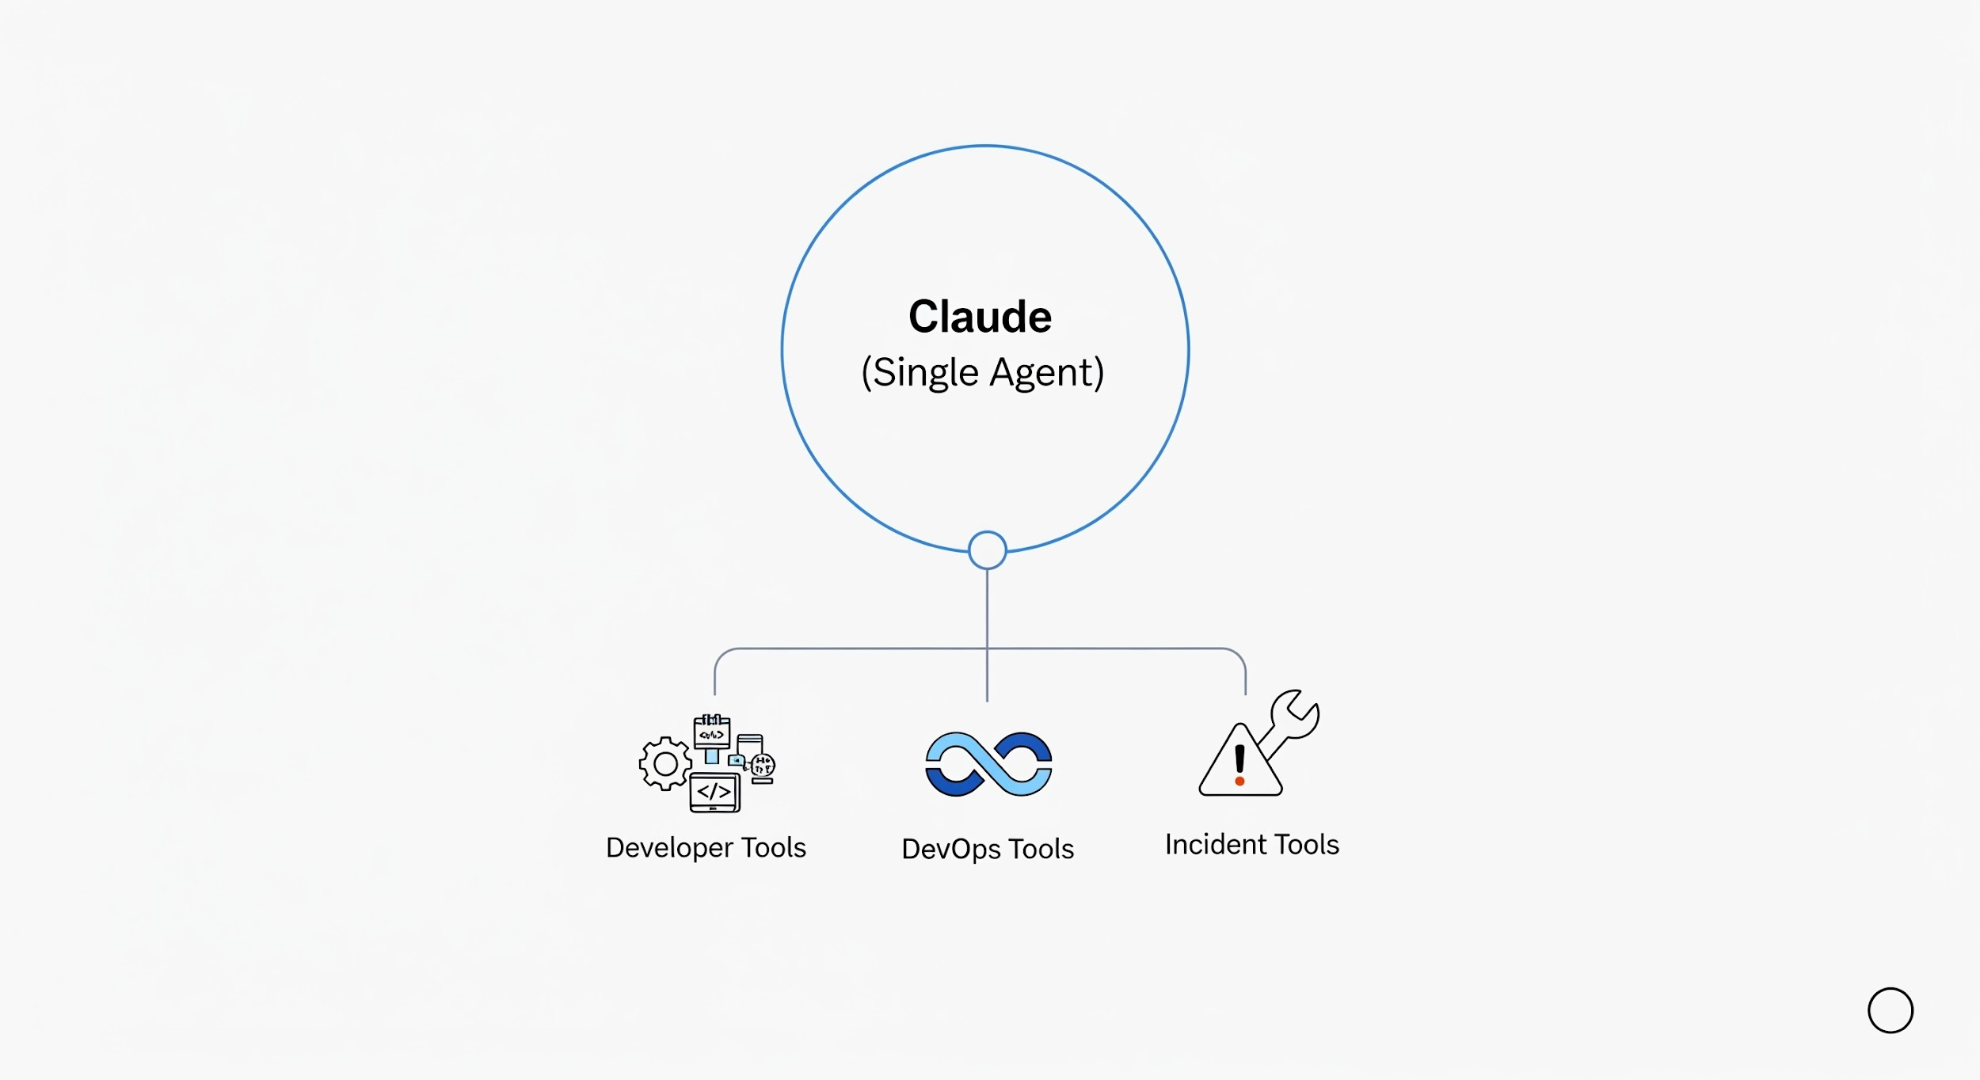
Solution - Dynamic Personas
The Insight: One Claude, Different "Hats"
How It Works
• Single Claude instance (single-agent)
• Personas are tool configuration profiles
• "Loading an agent" = changing available tools
• No coordination complexity
• Instant context switching
Notes:
Our solution is elegant - instead of multiple agents, we have one Claude that can wear different hats. Each persona is just a different tool configuration. When you say "load DevOps agent," we swap out the developer tools for DevOps tools. Same AI, different capabilities.

Slide 16

Persona Examples
Persona | Focus | Tool Count | Key Modules
👨‍💻 Developer | Coding, PRs | ~78 | git, gitlab, jira
🔧 DevOps | Deployments, K8s | ~74 | k8s, bonfire, quay
🚨 Incident | Production issues | ~78 | k8s, prometheus, alertmanager
📦 Release | Shipping | ~91 | konflux, quay, git
💬 Slack | Autonomous bot | ~85 | slack, jira, gitlab
All personas include
• Core workflow tools (memory, skills, session)
• Jira tools (issue tracking is universal)
• Auto-heal infrastructure
Notes:
We have five main personas, each optimized for a different workflow. Developer for day-to-day coding, DevOps for infrastructure work, Incident for production issues, Release for shipping, and Slack for our autonomous bot. All stay under the tool limit while providing focused capabilities.

Slide 17
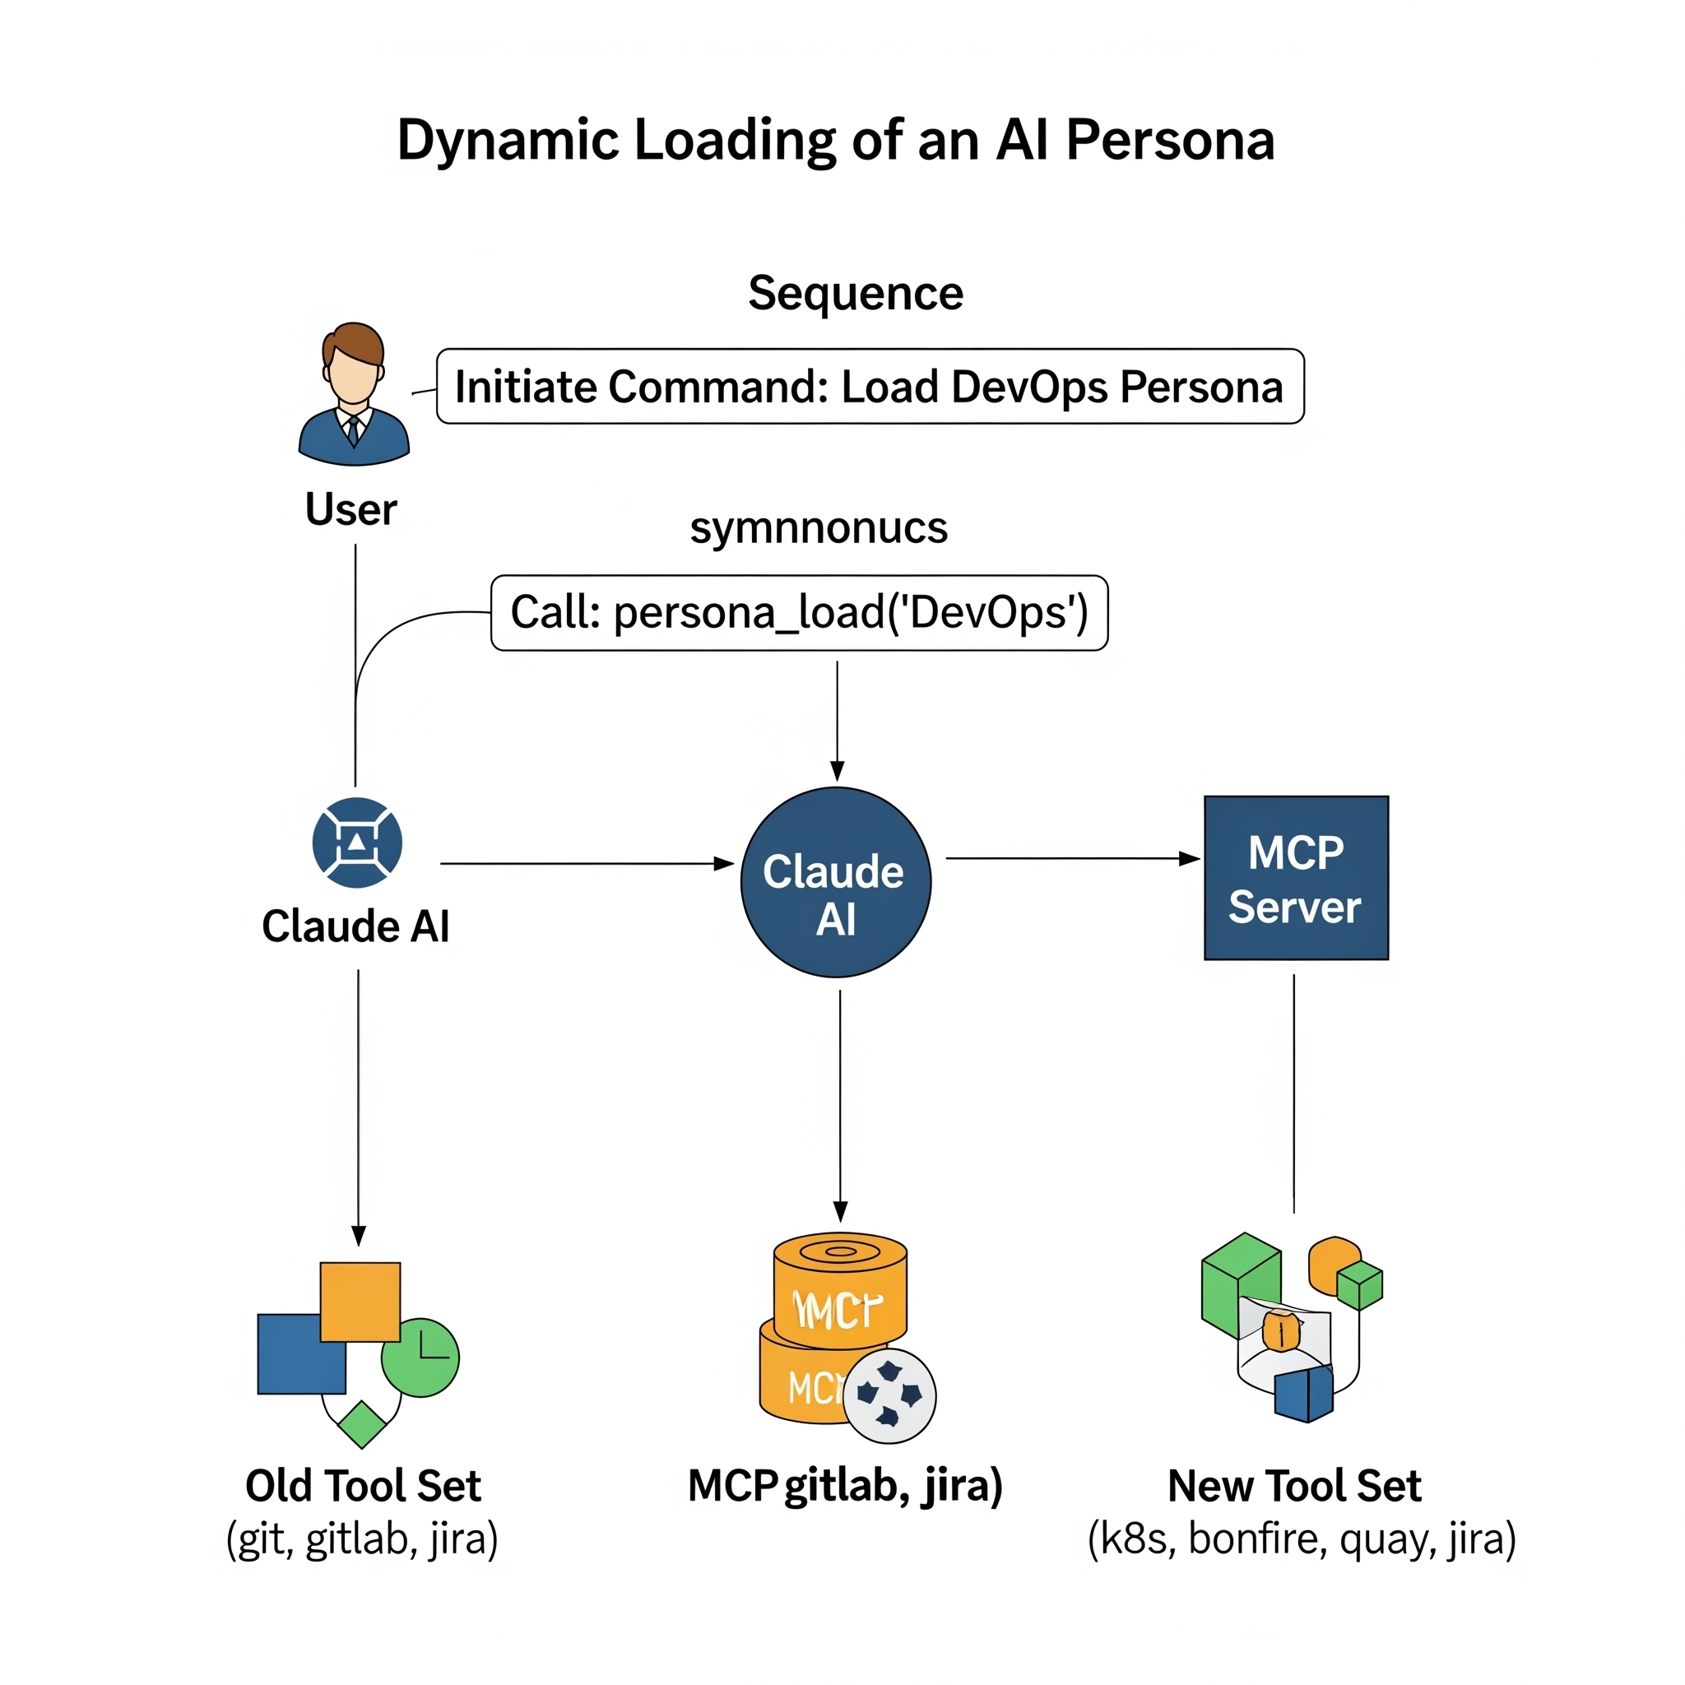
How Persona Loading Works
Sequence
1. User: "Load the devops agent" 2. Claude calls: persona_load("devops") 3. MCP Server: - Unloads current tools (git, gitlab, jira) - Loads new tools (k8s, bonfire, quay, jira) - Sends tools/list_changed notification
Notes:
The loading process is seamless. You just ask Claude to load a different persona, and within seconds the tools swap out. The IDE gets notified and refreshes its tool list. You can switch between personas as often as needed without restarting anything.

Slide 18
Skills - Multi-Step Workflows

Slide 19
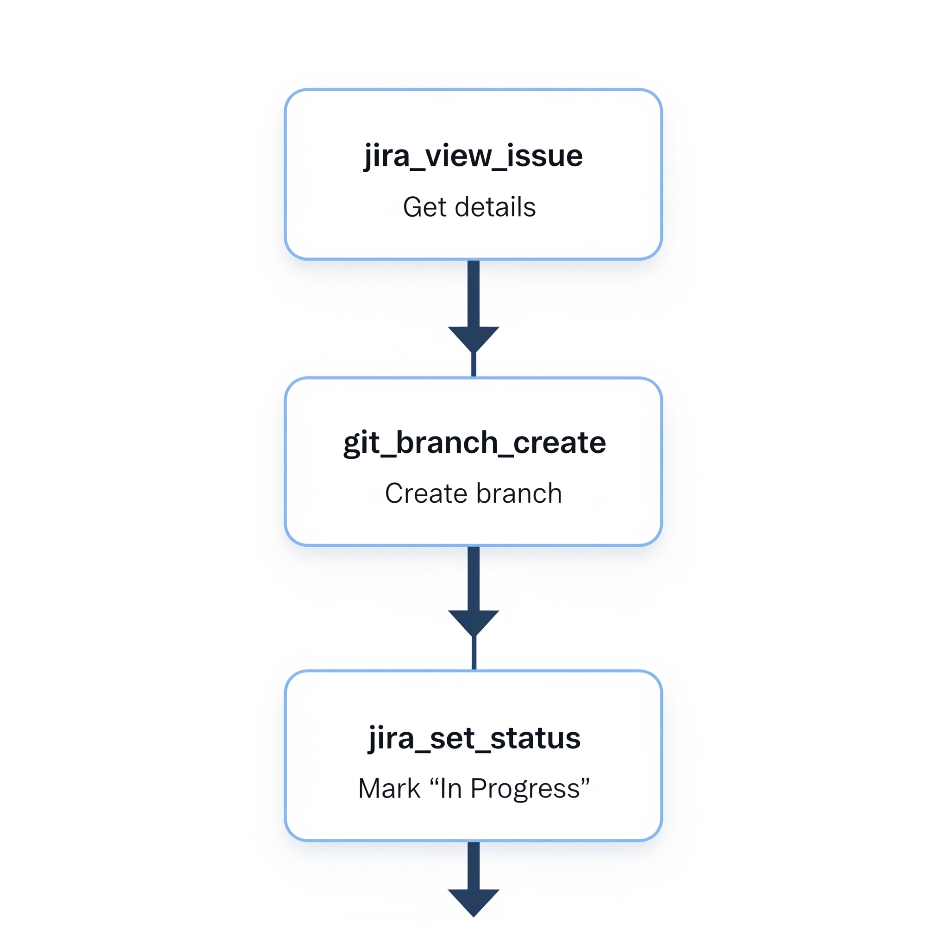
What Are Skills?
The Problem
• Many tasks require multiple tool calls in sequence
• "Start work on issue" = view issue + create branch + update status
• Manual orchestration is tedious and error-prone
The Solution: Skills
• YAML-defined workflows
• Chain multiple tools together
• Include conditions and branching
• Handle errors gracefully
• Template substitution (Jinja2)
Notes:
Skills solve the orchestration problem. Instead of manually calling multiple tools, you define a workflow once and reuse it. Skills can include logic - if this fails, do that. They're defined in YAML so they're easy to read and modify.

Slide 20
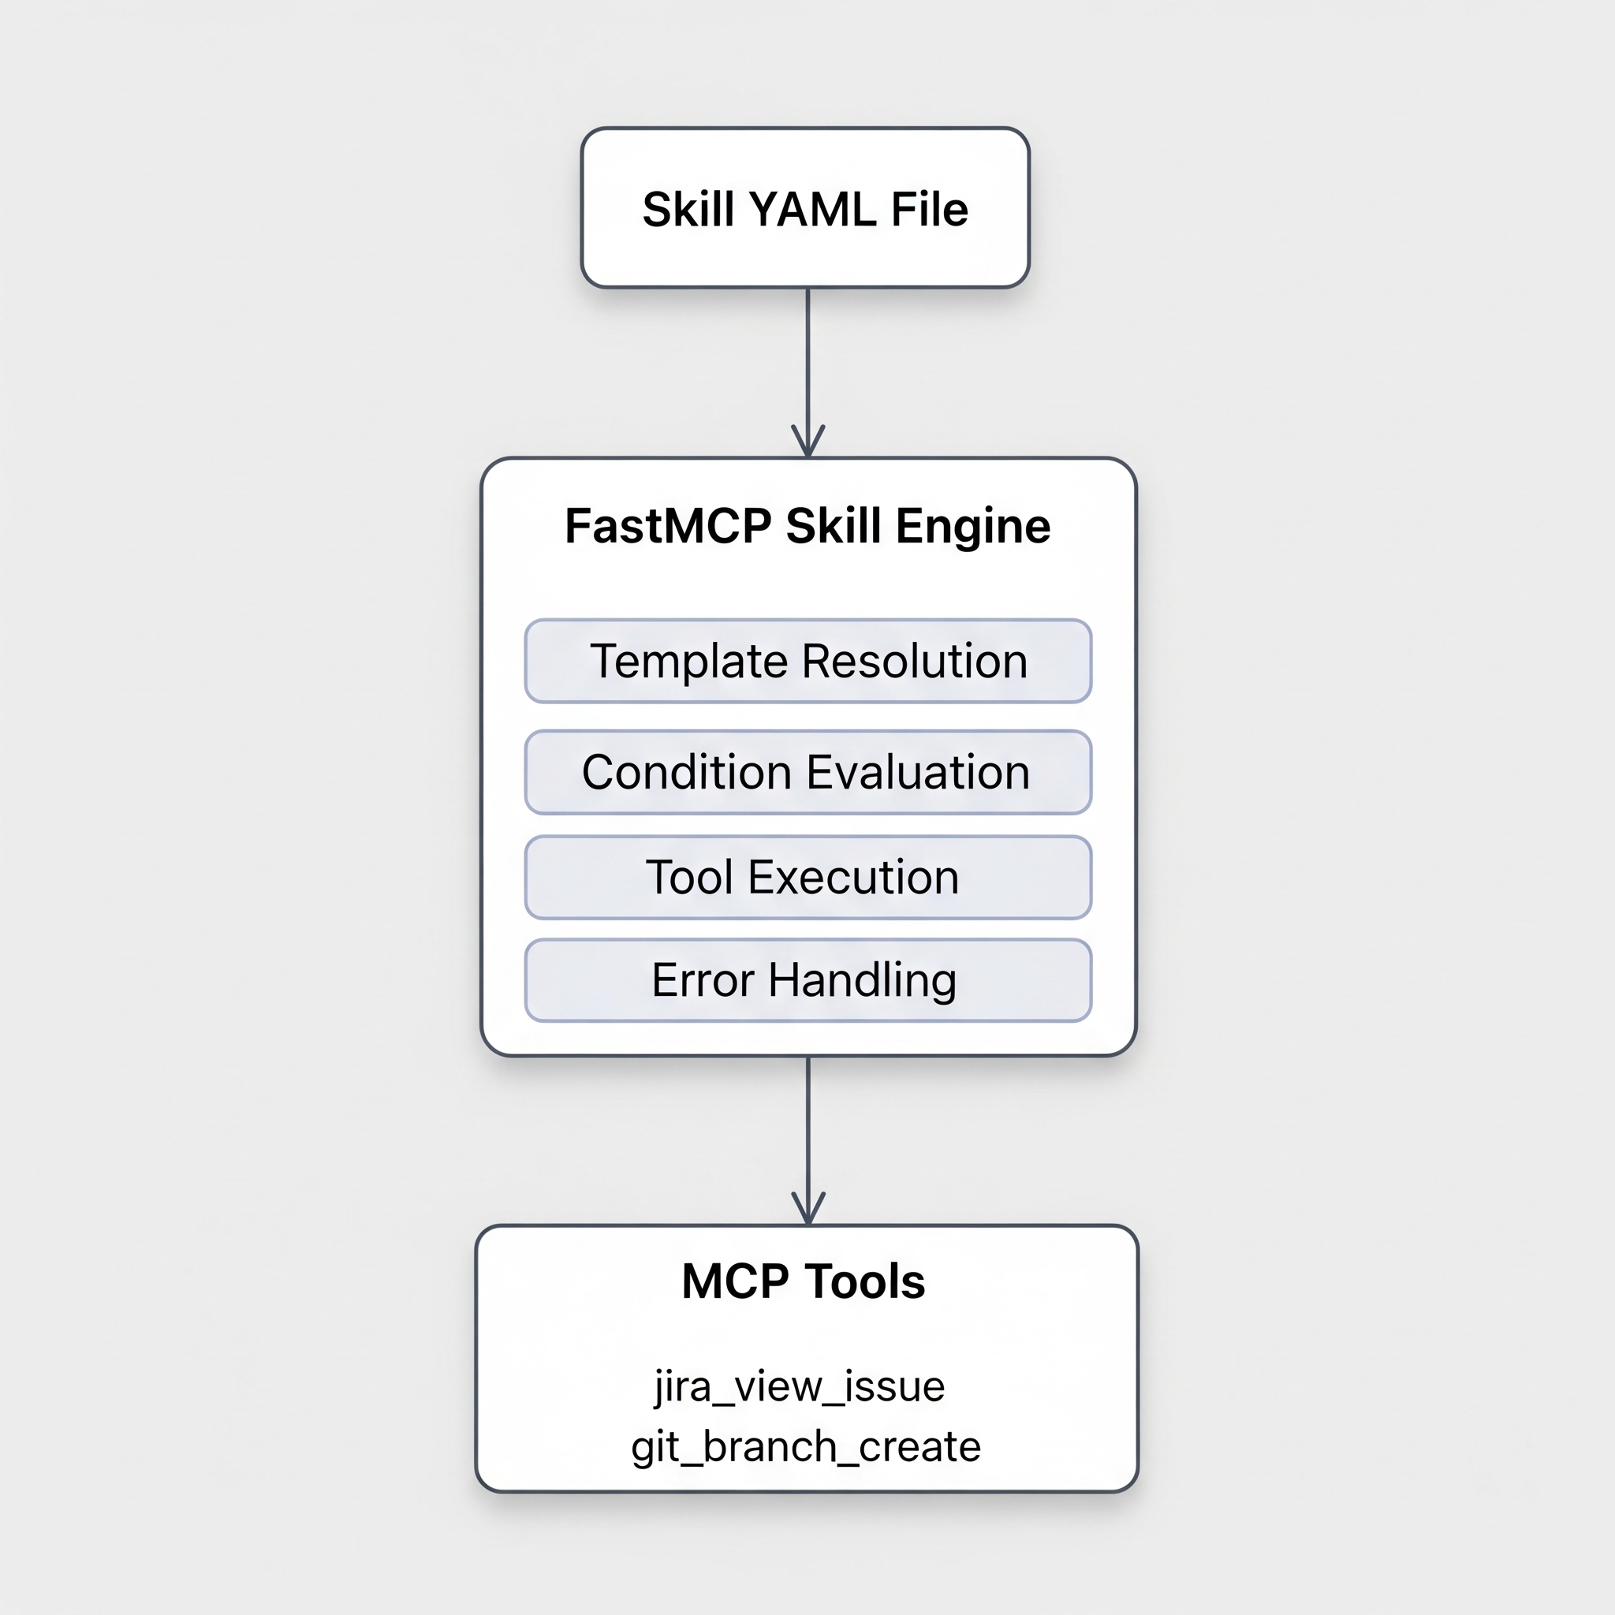
FastMCP Skill Engine
Capabilities
• Templating: `{{ inputs.issue_key }}` - Jinja2 syntax
• Conditions: `condition: "step1_result.success"`
• Compute steps: Python code for data transformation
• Error handling: `on_error: continue | fail | retry`
• Outputs: Pass data between steps
Notes:
The skill engine is built on FastMCP and provides powerful orchestration. Templates let you pass data between steps. Conditions let you branch based on results. Compute steps let you transform data with Python. Error handling ensures graceful failure.

Slide 21
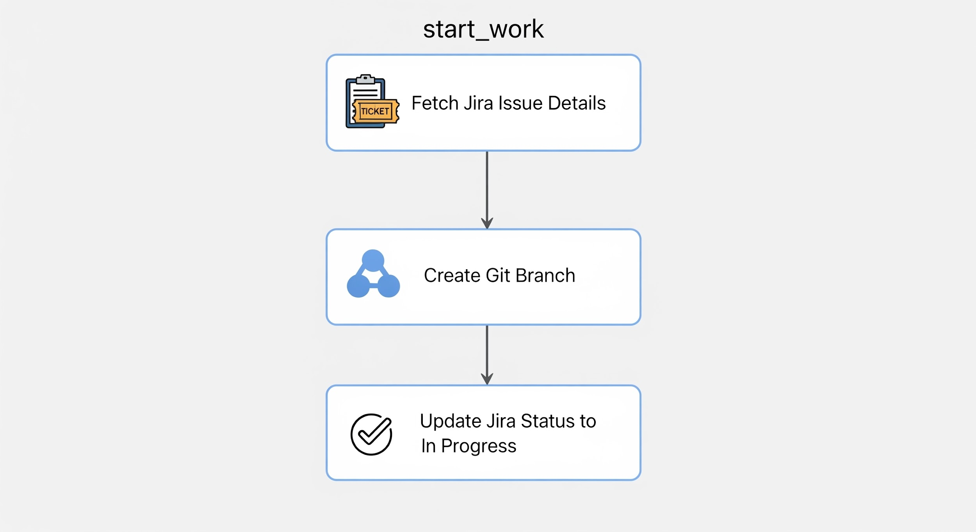
Example - start_work Skill
What it does
YAML snippet
name: start_work description: Begin working on a Jira issue inputs: - name: issue_key type: string required: true ...
Notes:
Here's a concrete example. The start_work skill takes an issue key, fetches the details, generates a branch name, creates the branch, and updates Jira. All in one command. The YAML is readable and maintainable.

Slide 22
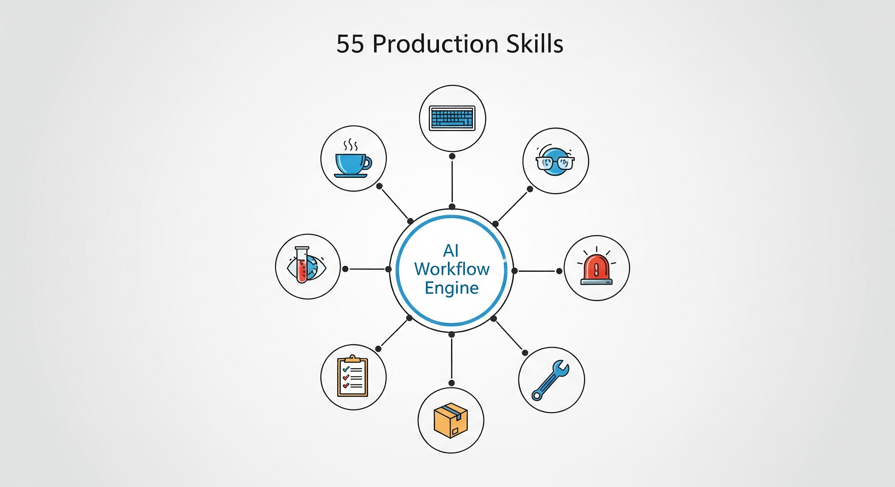
55 Production Skills
Categories
Category | Skills | Examples
☕ Daily Rituals | 4 | coffee, beer, standup_summary, weekly_summary
💻 Development | 8 | start_work, create_mr, close_issue, sync_branch
👀 Code Review | 6 | review_pr, check_my_prs, rebase_pr
🧪 Testing | 6 | test_mr_ephemeral, deploy_to_ephemeral
🚨 Incident | 5 | investigate_alert, debug_prod, silence_alert
📋 Jira | 4 | create_jira_issue, jira_hygiene
📦 Release | 4 | release_to_prod, konflux_status
🔧 Utility | 18 | memory_*, learn_pattern
Notes:
We have 55 production-ready skills covering the full development lifecycle. From morning coffee briefings to end-of-day summaries, from starting work to releasing to production. Every skill is tested and includes automatic error recovery.

Slide 23
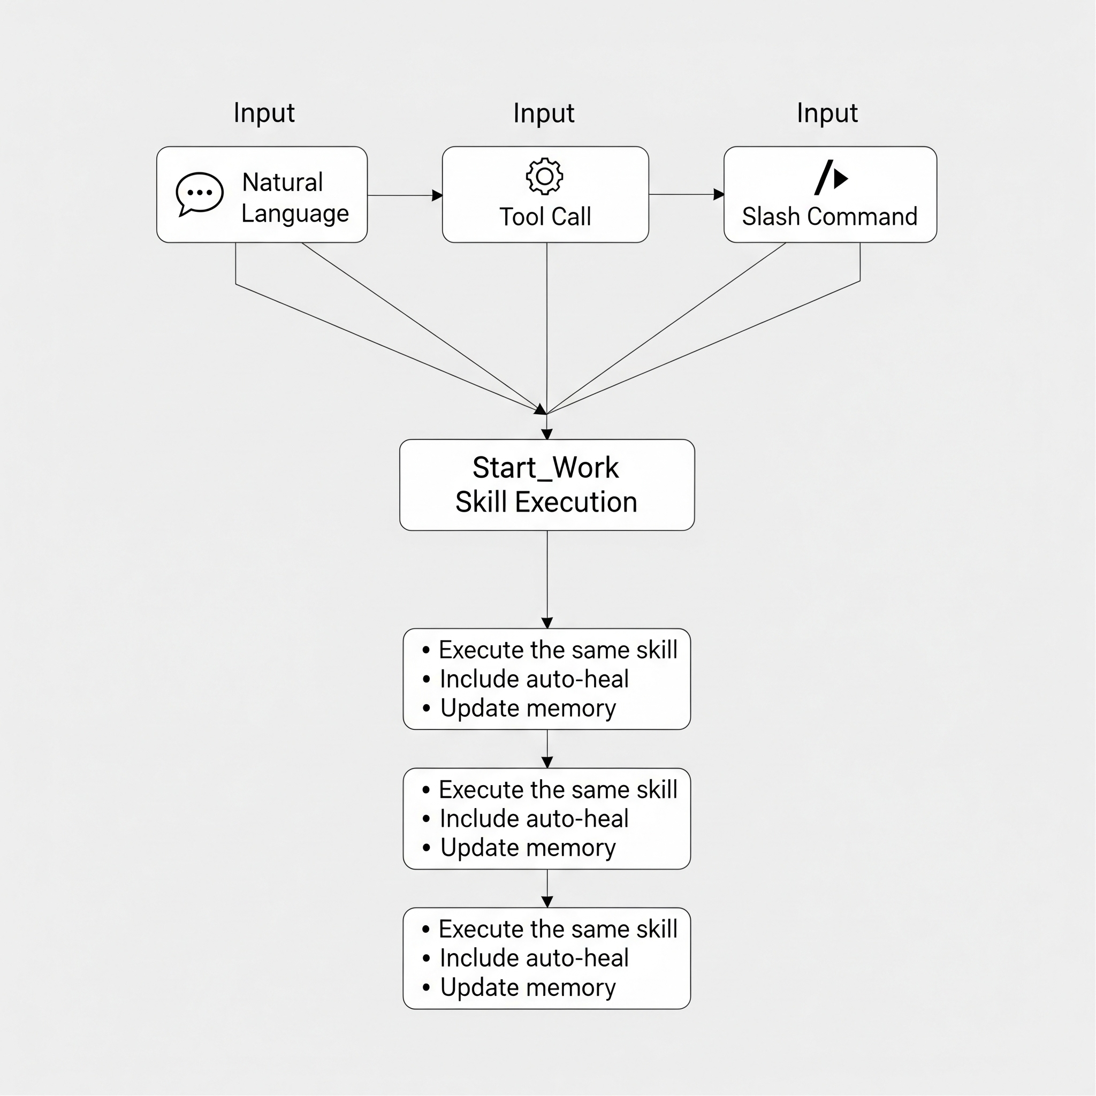
Running Skills
Run the start_work skill for AAP-12345
skill_run("start_work", '{"issue_key": "AAP-12345"}')
/start-work AAP-12345
All three methods
• Execute the same skill
• Include auto-heal
• Update memory
• Return consistent results
Notes:
Skills are accessible in whatever way is most natural. In conversation, just describe what you want. For precision, use the tool call. For quick access, use slash commands. They all run the same underlying skill with the same reliability.

Slide 24
Auto-Remediation

Slide 25

The Problem - Things Break
Common Failures
Issue | Symptom | Cause
VPN Disconnected | "No route to host" | Network timeout
Token Expired | "401 Unauthorized" | Auth expired
Rate Limited | "429 Too Many Requests" | API throttling
Cluster Unreachable | "Connection refused" | Wrong cluster/config
The Old Way
Time wasted: 2-5 minutes per failure
Notes:
Working with external systems means dealing with failures. VPN disconnects, tokens expire, services go down. Traditionally, you'd have to diagnose each failure and fix it manually. This wastes time and breaks your flow.

Slide 26
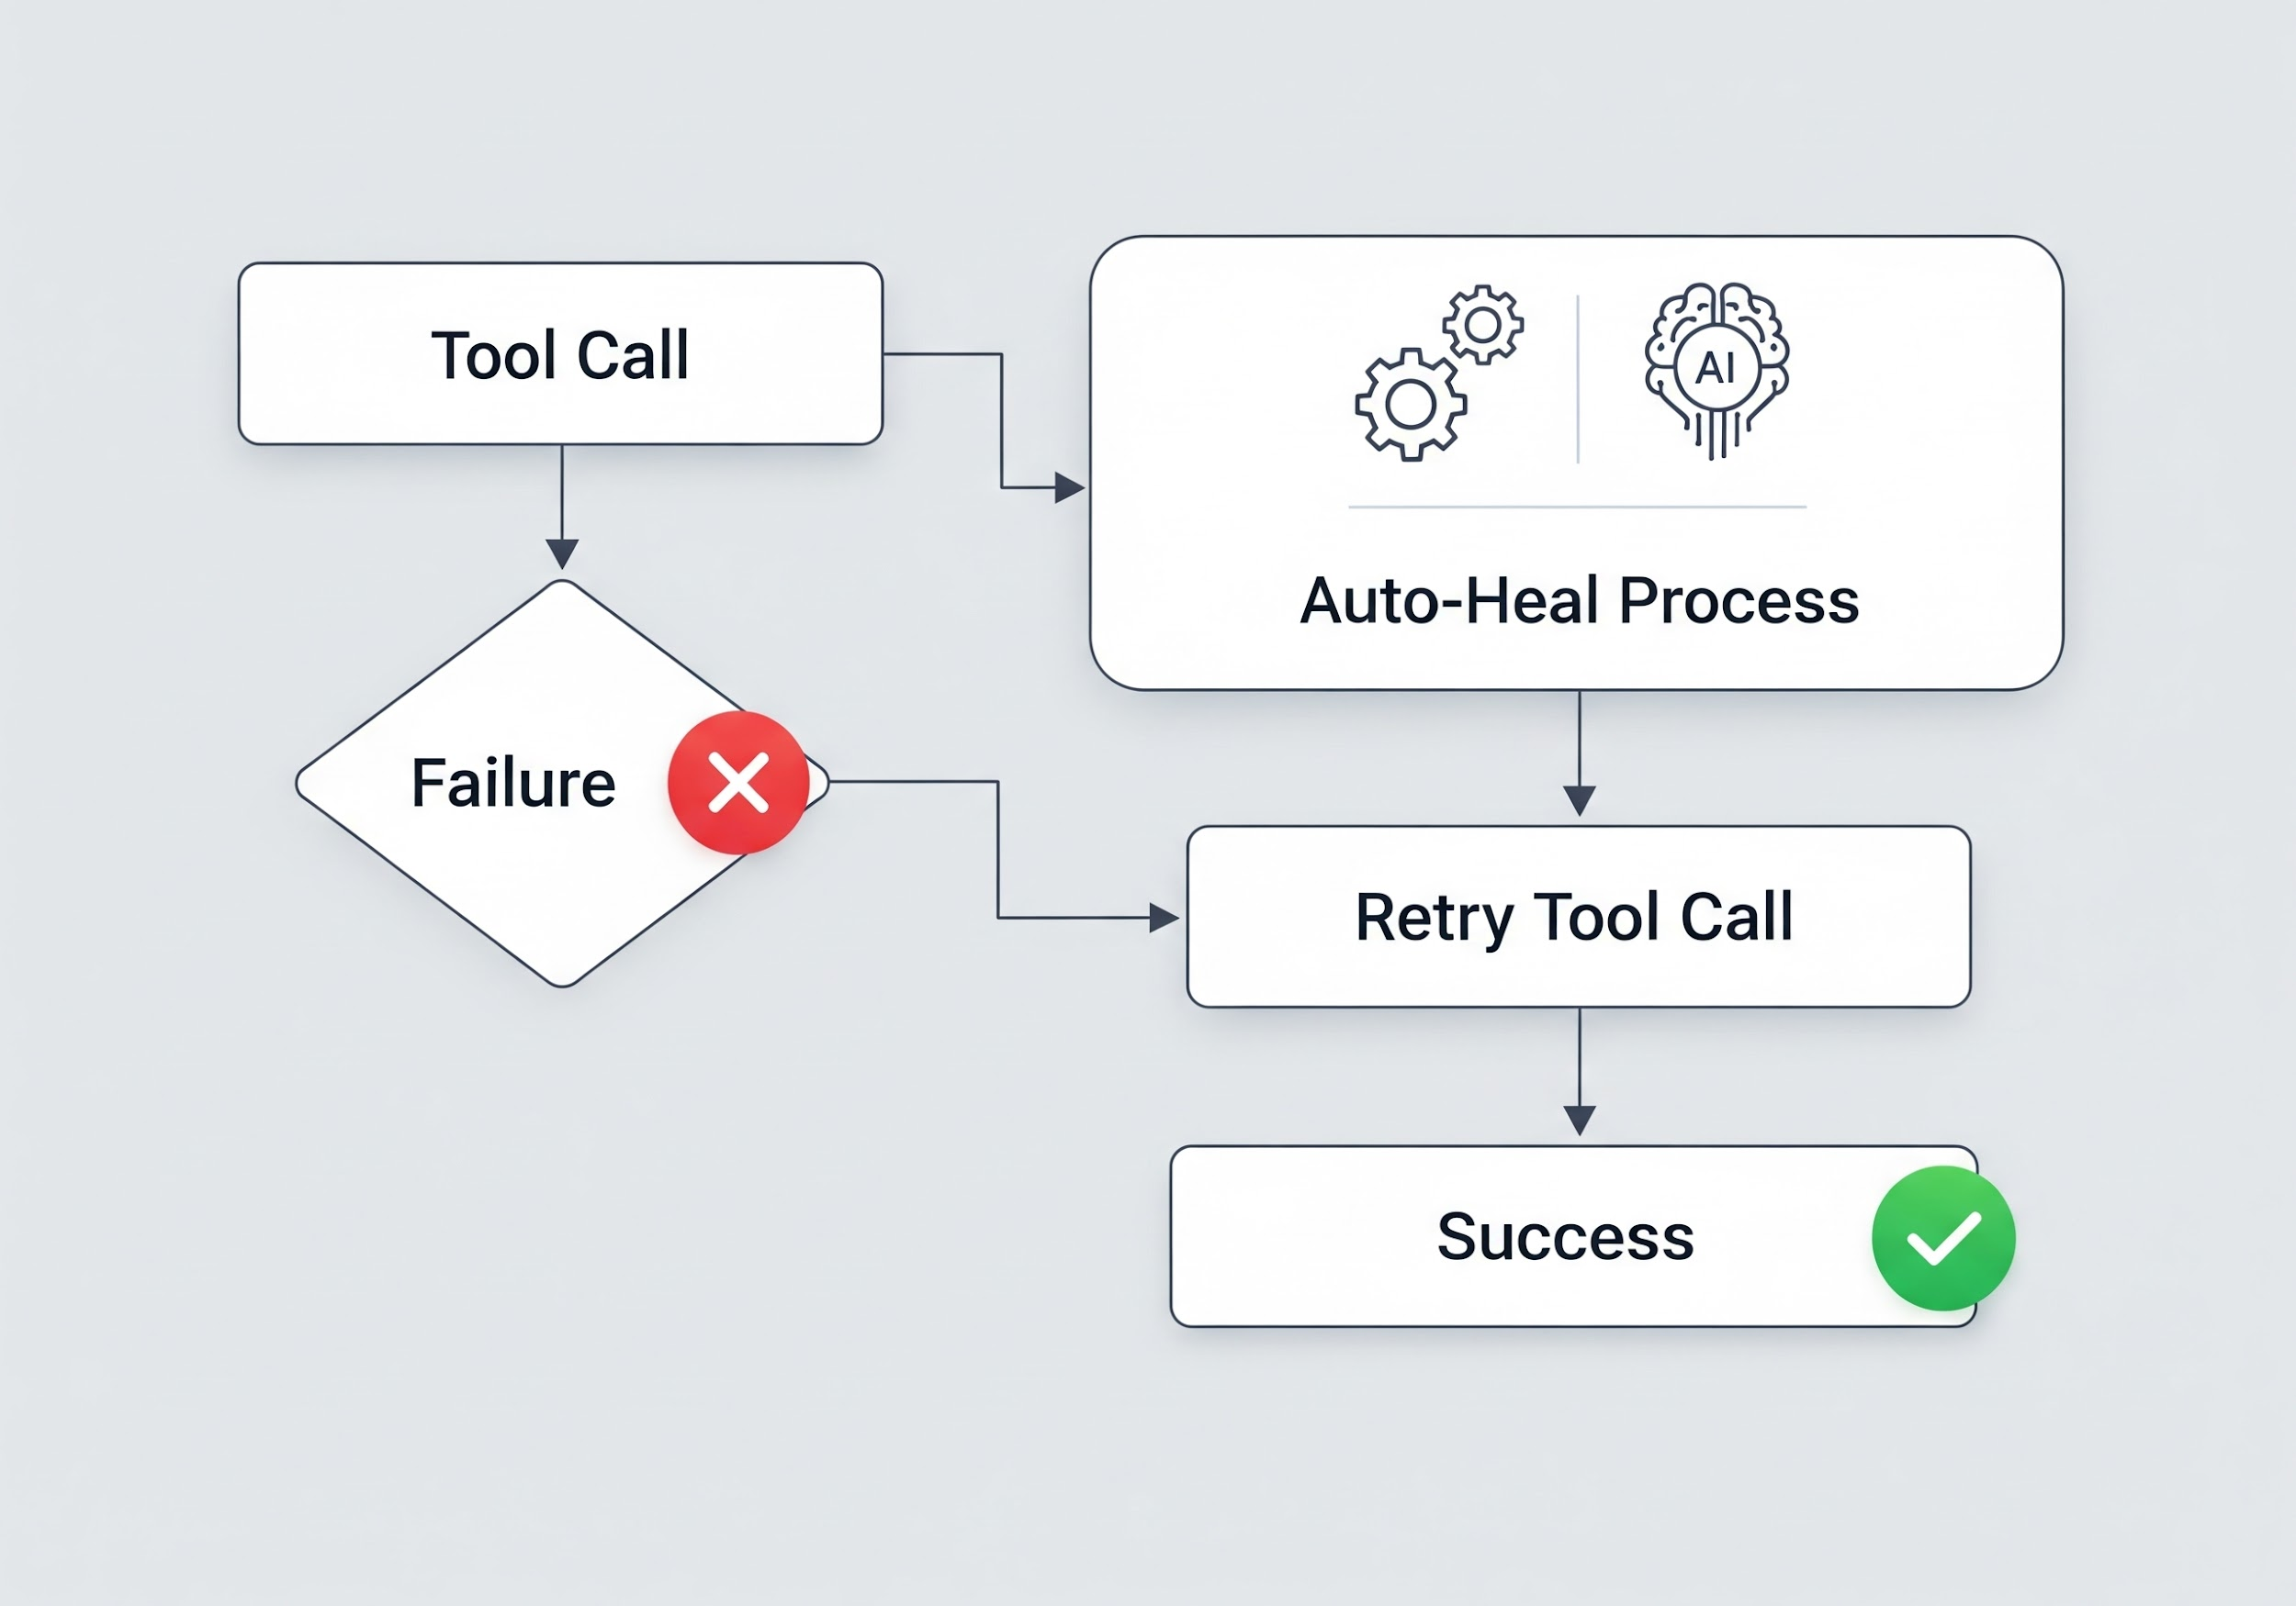
Tool-Level Auto-Heal
How It Works
Tool Call → Failure → Detect Pattern → Apply Fix → Retry → Success
Python Decorators
from server.auto_heal_decorator import auto_heal_k8s @registry.tool() @auto_heal_k8s() async def kubectl_get_pods(namespace: str, environment: str = "stage"): """Get pods - auto-heals VPN/auth failures.""" # If this fails with auth/VPN issues, the decorator # automatically runs kube_login or vpn_connect and retries ...
Available Decorators
Decorator | Environment | Use Case
`@auto_heal_ephemeral()` | Ephemeral | Bonfire tools
`@auto_heal_konflux()` | Konflux | Build pipelines
`@auto_heal_k8s()` | Stage/Prod | Kubectl tools
`@auto_heal_jira()` | - | Jira tools
`@auto_heal_git()` | - | Git/GitLab tools
Notes:
Every tool in the system is wrapped with an auto-heal decorator. When a tool fails, the decorator checks the error pattern, applies the appropriate fix (VPN connect or kube login), and retries automatically. You don't even notice the failure.

Slide 27
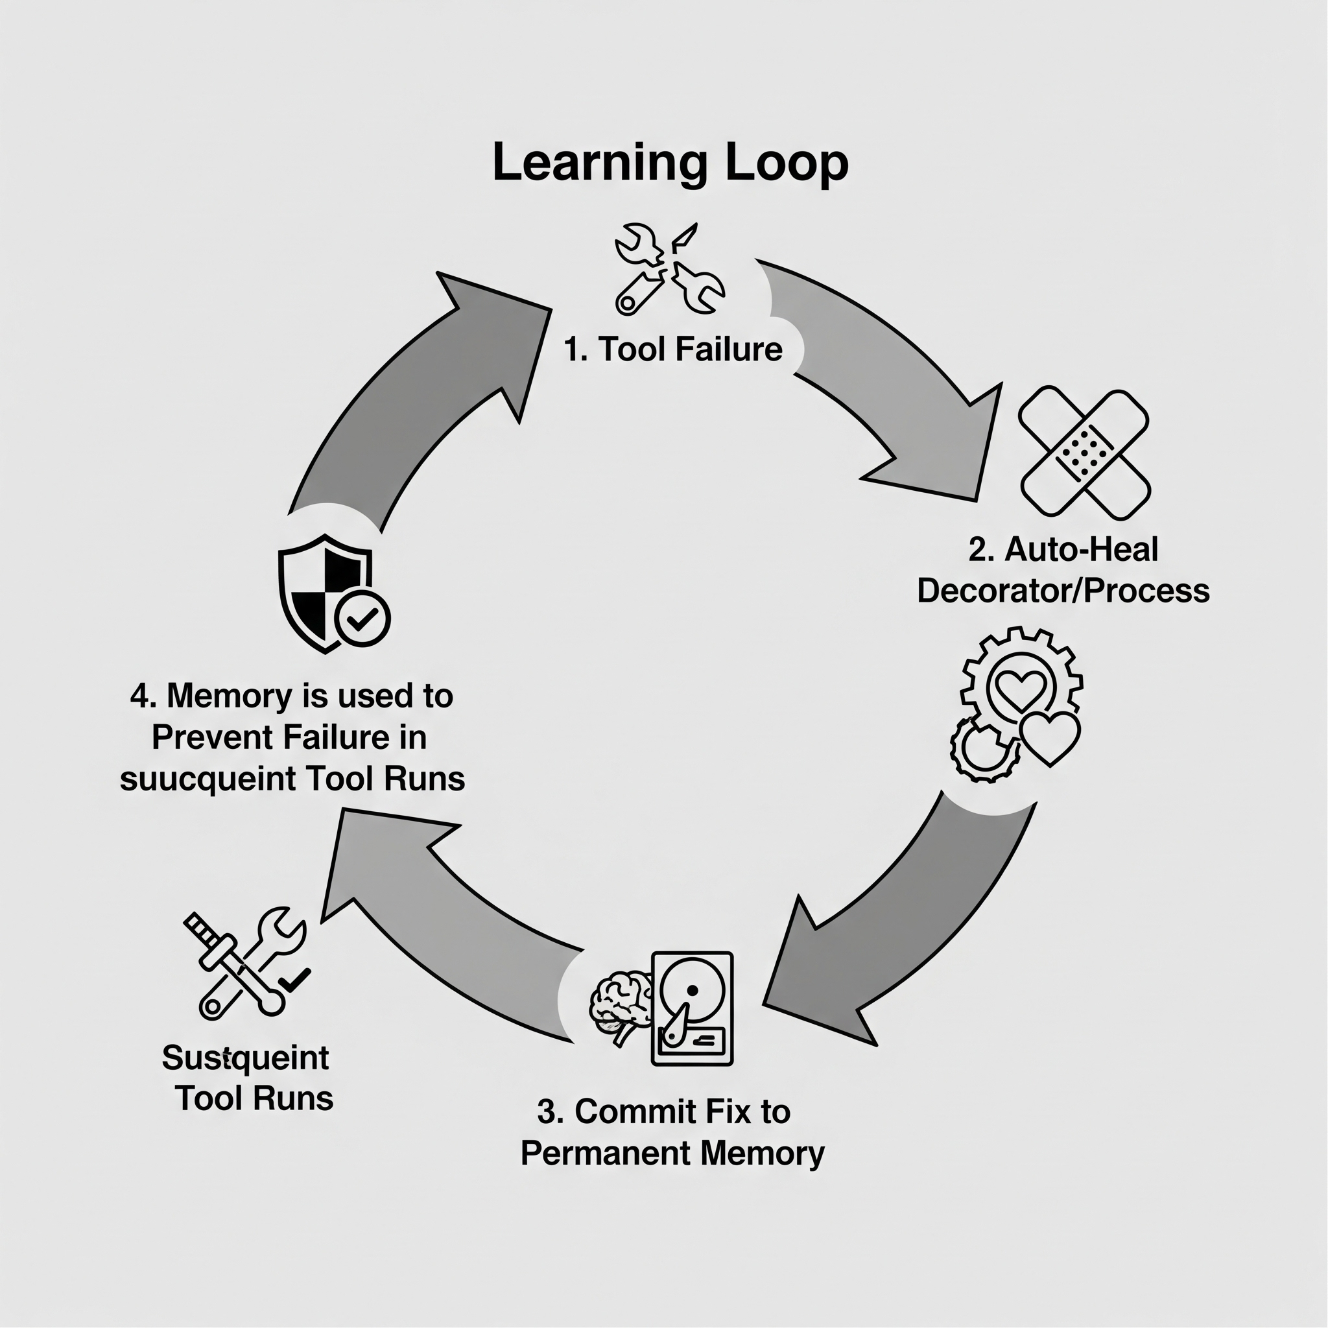
The Learning Loop
Flow
Key Insight: Fixes are remembered forever - the same mistake never happens twice!
Notes:
The learning loop ensures continuous improvement. When a tool fails, we first check if we've seen this error before. If yes, apply the known fix. If no, debug the issue, fix it, and save the fix for next time. Over time, the system gets smarter.

Slide 28
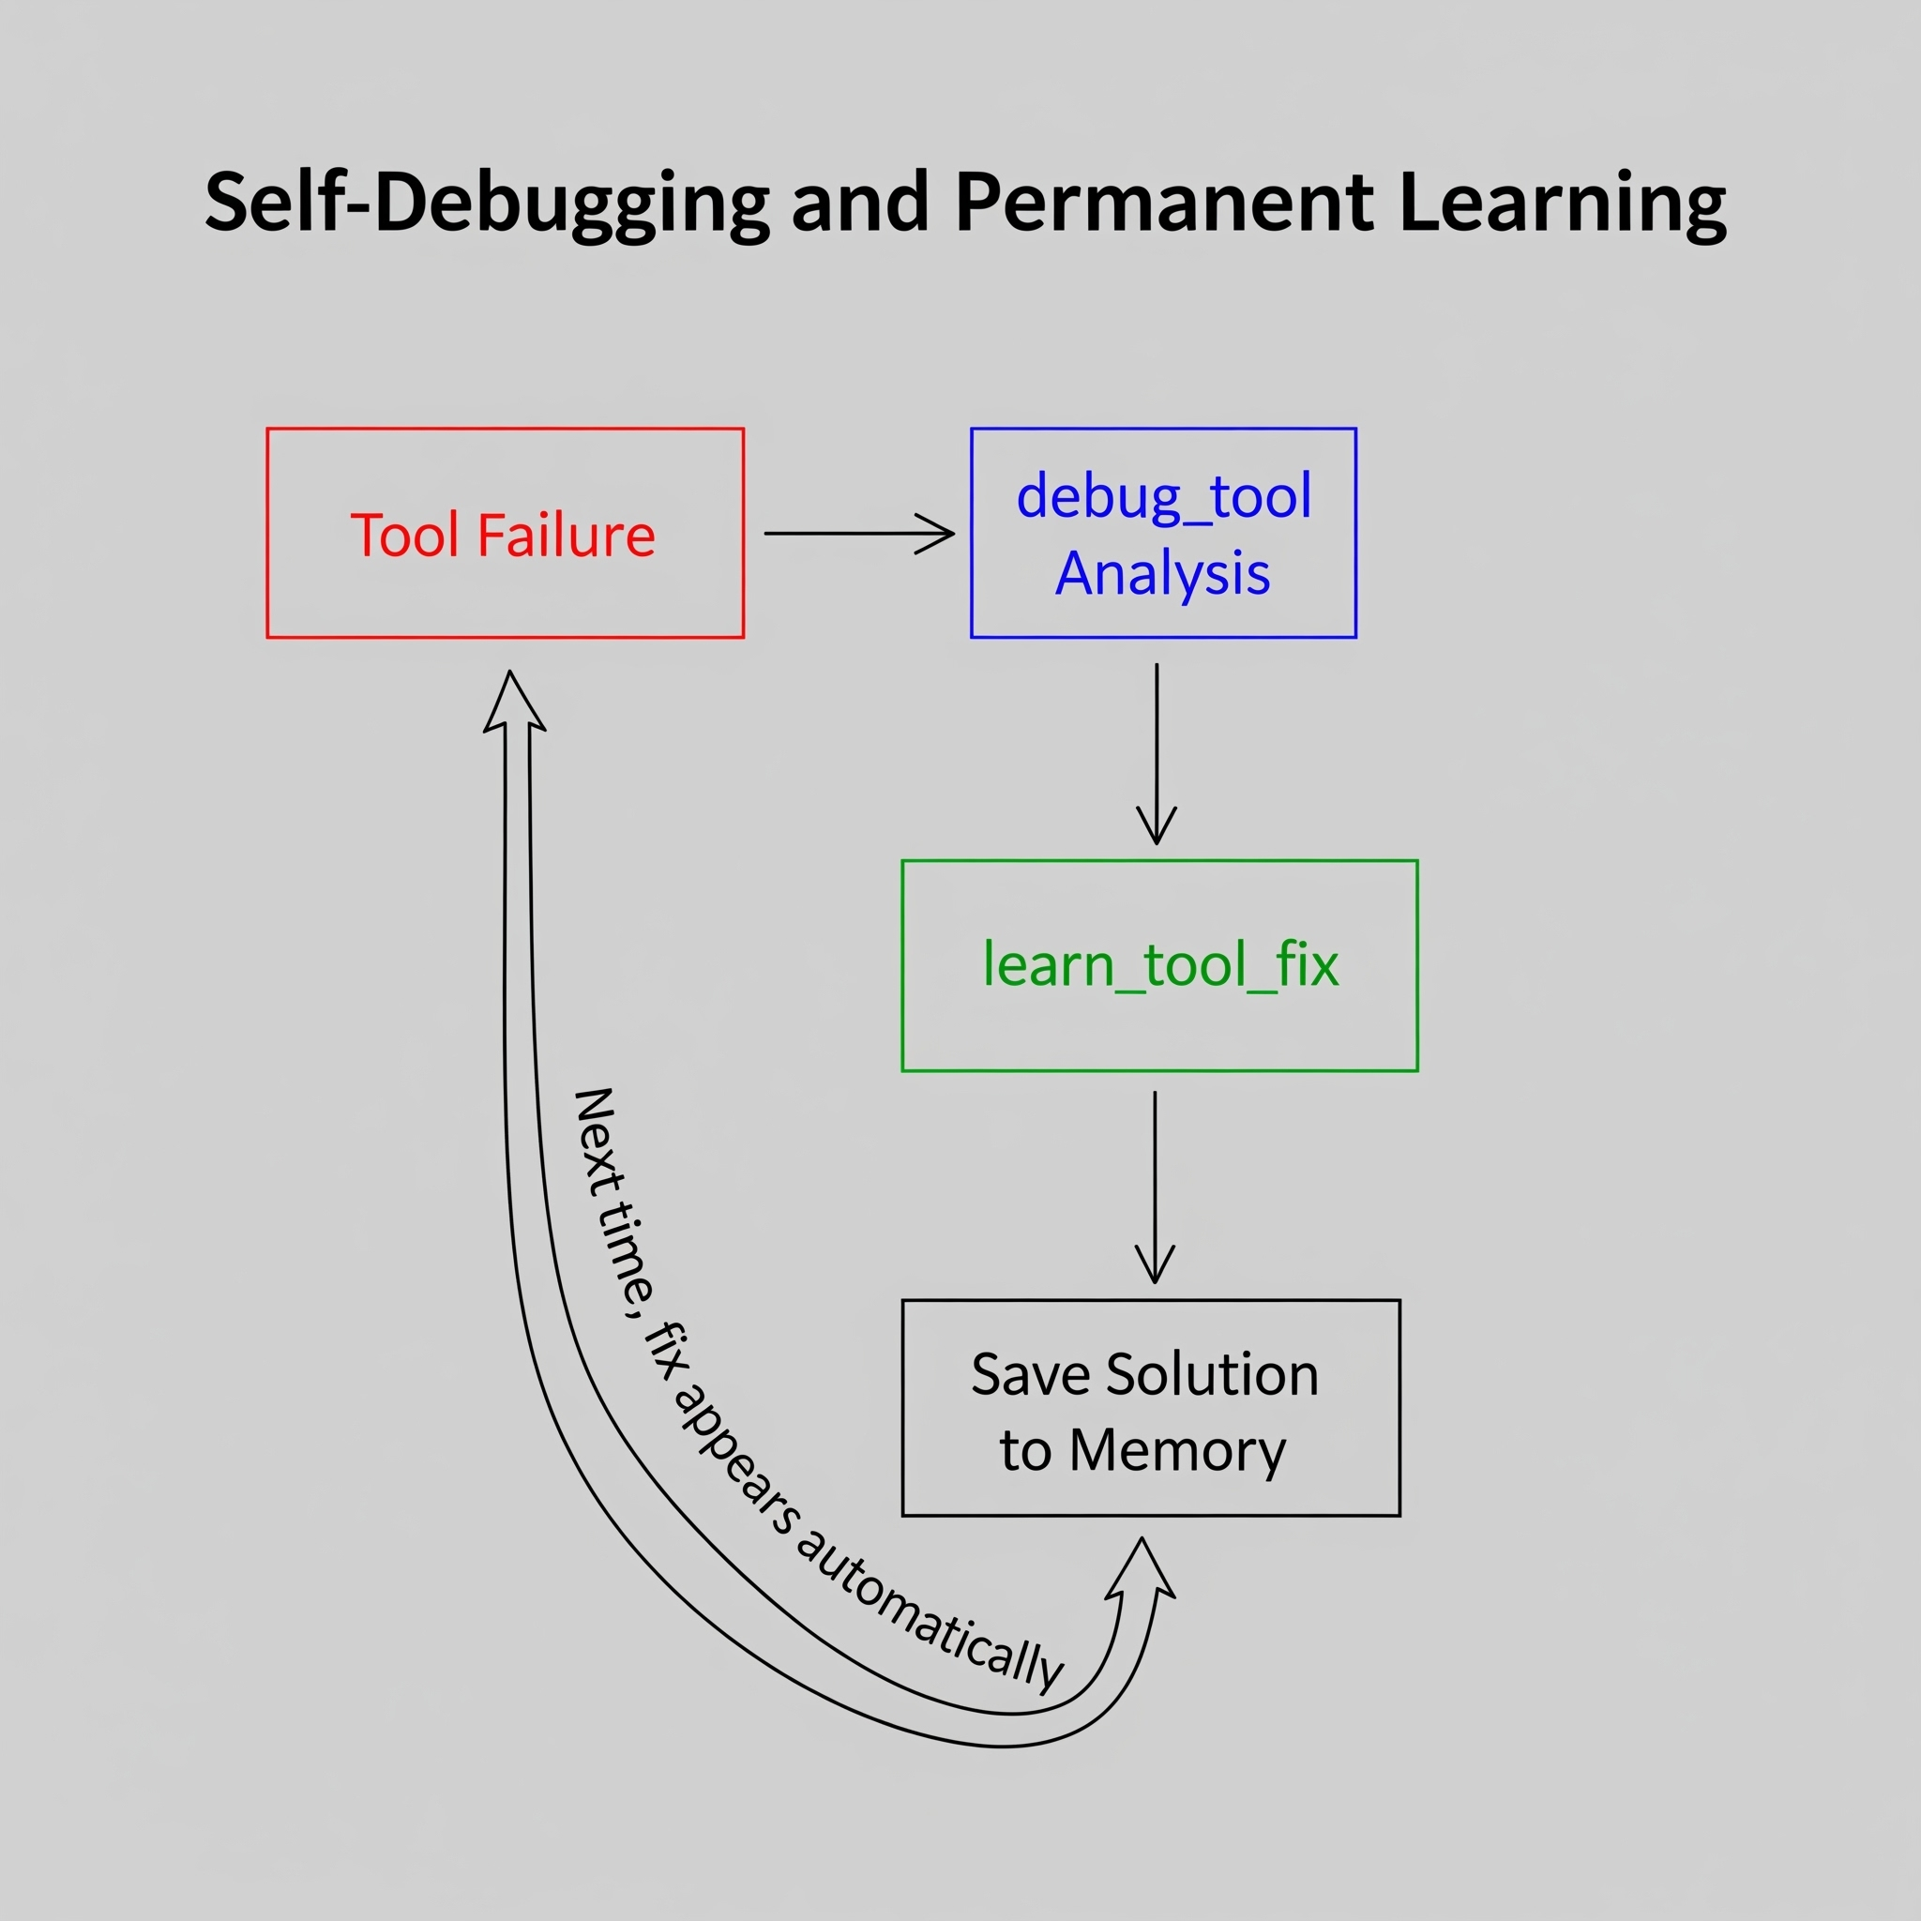
debug_tool + learn_tool_fix
debug_tool("bonfire_deploy", "manifest unknown: image not found")
• Source file location
• Function code
• Step-by-step fix instructions
• Reminder to save the fix
learn_tool_fix( tool_name="bonfire_deploy", error_pattern="manifest unknown", root_cause="Short SHA doesn't exist in Quay", fix_description="Use full 40-char SHA instead of 8-char" )
Next time: The fix appears automatically!
Notes:
These two tools enable self-healing at a deeper level. debug_tool lets Claude analyze its own source code to find bugs. learn_tool_fix saves that knowledge permanently. The AI literally fixes itself and remembers how.

Slide 29
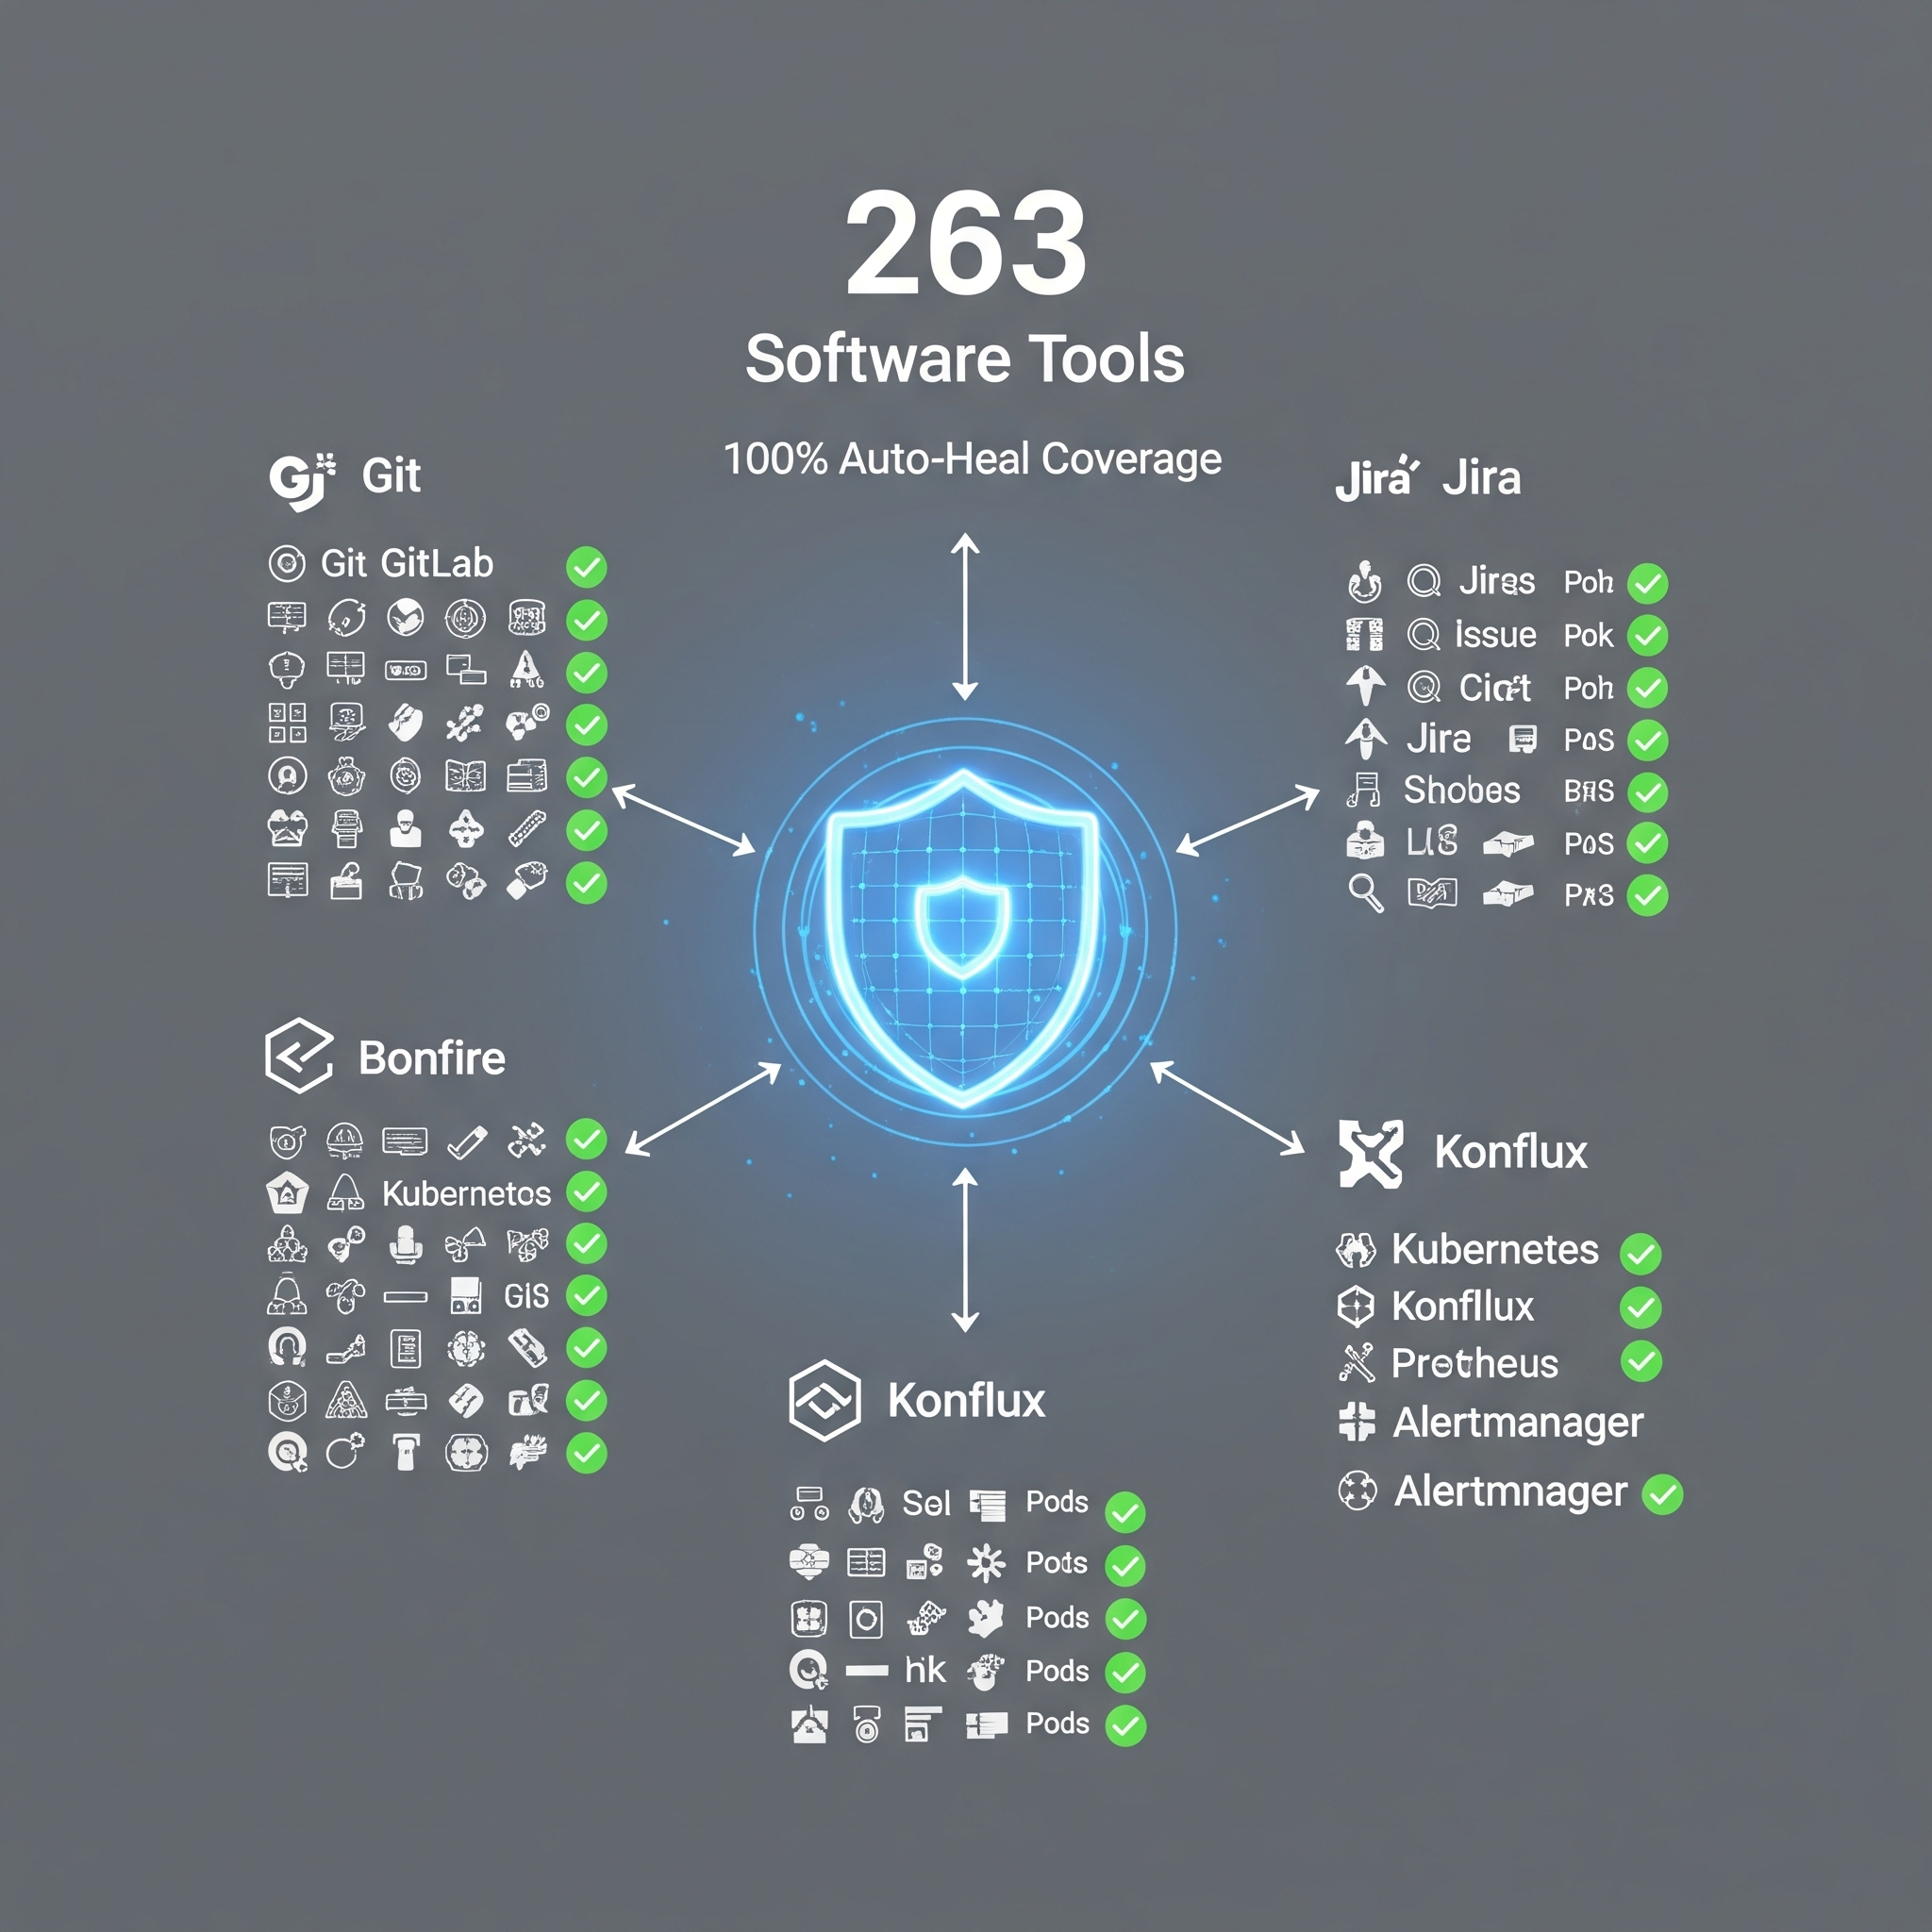
Coverage
All 263 tools have auto-heal decorators
Module | Tools | Auto-Heal
Git tools | 30 | ✅ @auto_heal()
GitLab tools | 30 | ✅ @auto_heal()
Jira tools | 28 | ✅ @auto_heal()
K8s tools | 28 | ✅ @auto_heal_k8s()
Bonfire tools | 20 | ✅ @auto_heal_ephemeral()
Konflux tools | 35 | ✅ @auto_heal_konflux()
Prometheus tools | 13 | ✅ @auto_heal()
Alertmanager tools | 7 | ✅ @auto_heal()
... | ... | ✅
Result: Seamless experience even when infrastructure is flaky
Notes:
This isn't a partial solution - every single tool in the system has auto-heal. Every skill retries after fixes. The result is a remarkably resilient system that handles infrastructure issues transparently.

Slide 30
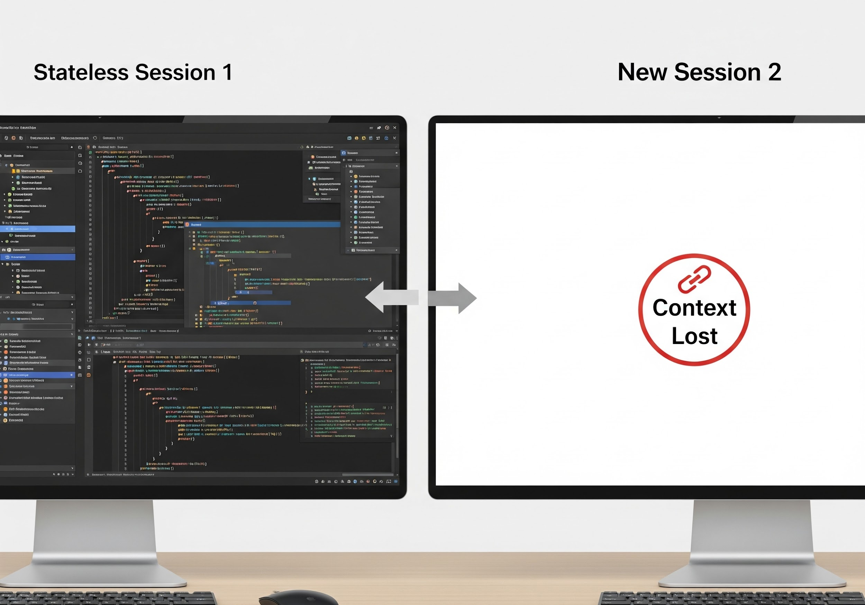
Why Memory Matters
The Problem
• Claude is stateless by default
• Each session starts fresh
• Context is lost between conversations
• "What was I working on?" - You have to explain every time
What We Need
• Track current work (issues, branches, MRs)
• Remember learned patterns
• Maintain session continuity
• Prevent repeated mistakes
Visual: Session 1 context being lost, Session 2 starting fresh
Notes:
By default, every Claude session is a blank slate. This is frustrating when you're in the middle of complex work. You shouldn't have to re-explain your context every time. Memory solves this by persisting important state.

Slide 31
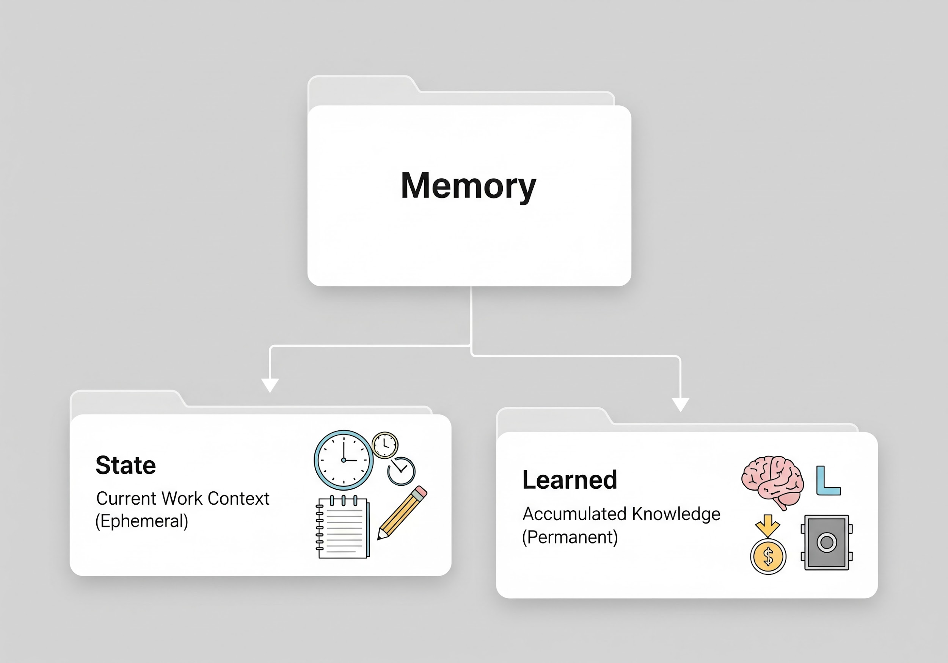
Memory Structure
Two Categories
memory/ ├── state/ # Current work context │ ├── current_work.yaml # Active issues, branches, MRs │ └── environments.yaml # Stage/prod health status │ └── learned/ # Accumulated knowledge ├── patterns.yaml # Error patterns & solutions ├── tool_fixes.yaml # Tool-specific fixes ...
State: What you're working on right now
Learned: Knowledge accumulated over time
Notes:
Memory is organized into two categories. State is your current work context - what you're working on today. Learned is accumulated knowledge - patterns and fixes discovered over time. Both persist across sessions.

Slide 32
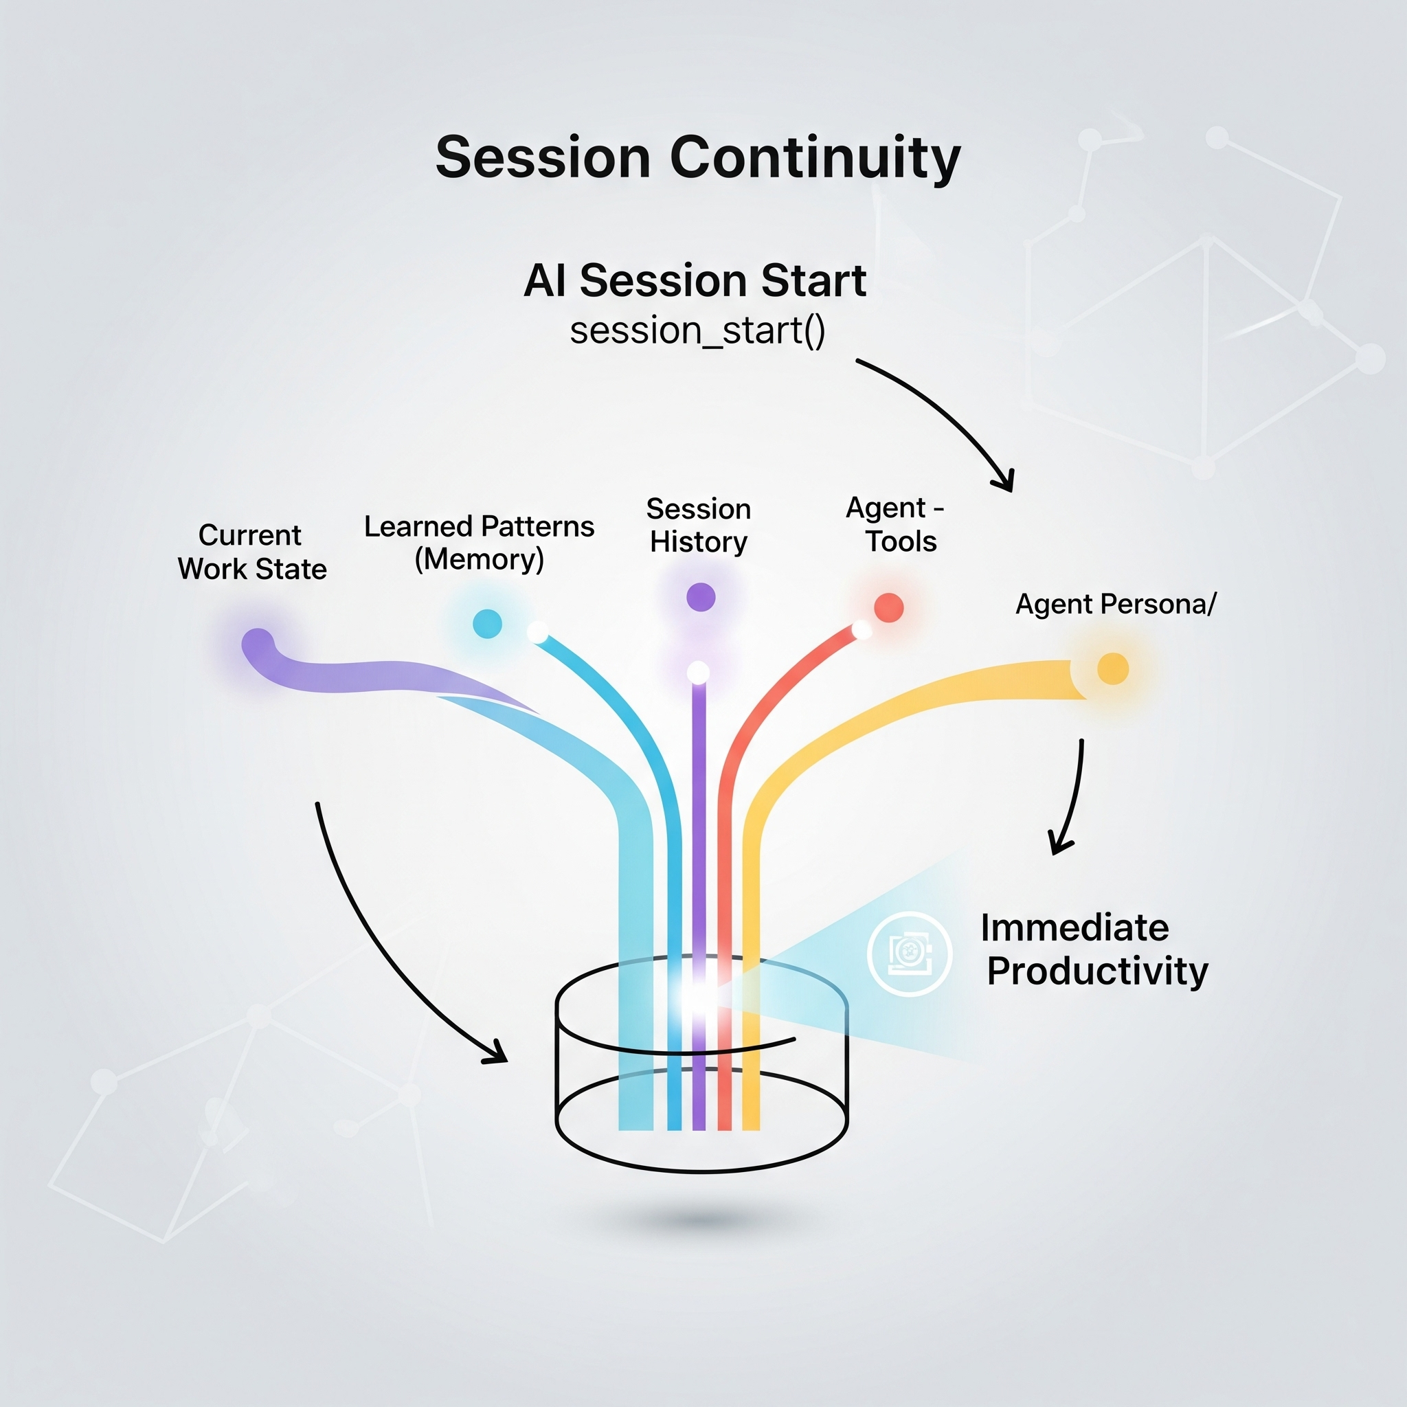
Session Continuity
session_start(agent="developer")
What It Loads
• ✅ Current work state (active issues, branches, MRs)
• ✅ Today's session history (if resuming)
• ✅ Learned patterns (count by category)
• ✅ Agent persona with tools
Example Output
📋 Session Started 🧠 Learned Patterns: 12 patterns loaded - Jira CLI: 3 patterns - Error handling: 5 patterns - Authentication: 4 patterns 🛠️ Currently Loaded Tools: git, gitlab, jira (~78 tools) 📍 Current Work: ...
Notes:
session_start is the first tool you call. It loads your entire context - what you were working on, what patterns have been learned, which tools are available. You're immediately productive, no re-explanation needed.

Slide 33
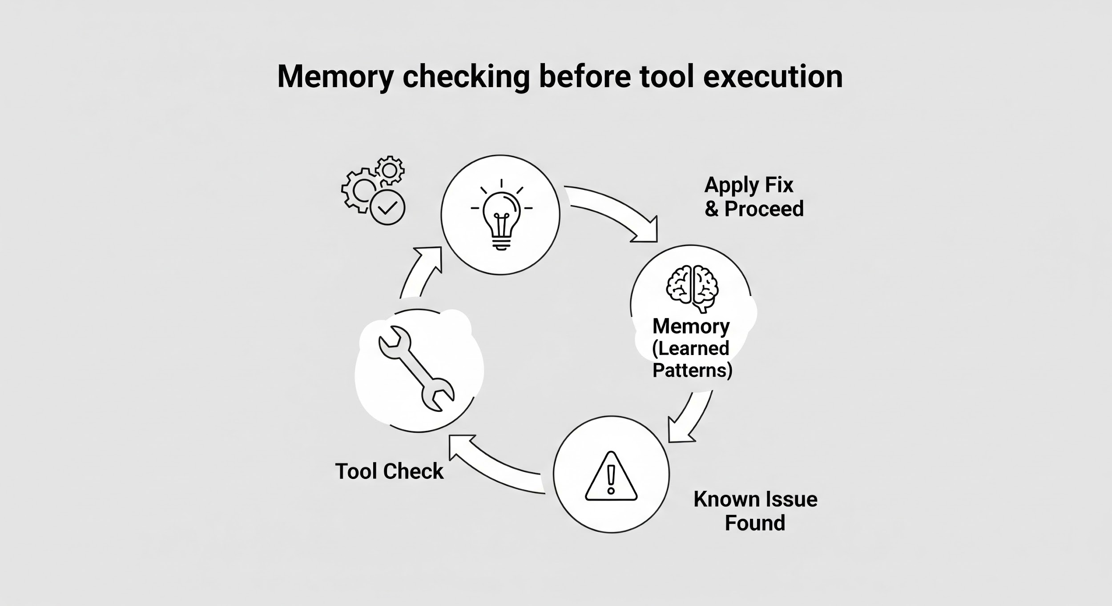
Error Prevention
# Before a risky operation check_known_issues(tool_name="bonfire_deploy") # After a failure check_known_issues(error_text="manifest unknown")
Output
## 💡 Known Issues Found! **Previous fix for `bonfire_deploy`:** - Pattern: `manifest unknown` - Root cause: Short SHA doesn't exist in Quay - **Fix:** Use full 40-char SHA instead of 8-char
Memory Files Updated Automatically
• Failures logged with timestamps
• Success rates tracked
• Patterns deduplicated
Notes:
Memory isn't just for loading context - it actively prevents errors. Before risky operations, Claude can check for known issues. After failures, it can recall how we fixed this last time. The system gets smarter with every use.

Slide 34
The Context Engineering Challenge

Slide 35
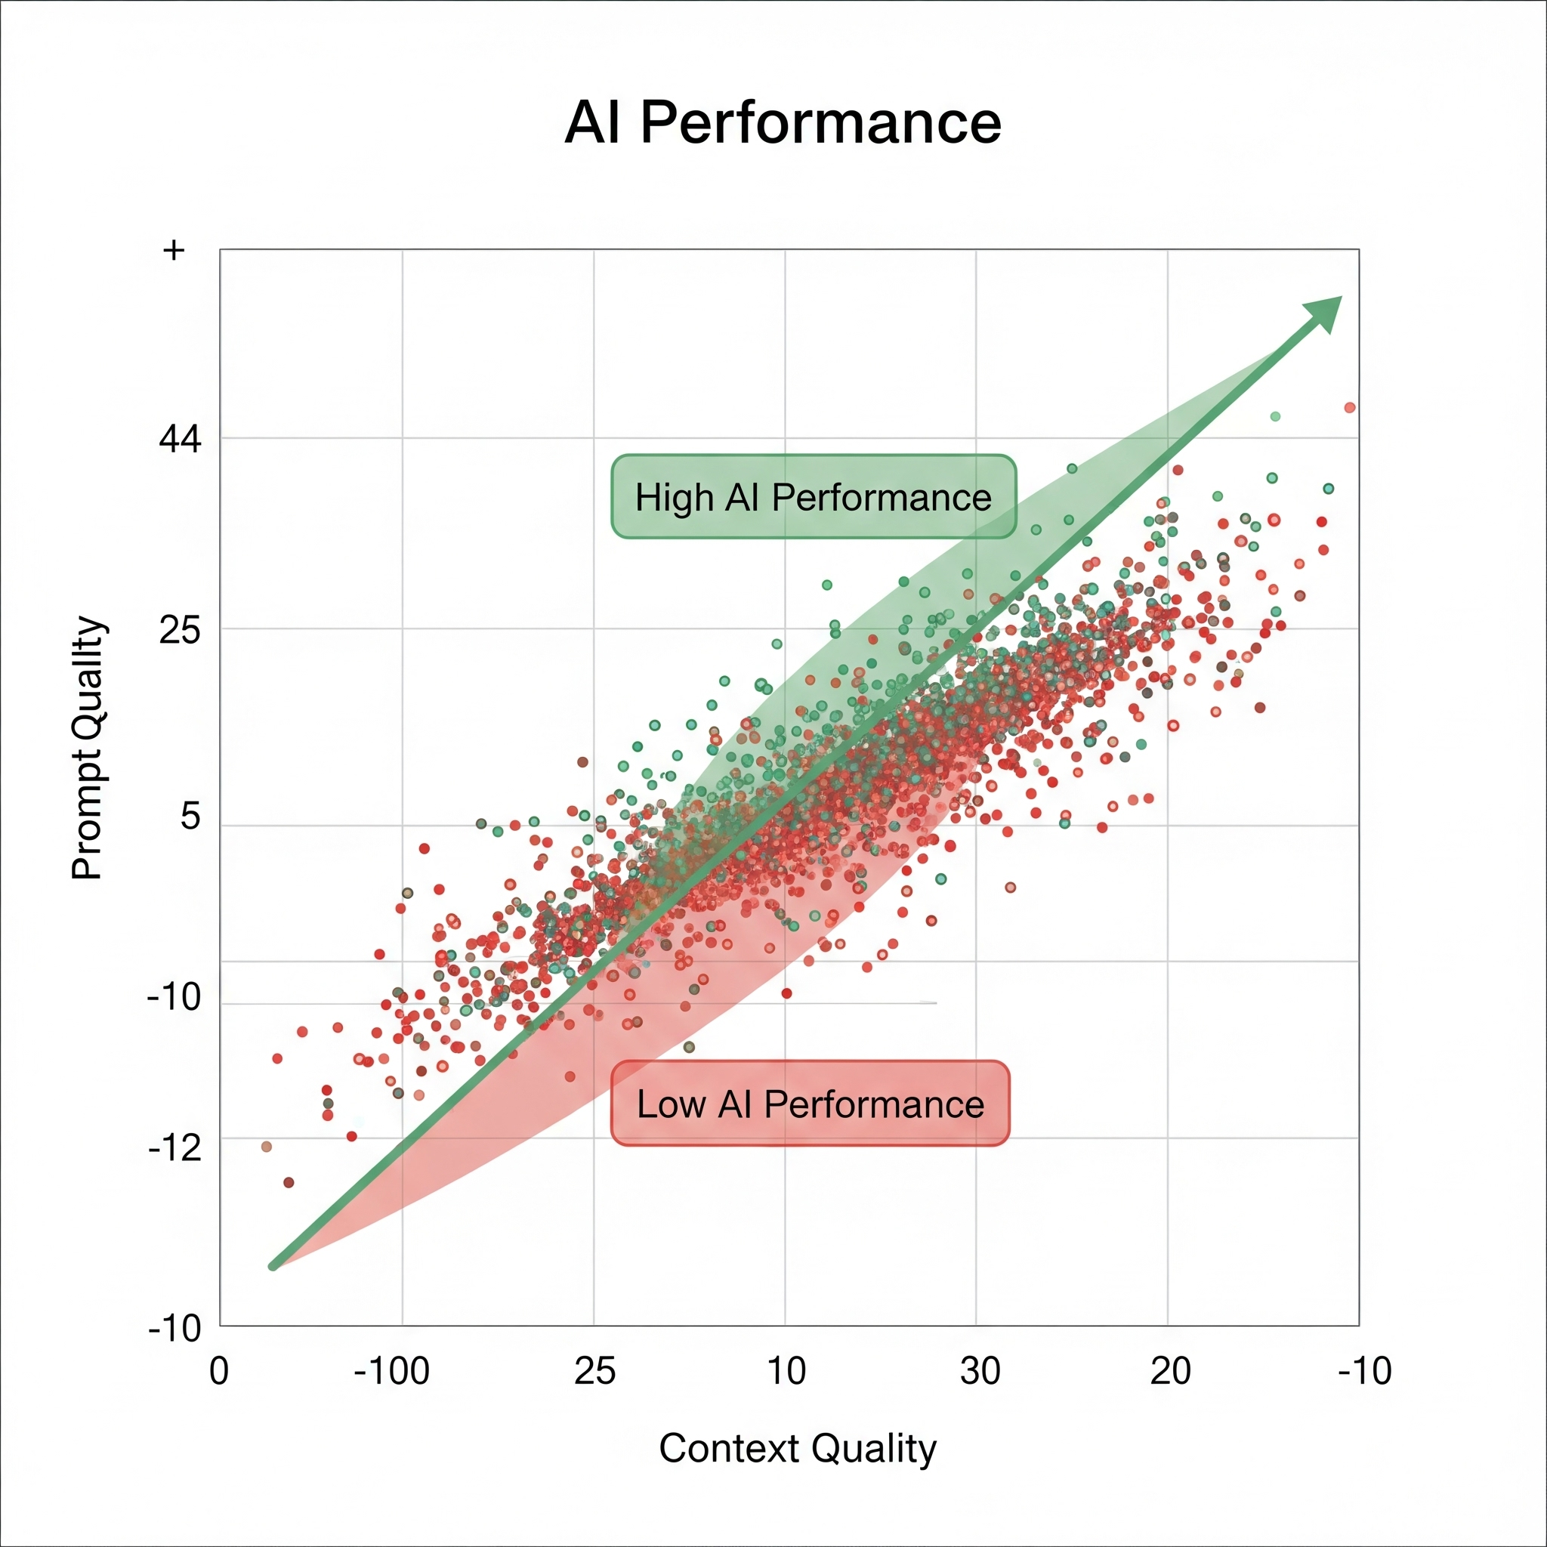
Prompt vs Context Engineering
Key Points
• Prompt Engineering: Crafting better instructions for each task
• Context Engineering: Managing what the AI knows before the task
• Both are essential for consistent outcomes
• We've been doing both - tools, skills, memory, personas
Notes:
Prompt engineering is about asking better questions. Context engineering is about ensuring the AI has the right background knowledge. We've been doing both - skills handle prompts, memory handles context. Now we're adding a knowledge layer.

Slide 36
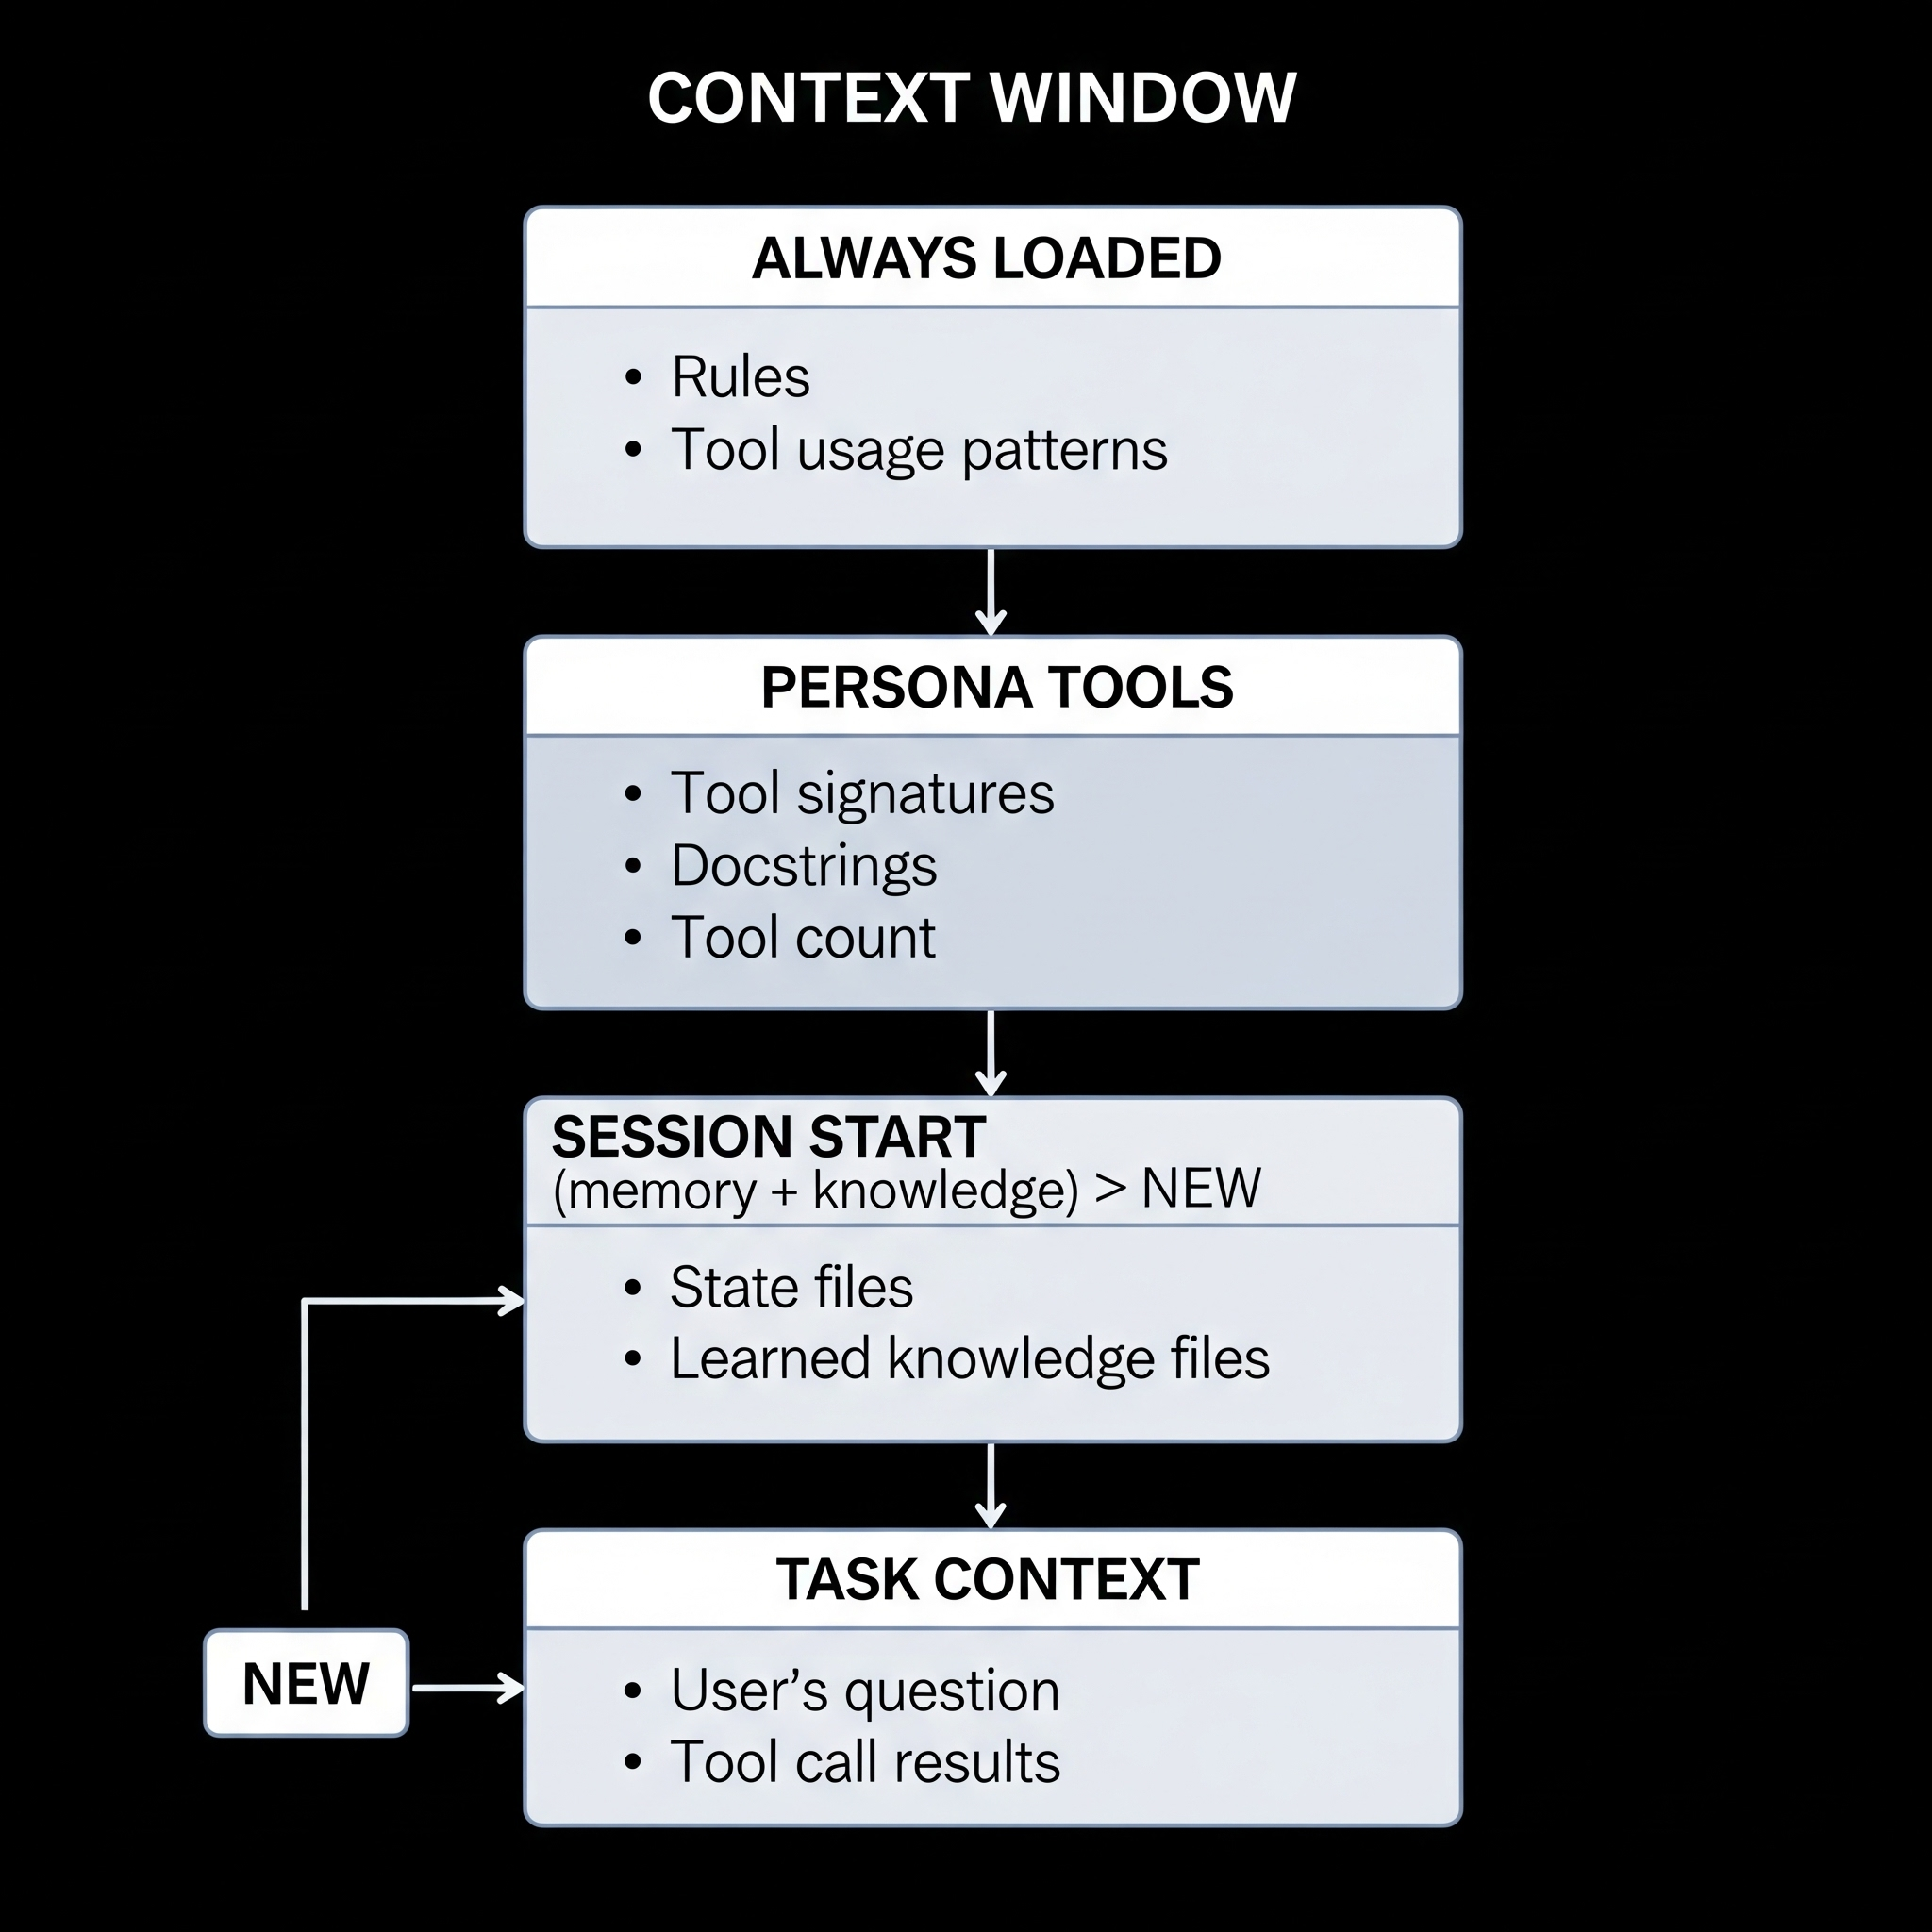
The Context Window
Key Points
• Claude has ~128K-200K token context window
• Everything the AI "knows" must fit in this window
• Includes: System prompt, tools, memory, user messages, file contents
Notes:
The context window is finite but large. Our baseline - rules, tools, memory - uses only about 3% of available space. We have plenty of room for knowledge without crowding out task context.

Slide 37
What We Already Manage
Key Points
• Personas (fastmcp): Control which tools are loaded (~74-91 tools)
• Memory: Persist state across sessions
• Skills: Encode best practices into workflows
• Auto-heal: Learn from failures
Notes:
We already manage context well - personas reduce tool count by 30%, skills encode workflows, memory persists state. But we're missing project-specific knowledge that varies by persona.

Slide 38
Knowledge Layer

Slide 39
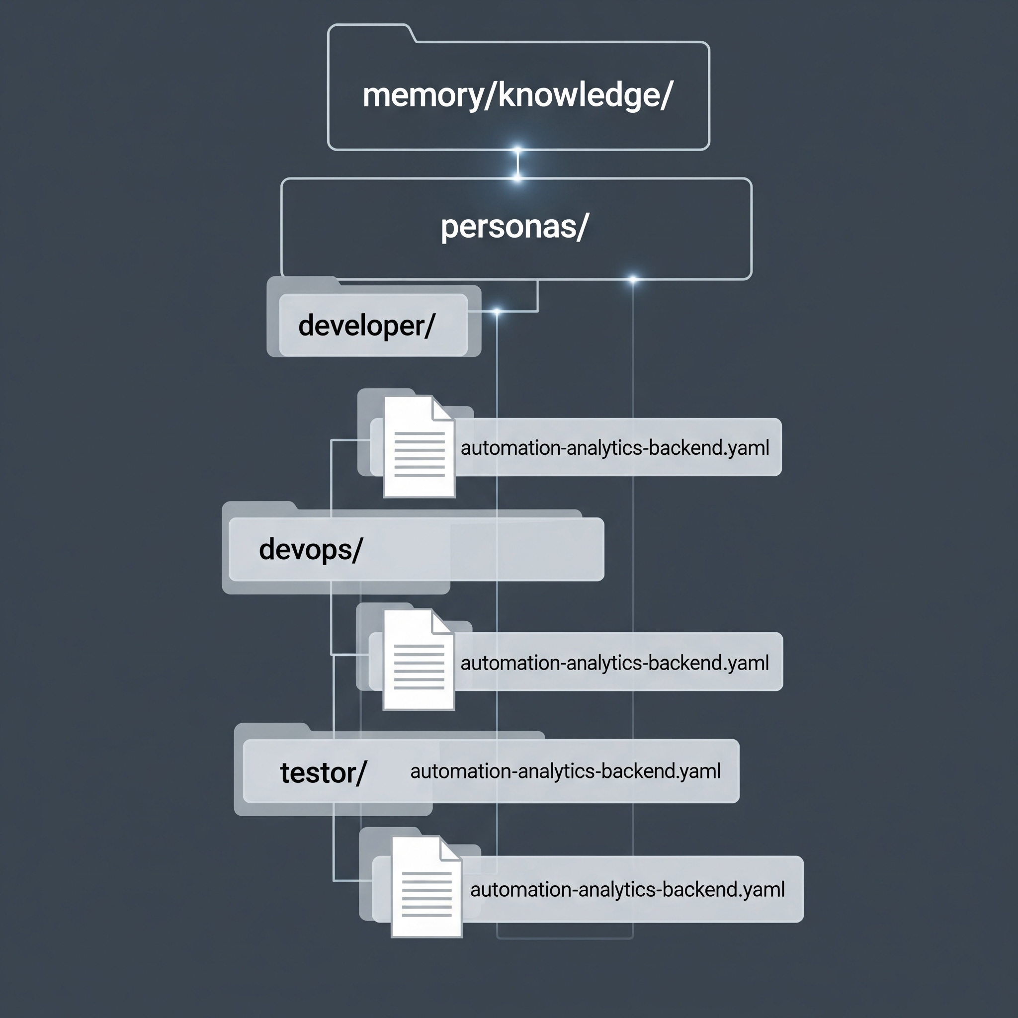
Introducing the Knowledge Layer
Key Points
• Project-specific knowledge per persona
• Architecture, patterns, gotchas, testing approaches
• Auto-loaded at session start
• AI builds and maintains it
Notes:
The knowledge layer adds project-specific context that varies by persona. A developer needs to know about code patterns. A devops engineer needs deployment details. Same project, different knowledge.

Slide 40
Knowledge Schema
Developer Knowledge
architecture: framework: FastAPI database: PostgreSQL orm: SQLAlchemy cache: Redis patterns: api: "RESTful with OpenAPI" ...
DevOps Knowledge
deployment: platform: Konflux namespace: aap-aa-tenant ephemeral: clowdapp: tower-analytics-clowdapp image_base: quay.io/redhat-user-workloads/...
Notes:
Each persona gets different knowledge. Developers see code patterns and gotchas. DevOps sees deployment details. The schema is flexible - whatever helps that persona be effective.

Slide 41
Build vs Pre-load Trade-off
Without Pre-loaded Knowledge
User: "Add a new API endpoint" AI: [reads directory structure] ← 1 tool call AI: [reads existing endpoint] ← 1 tool call AI: [reads test file] ← 1 tool call AI: [reads conftest.py] ← 1 tool call AI: [makes changes] AI: [runs tests, hits UTC gotcha] ← Failure! ...
With Pre-loaded Knowledge
User: "Add a new API endpoint" AI: [already knows: FastAPI, SQLAlchemy, pytest, UTC timestamps] AI: [makes changes following known patterns] AI: [runs tests] ← Success!
Time saved: 3-5 minutes per task
Notes:
Without knowledge, the AI has to rediscover patterns every time. With knowledge, it starts with understanding. The gotchas section is especially valuable - prevents hitting the same issues repeatedly.

Slide 42
Auto-Loading at Session Start
How It Works
session_start(agent="developer") # 1. Detect current project from working directory project = detect_current_project() # "automation-analytics-backend" # 2. Get current persona persona = "developer" ...
Result: Context is ready before you ask your first question
Notes:
Knowledge loading is automatic. When you start a session, we detect your project and persona, then load the relevant knowledge. If none exists, we prompt you to generate it. Zero manual effort.

Slide 43
Knowledge Tools
Tool | Purpose
`knowledge_load(project, persona)` | Load knowledge into context
`knowledge_scan(project, persona)` | Scan project and generate knowledge
`knowledge_update(section, content)` | Update specific sections
`knowledge_learn(learning, task)` | Record learnings from tasks
`knowledge_list()` | List available knowledge files
Skills
Skill | Purpose
`bootstrap_knowledge` | Full scan for all personas
`learn_architecture` | Deep architecture analysis
Notes:
We have tools for every knowledge operation. Scan to generate, load to use, update to refine, learn to capture insights. The bootstrap skill generates knowledge for all personas at once.

Slide 44
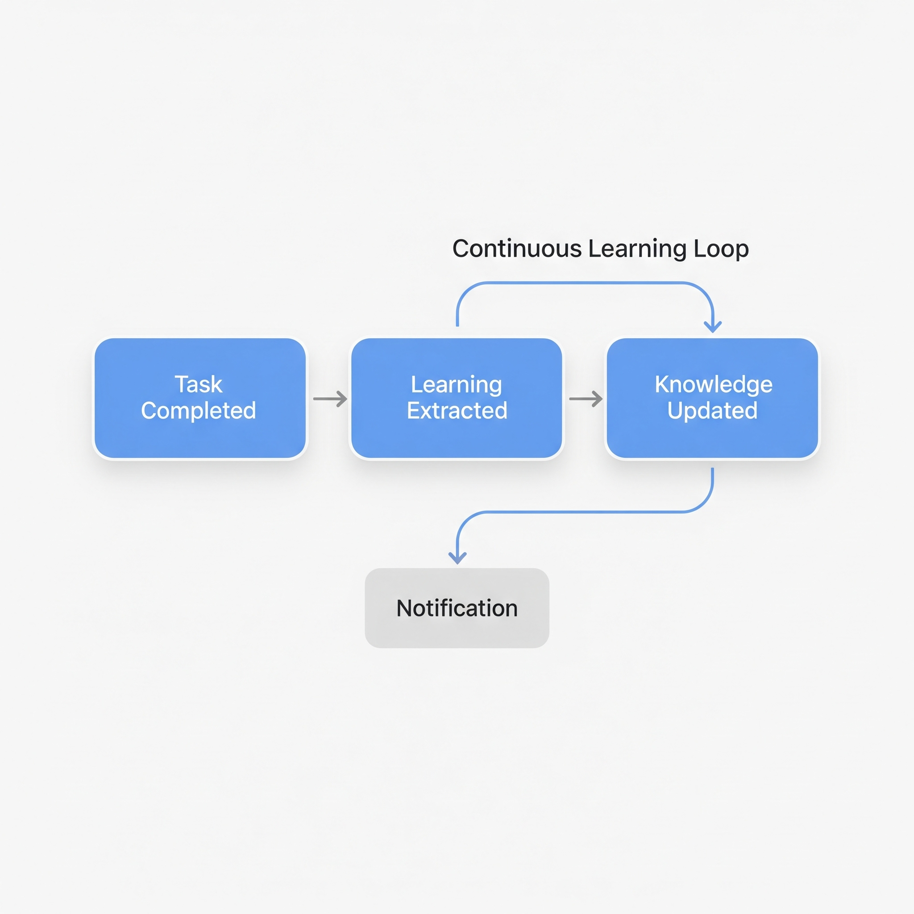
Continuous Learning
Key Points
• AI scans project to generate initial knowledge
• Learnings captured during task completion
• Notifications when knowledge is updated
• Human reviews significant changes
Notes:
The AI doesn't just consume knowledge - it builds it. When completing tasks, learnings are extracted and saved. You get notified of significant updates. Over time, the knowledge base grows automatically.

Slide 45
Project Management

Slide 46
Managing Projects in config.json
The Problem
• Projects defined in config.json
• Manual editing is error-prone
• Settings need to be detected, not guessed
The Solution: Project management tools
Tool | Purpose
`project_list()` | List all configured projects
`project_detect(path)` | Auto-detect project settings
`project_add(...)` | Add a new project
`project_update(...)` | Update project settings
`project_remove(...)` | Remove a project
Notes:
We now have tools to manage projects in config.json. No more manual editing. The tools auto-detect settings from the project directory - language, branch, lint commands, test commands.

Slide 47
Auto-Detection
What Gets Detected
Setting | Detection Method
Language | pyproject.toml, package.json, go.mod
Default branch | git symbolic-ref refs/remotes/origin/HEAD
GitLab remote | git remote get-url origin
Lint command | Config files (black, flake8, eslint)
Test command | Test framework detection
Scopes | Directory structure
Example
project_detect(path="/home/user/src/new-project") # Output: # Language: python # Default Branch: main # GitLab: myorg/new-project # Lint Command: black --check . && flake8 . # Test Command: pytest tests/ -v ...
Notes:
Auto-detection examines the project directory and figures out settings automatically. It checks for config files, git remotes, directory structure. You just confirm and add.

Slide 48
The add_project Skill
Skill Steps
1. detect_settings → Auto-detect from directory 2. validate_path → Verify path exists 3. get_project_name → Determine project name 4. check_gitlab_access → Verify GitLab is accessible 5. check_jira_access → Verify Jira project exists 6. add_project → Add to config.json 7. setup_quay_repo → Configure Quay (optional) 8. setup_bonfire_app → Configure Bonfire (optional) ...
Usage
skill_run("add_project", '{ "path": "/home/user/src/new-service", "jira_project": "AAP", "generate_knowledge": true }')
Notes:
The add_project skill handles the complete workflow. It detects settings, validates access, adds to config, and optionally generates knowledge. One command to onboard a new project.

Slide 49
Cursor Commands

Slide 50
New Slash Commands
Knowledge Commands
Command | Purpose
`/knowledge-scan` | Scan project for knowledge
`/knowledge-load` | Load knowledge into context
`/knowledge-update` | Update specific sections
`/knowledge-learn` | Record learnings
`/knowledge-list` | List knowledge files
`/bootstrap-knowledge` | Full knowledge generation
`/learn-architecture` | Deep architecture scan
Project Commands
Command | Purpose
`/add-project` | Add project to config
`/list-projects` | List configured projects
`/detect-project` | Auto-detect settings
`/remove-project` | Remove project
Notes:
All features are accessible via slash commands. Type /knowledge or /project to see options. Commands are documented in .cursor/commands/ directory.

Slide 51
VSCode Extension Updates
Key Points
• Extension now reads skill tags from YAML
• Skills auto-categorized by tags or name patterns
• New categories: Knowledge, Project
• Icons inferred from skill names
Before: Hardcoded skill lists
After: Dynamic detection from skills/ directory
New Categories
Category | Icon | Skills
Knowledge | 📚 | bootstrap_knowledge, learn_architecture
Project | 📁 | add_project
Notes:
The VSCode extension now dynamically detects skills. No more manual updates when adding new skills. It reads tags from YAML files and categorizes automatically.

Slide 52
Integrations

Slide 53
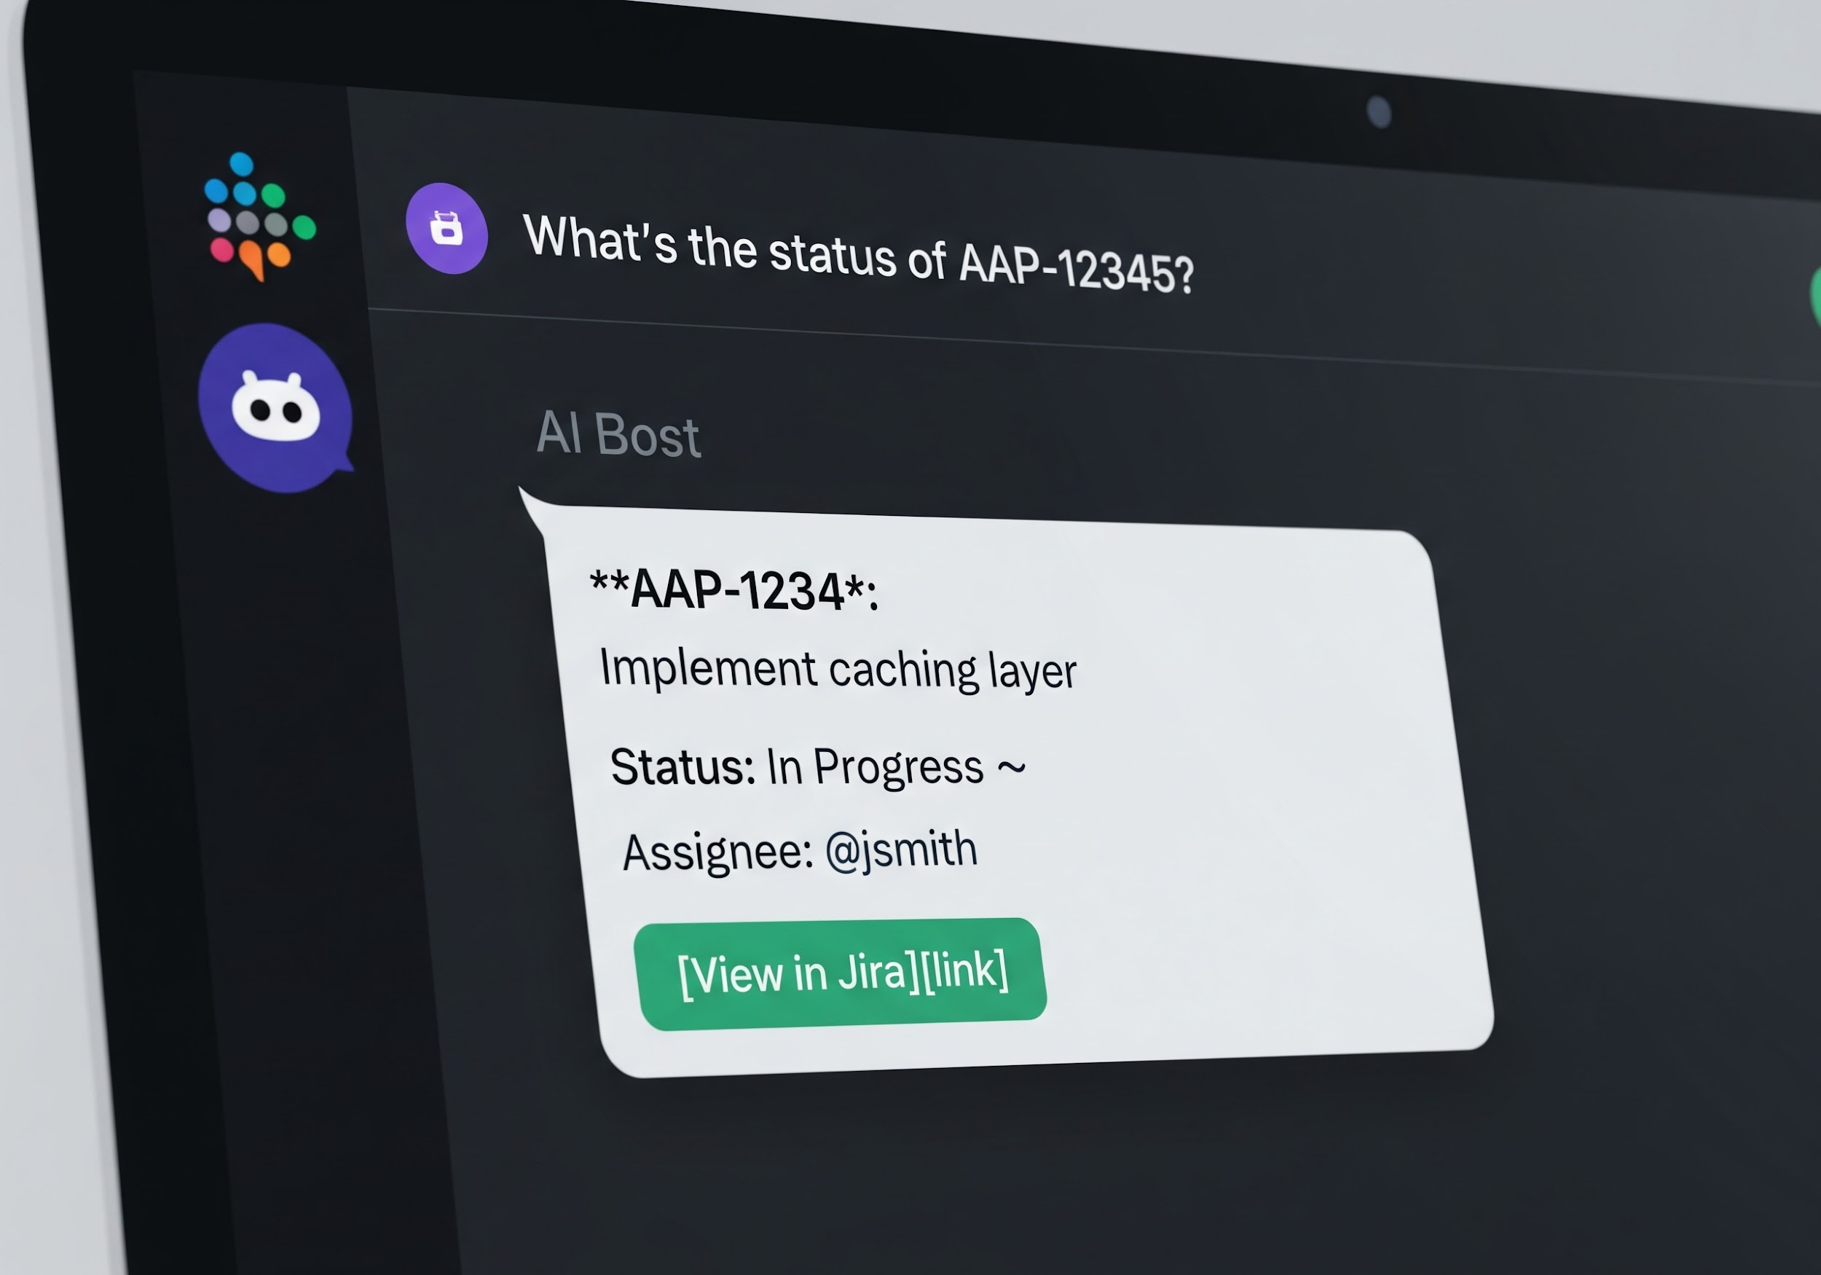
Slack Bot Integration
Capabilities
• Monitor channels for queries and alerts
• Respond to natural language requests
• Investigate alerts automatically
• Create Jira issues from conversations
• D-Bus IPC for control
Example Interaction
User: What's the status of AAP-12345? Bot: 📋 *AAP-12345*: Implement caching layer Status: In Progress 🔄 Assignee: @jsmith [View in Jira](link)
Visual: Screenshot of Slack conversation
Notes:
The Slack bot brings AI Workflow to where your team communicates. It monitors channels, understands intent, and responds using the same tools and skills. You can check Jira status, review PRs, or investigate alerts right from Slack.

Slide 54
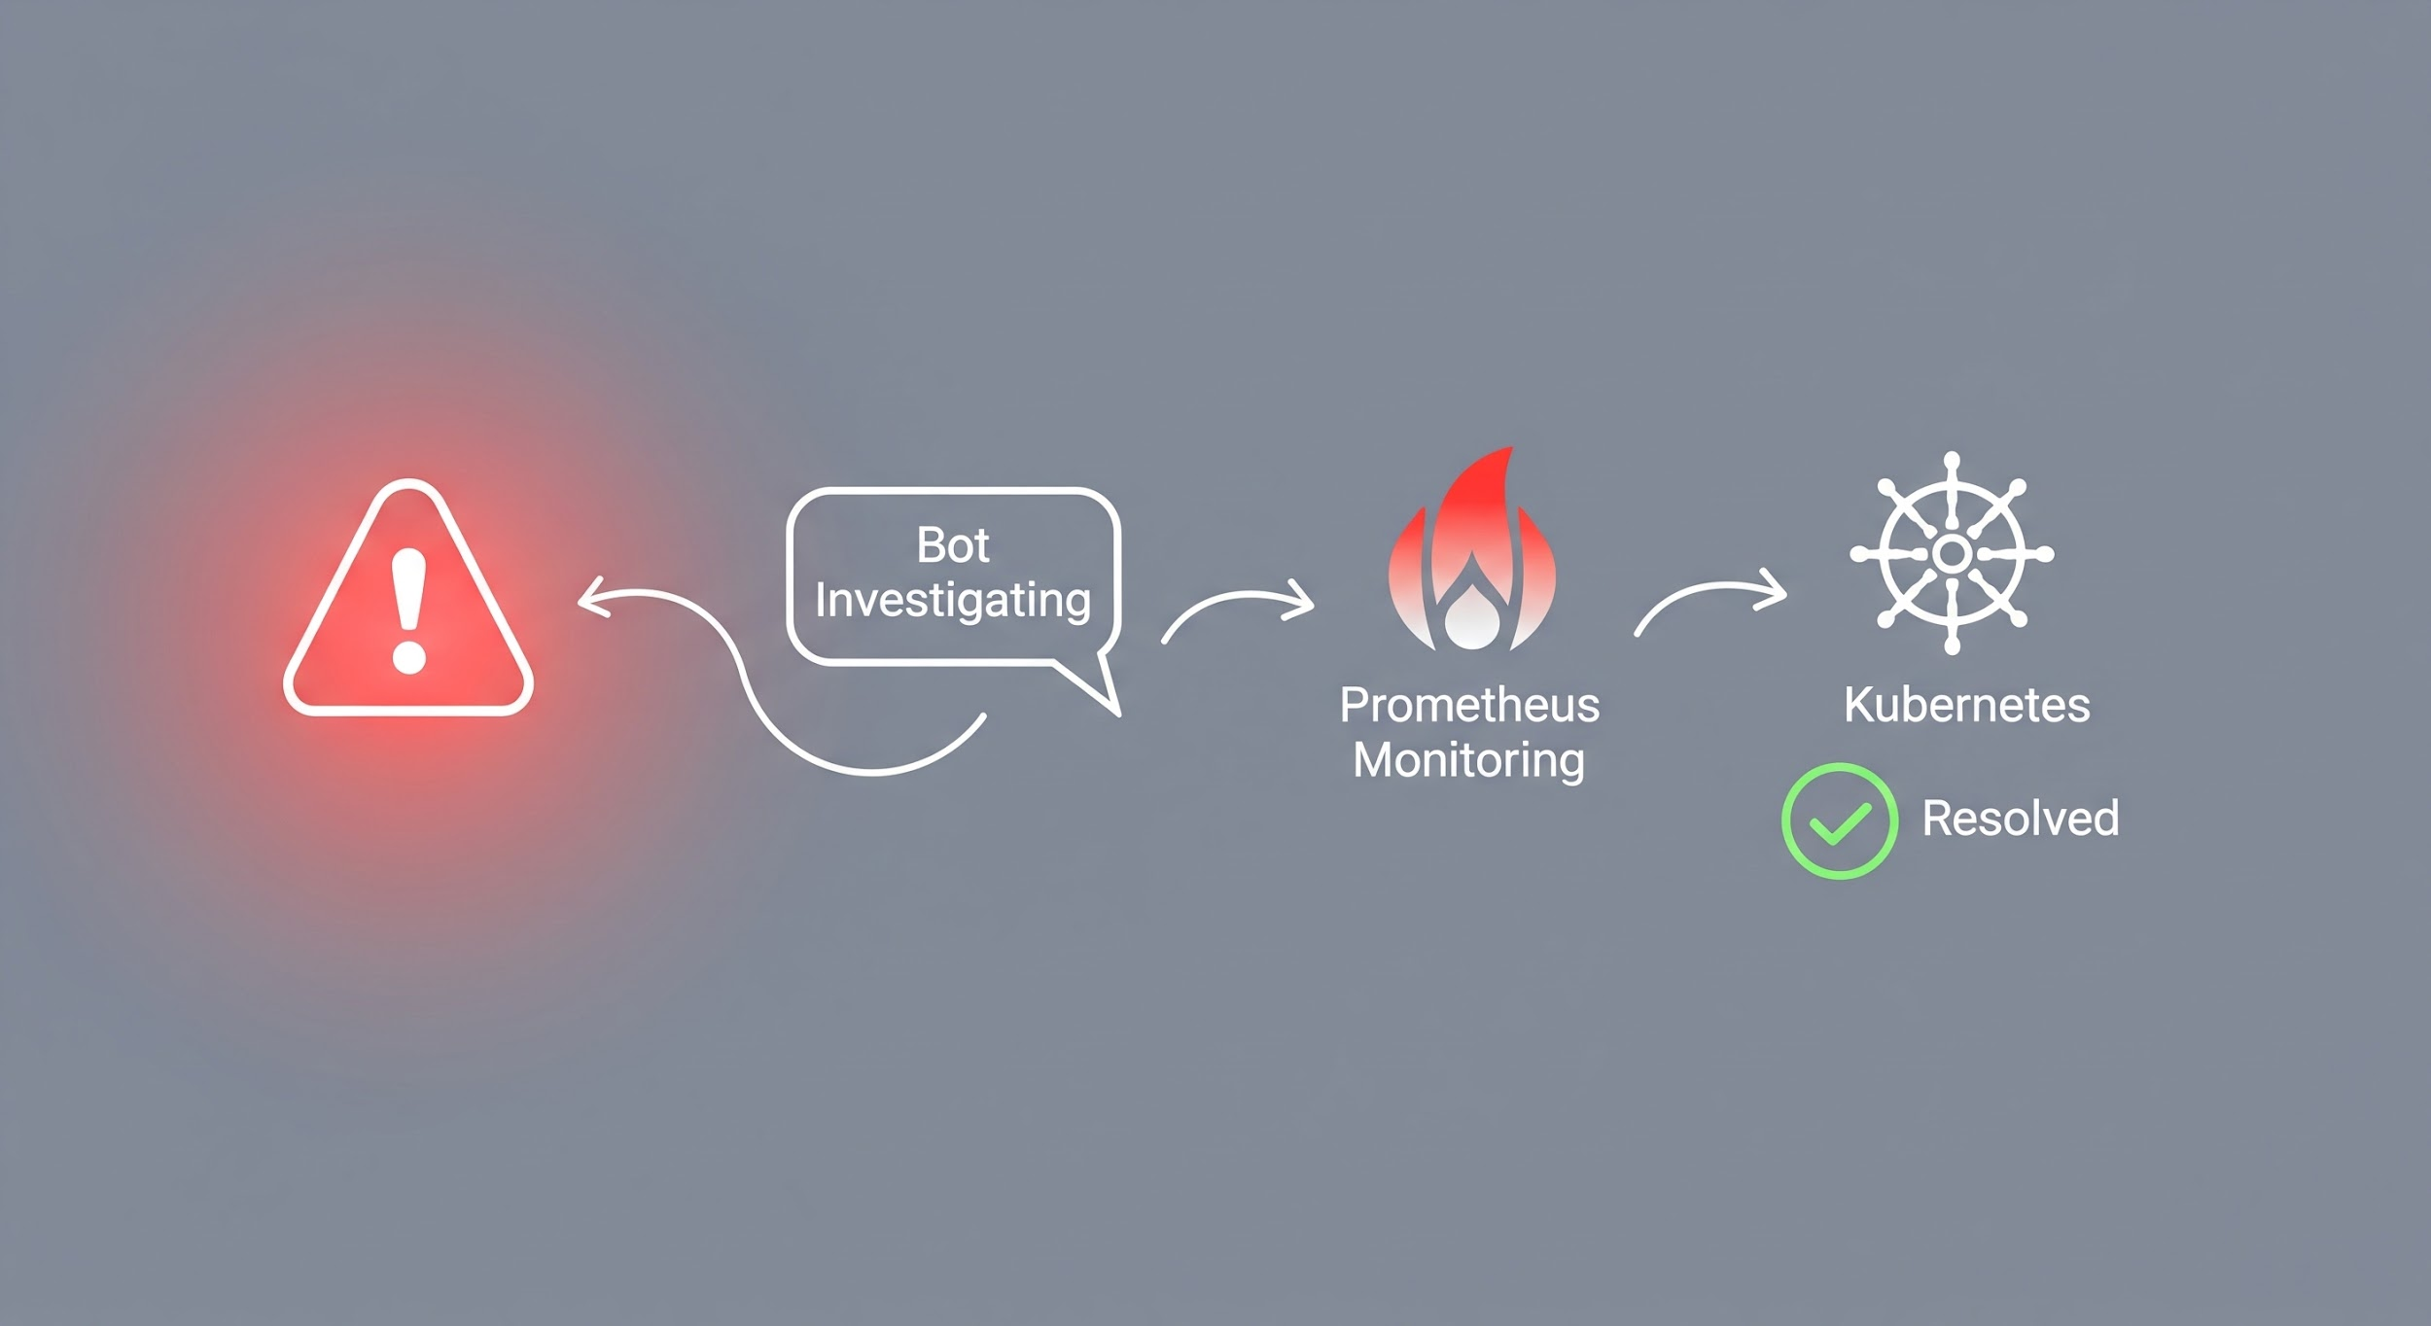
Alert Investigation
When Prometheus Alert Fires
AlertManager: [FIRING:1] HighErrorRate - tower-analytics-api Bot: 👀 Investigating alert... 🚨 *HighErrorRate* - tower-analytics-api Environment: stage 📊 **Pod Status:** ...
Skills Used: investigate_slack_alert → investigate_alert → k8s tools
Notes:
One of the most powerful integrations. When an alert fires in a monitored channel, the bot automatically investigates - checks pod status, recent events, logs - and provides a summary with recommended actions. This dramatically speeds up incident response.

Slide 55
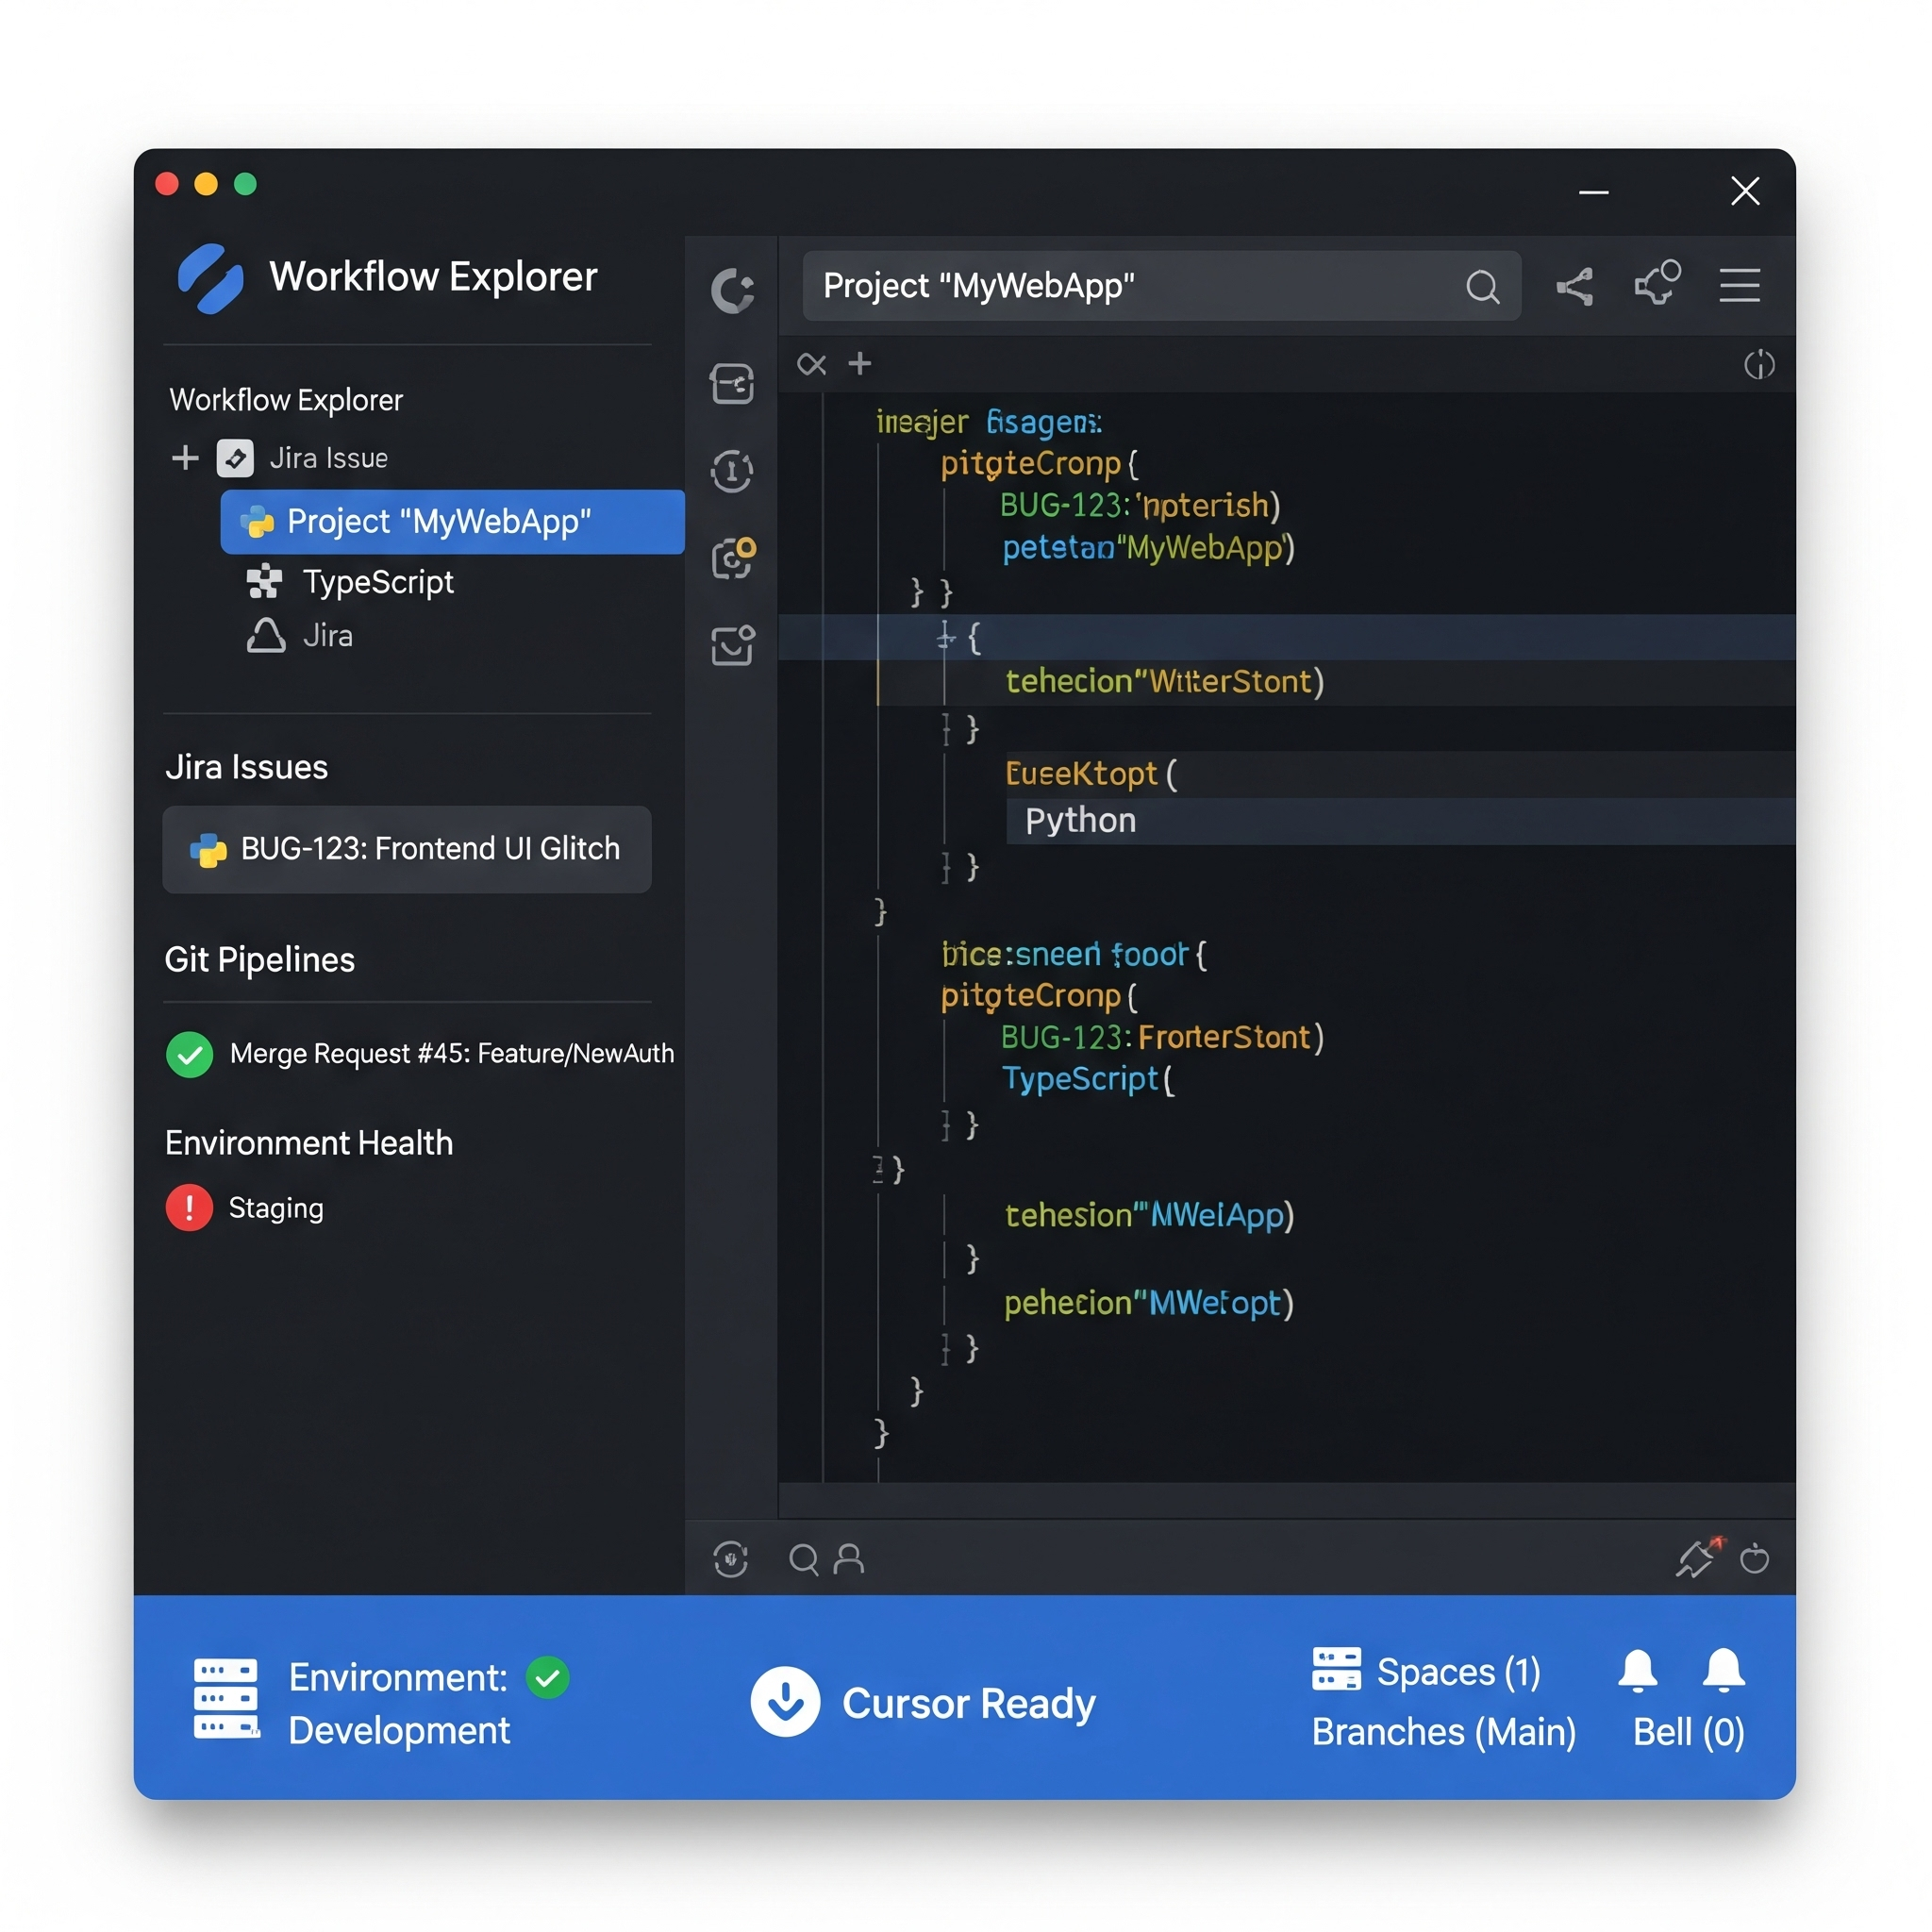
Cursor VSCode Extension
Features
Feature | Description
**Status Bar** | Active issue, MR status, environment health
**Tree View** | Workflow Explorer in sidebar
**Commands** | 10+ palette commands
**Notifications** | Toast alerts for important events
**Dashboard** | Rich webview overview
**Skill Visualizer** | Watch skill execution as flowchart
Status Bar Items
• 💬 Slack daemon status
• 🎫 Current Jira issue (click to open)
• 🌍 Environment health
• 🔀 Active MR with pipeline status
Visual: Screenshot of Cursor with extension visible
Notes:
The extension brings AI Workflow directly into your IDE. The status bar shows at-a-glance information. The tree view gives detailed context. Commands let you run skills. Notifications keep you informed. You never have to leave your editor.

Slide 56
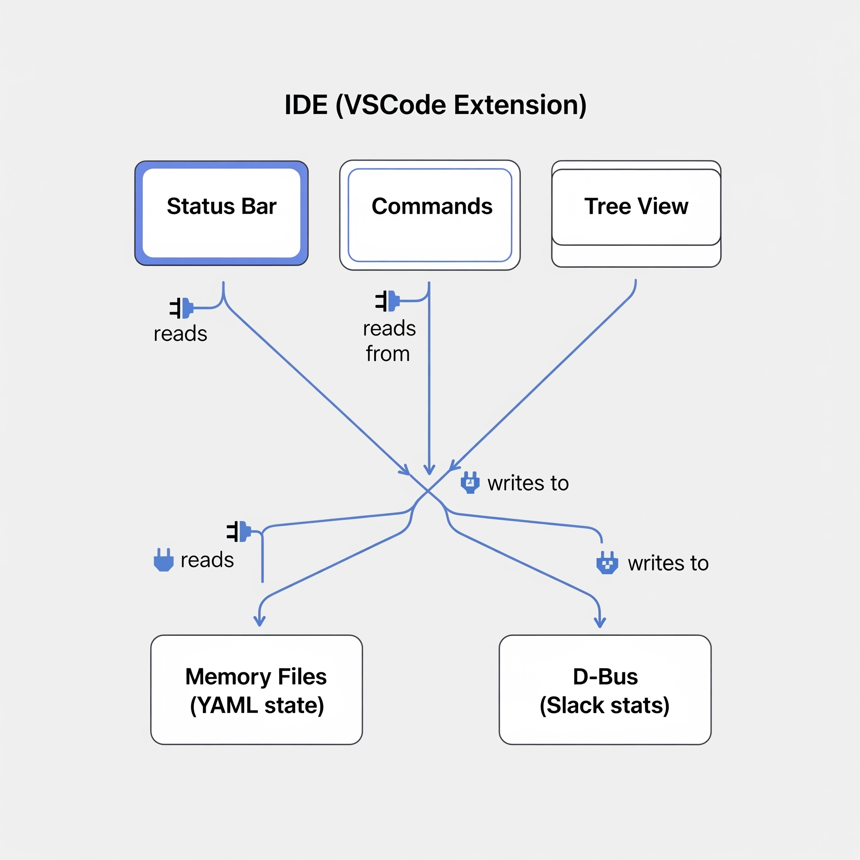
IDE Integration Points
Data Sources
┌────────────────────────────────────────────┐ │ VSCode Extension │ │ ┌──────────┐ ┌──────────┐ ┌──────────┐ │ │ │ StatusBar│ │ Commands │ │ TreeView │ │ │ └────┬─────┘ └────┬─────┘ └────┬─────┘ │ └───────┼─────────────┼─────────────┼────────┘ │ │ │ └─────────────┴──────┬──────┘ ...
Memory Files Read
• `memory/state/current_work.yaml`
• `memory/state/environments.yaml`
• Running status, uptime, message counts
Notes:
The extension reads directly from memory files for work context and connects to the Slack daemon via D-Bus for real-time statistics. This means the IDE always reflects the current state of your AI Workflow.

Slide 57
Getting Started

Slide 58
Quick Start
1. Clone & Install
git clone https://github.com/yourusername/ai-workflow.git cd ai-workflow uv venv && uv pip install -e .
2. Configure Cursor
{ "mcpServers": { "aa_workflow": { "command": "bash", "args": ["-c", "cd ~/src/ai-workflow && source .venv/bin/activate && python3 -m server"] } } }
3. Start Session
You: session_start(agent="developer") Claude: 👨‍💻 Developer persona loaded with ~78 tools
Notes:
Getting started is straightforward. Clone the repo, install with UV (fast!), configure Cursor with the MCP server, and call session_start. You're up and running in under 5 minutes.

Slide 59
Daily Workflow
Morning
/coffee
Start Work
/start-work AAP-12345
Submit Code
/create-mr
End of Day
/beer
Notes:
Here's what a typical day looks like. Four commands that handle hours of administrative work. Morning briefing, starting work with proper tracking, submitting code with validation, and end-of-day wrap-up. AI handles the tedium, you focus on the code.

Slide 60
Resources
Documentation
• 📖 README - Getting started guide
• ⚡ Skills Reference - All 55 skills
• 🎭 Personas Reference - Tool profiles
• 🔧 Tool Modules - 263 tools documented
• 📚 Commands Reference - 66 slash commands
Key Files
• `CLAUDE.md` - AI context file (what Claude reads)
• `config.json` - Configuration
• `memory/` - Persistent state
• Slack: #aa-api-team
• Issues: GitLab project
Notes:
These are your resources for going deeper. The README gets you started, the reference docs cover everything in detail. CLAUDE.md is worth reading to understand what the AI "sees." And of course, reach out on Slack with questions.

